Slide 1
zephr
SWPC GNSS User Engagement Workshop, 5/21/2025
Kostas Stamatiou, Engineer & Co-Founder
better GNSS
through cooperation
0‹#›

Slide 2
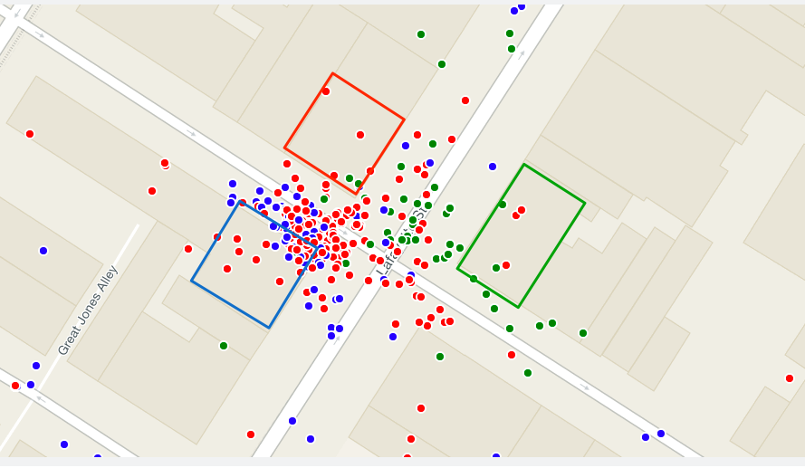
zephr
GPS can be terrible
GPS errors make many daily interactions with positioning frustrating:
Rideshare pickups
Food delivery drop offs
Navigation
Finding/returning a scooter/bike share
What does this mean for our location enabled AI and autonomous future?
Image credit: FSQ
FSQ CHECK-INS VS GPS
Store 1
Store 2
Store 3
the problem
‹#›

Slide 3
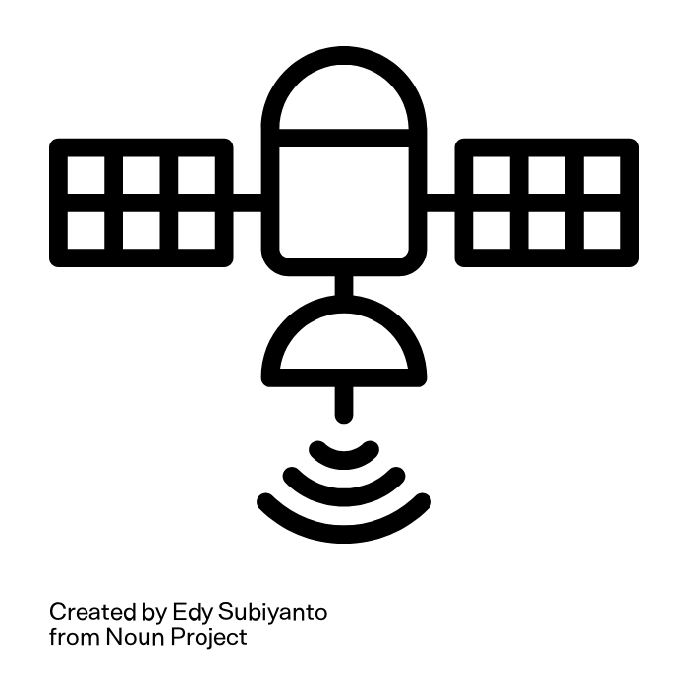
cooperative positioning…
zephr
Commodity devices correct each other
PPP
how do we fix this?
RTK - relative distances
PPP
… and precise satellite orbit, clock and atmospheric modeling
PPP
Use a “spatial” average instead of a “temporal” average
‹#›

Slide 4
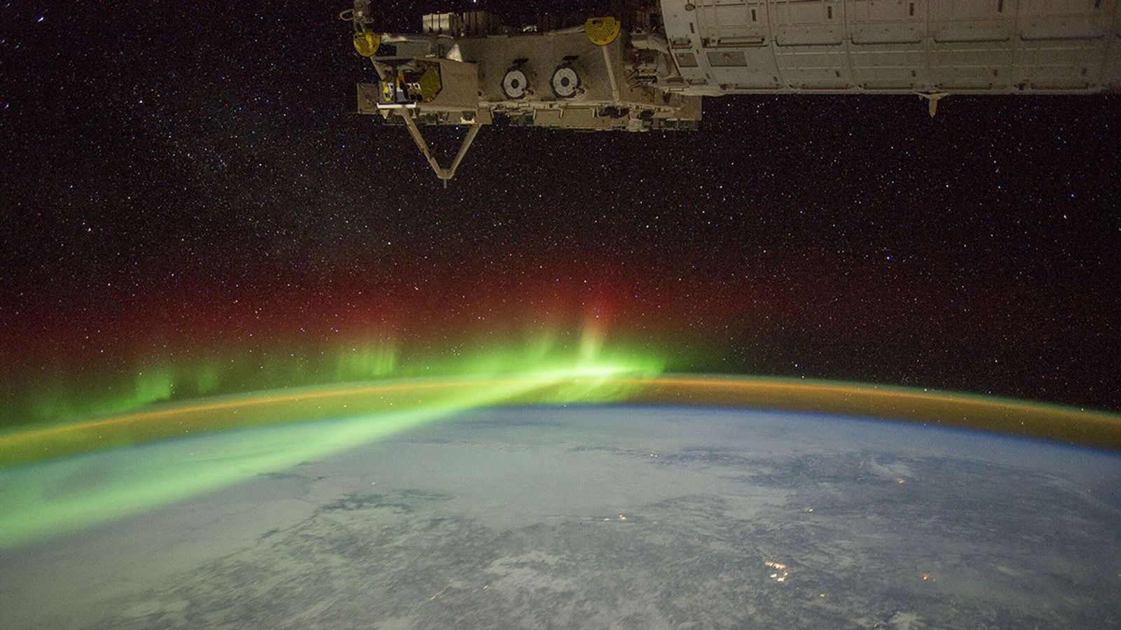
Regional fits of Klobuchar coefficients to TEC maps
ionospheric modeling
‹#›

Slide 5
Download TEC map product
e.g., GLOTEC from SWPC or c1p/c2p products from Center of Orbit Determination in Europe (CODE)
Perform a regional fit of the Klobuchar model to the TEC map
Transmit fitted Klobuchar parameters to the device over LTE positioning protocol (LPP)
This method enables more accurate ionospheric modeling while keeping calculations on the device simple
ionospheric delay estimation
‹#›

Slide 6
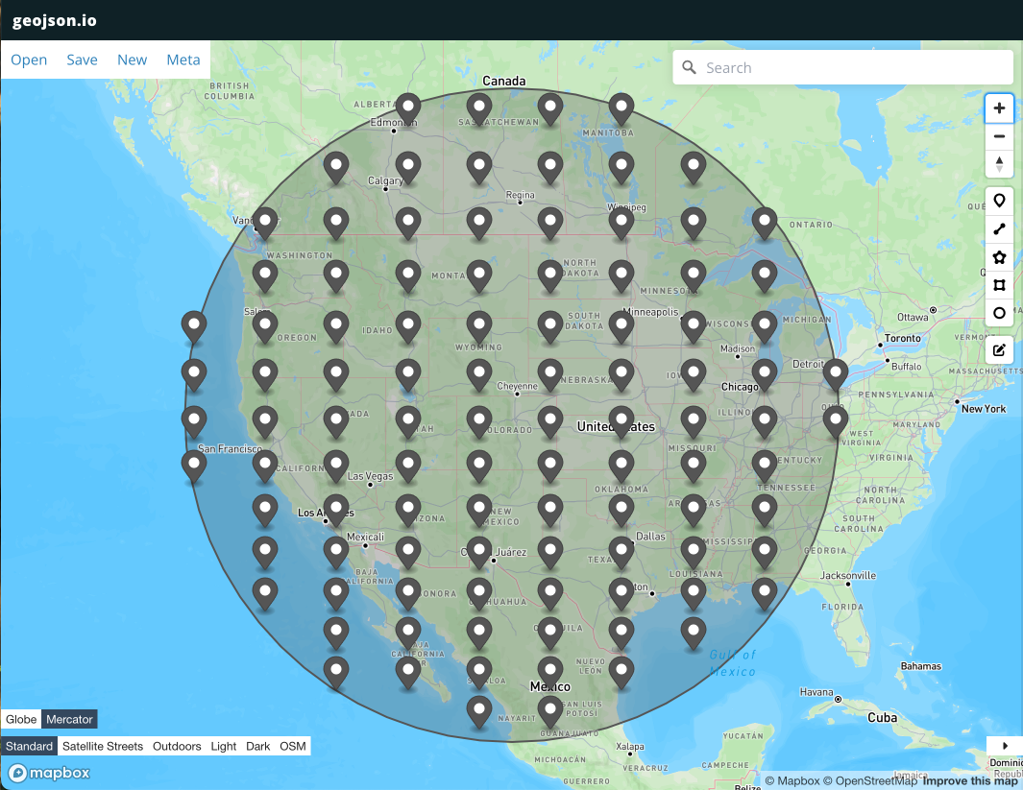
Fit the Klobuchar coefficients to the VTEC values of the TEC map intersect with the region of interest
Region of interest determined by minimum allowable satellite elevation
regional Klobuchar fit
‹#›

Slide 7
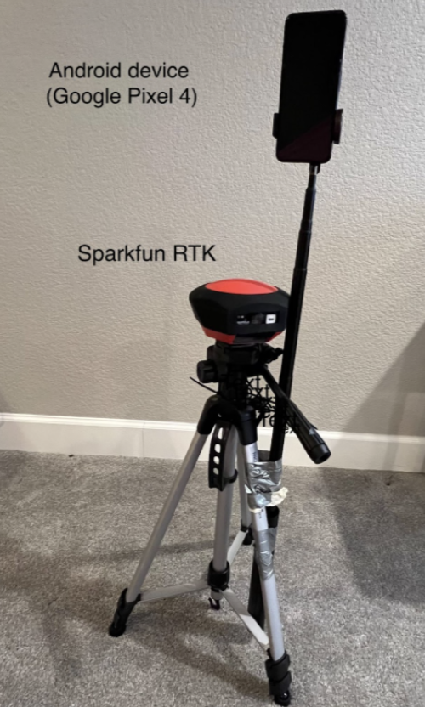
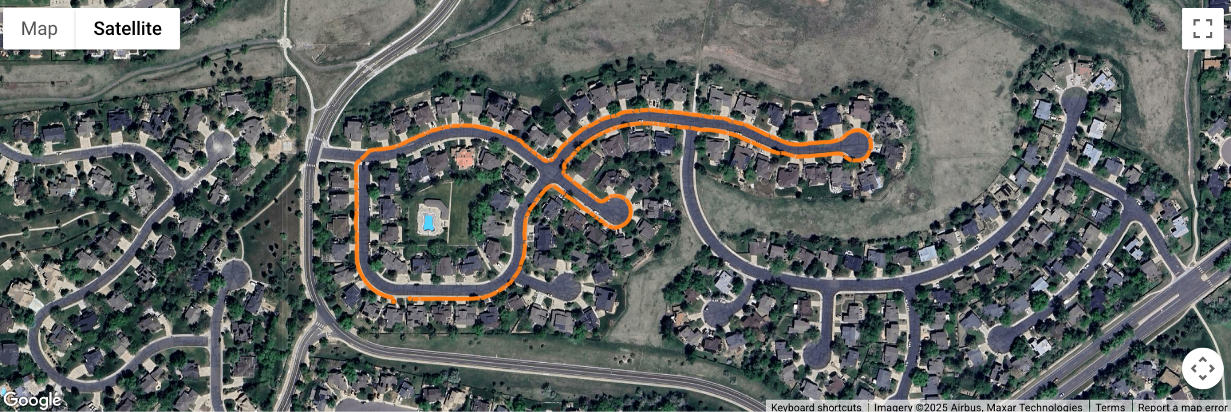
51 data collection campaigns in opensky/suburban and static/walking/driving scenarios
Pixel-8 smartphone + SparkFun RTK unit
experimental campaign
‹#›

Slide 8
 | 3D error (m) | 2D error (m)
zephr + GLOTEC | 2.16 | 1.14
zephr + predicted CODETEC | 3.23 | 1.31
smartphone GPS | 3.92 | 1.66
results
zephr + GLOTEC improvement over zephr + predicted CODETEC in 3D error is 33%
zephr + GLOTEC improvement over smartphone GPS in 3D error is 45%
‹#›

Slide 9
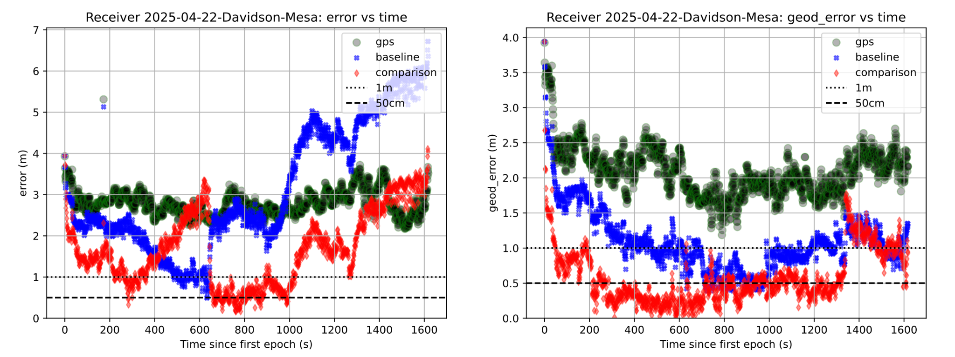
results (opensky, walking)
 | 3D error (m) | 2D error (m)
zephr + GLOTEC | 2.23 | 0.58
zephr + predicted CODETEC | 3.98 | 1.08
smartphone GPS | 3.45 | 2.09
‹#›

Slide 10
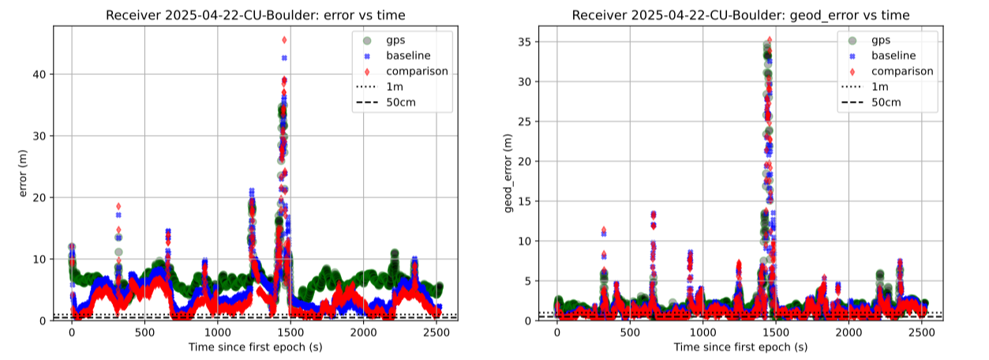
results (suburban, walking)
 | 3D error (m) | 2D error (m)
zephr + GLOTEC | 3.51 | 1.61
zephr + predicted CODETEC | 4.51 | 1.77
smartphone GPS | 6.49 | 1.95
‹#›

Slide 11
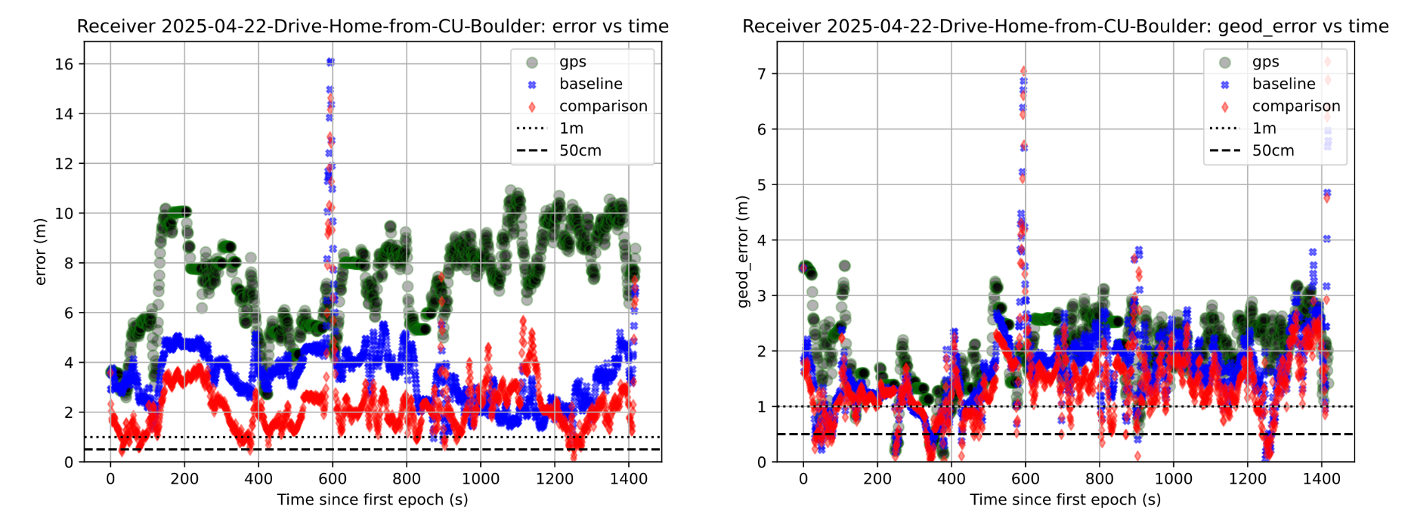
results (driving)
 | 3D error (m) | 2D error (m)
zephr + GLOTEC | 2.27 | 1.39
zephr + predicted CODETEC | 3.44 | 1.63
smartphone GPS | 7.36 | 2.21
‹#›

Slide 12
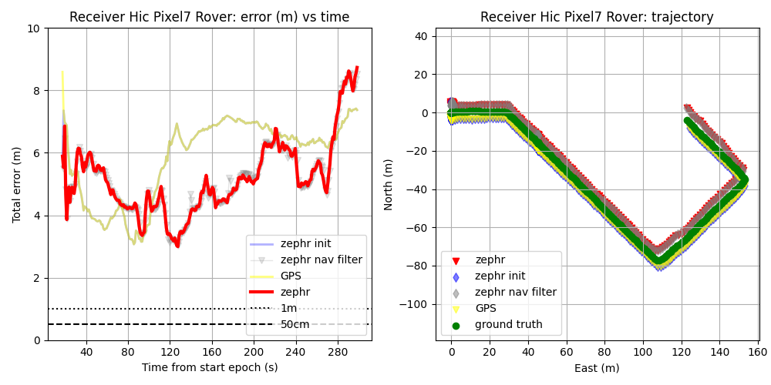
Hawaii Hickam Air Force base (21.3360° N, 157.9557° W)
additional results
‹#›
Ionospheric delay estimated from Klobuchar model

Slide 13
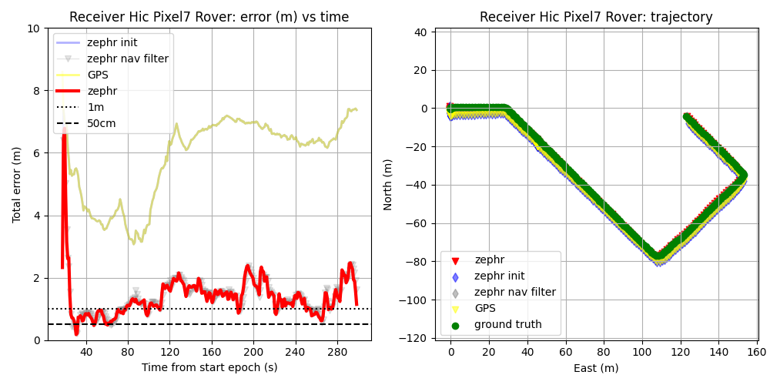
Hawaii Hickam Air Force base (21.3360° N, 157.9557° W)
additional results
‹#›
Ionospheric delay estimated from COD0OPSFIN product

Slide 14
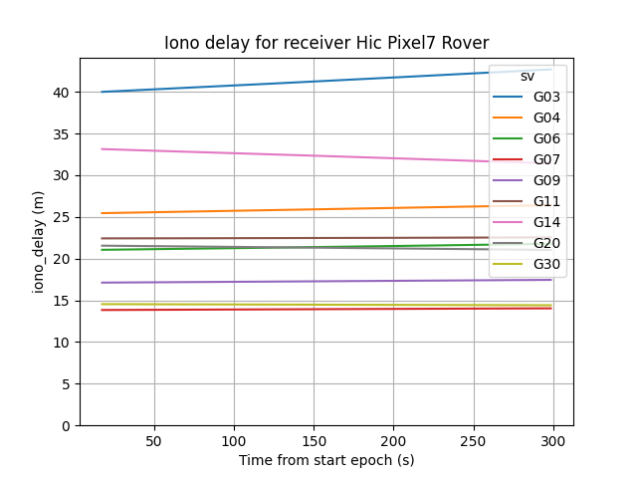
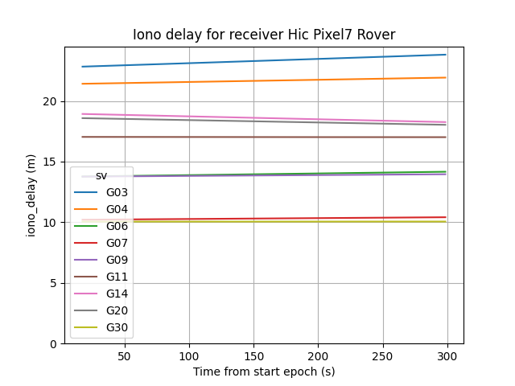
Hawaii Hickam Air Force base (21.3360° N, 157.9557° W)
additional results
COD0OPSFIN
Klobuchar model
‹#›

Slide 15
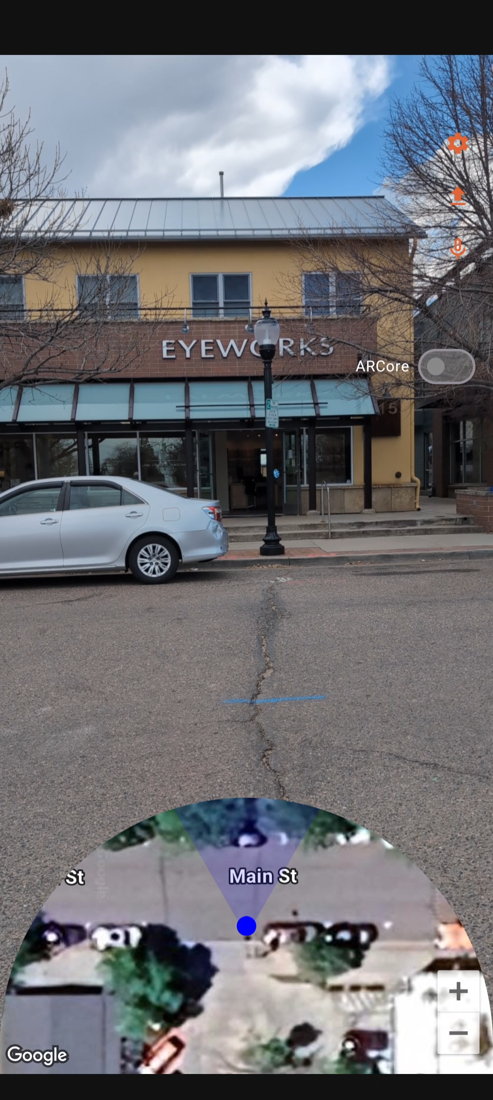
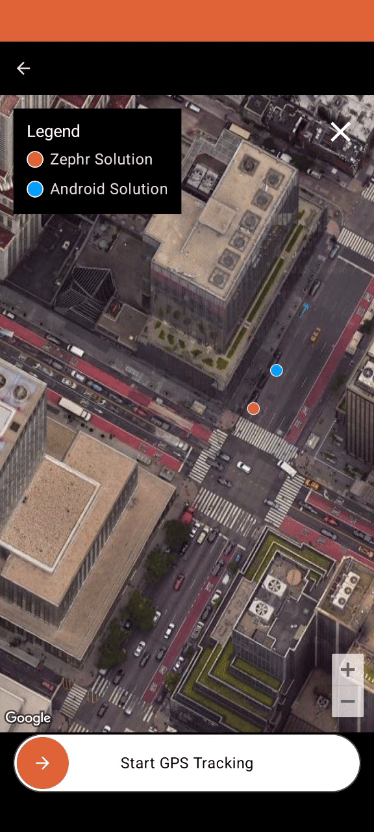
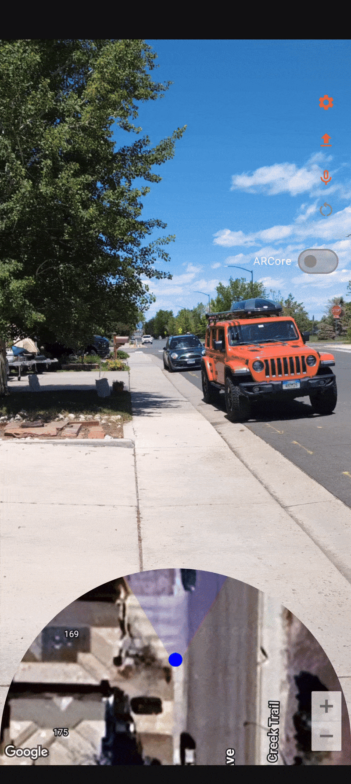
zephr positioning in action
‹#›

Slide 16
Accurate ionospheric delay estimation is crucial for smartphone positional accuracy
TEC maps improve accuracy over broadcast Klobuchar model
GLOTEC outperforms predicted CODE product
Zephr has also partnered with Hexagon to deliver local ionospheric corrections to the device (tests are underway)
comments
‹#›

