Slide 1
Space Weather Impact on the Wide Area Augmentation System

Slide 2
Introduction
The Federal Aviation Administration commissioned the Wide Area Augmentation System (WAAS) for safety of life use on July 10, 2003
WAAS provides GPS clock, ephemeris, and integrity information to suitably equipped users
WAAS broadcasts information from three geostationary satellites on the GPS L1 frequency
This reduces the complexity of a WAAS user receiver
Additional processing is needed in a GPS receiver to apply the WAAS information
Aviation users can utilize WAAS for all phases of flight from takeoff to landing
WAAS provides ionospheric vertical delays and their accuracy (Grid Ionospheric Vertical Error (GIVE)) at geographically defined ionospheric grid points to users
User interpolates vertical delay due to the ionosphere using information provided by WAAS
The GIVE has a high level of integrity to ensure the user computed vertical error is bound with a very high probability

Slide 3
WAAS User Bound on Position Error
WAAS users compute a safety bound on the position error using various parameters provided by WAAS, including the GIVE
This safety bound on the user position error is broken up into horizontal and vertical components, i.e., the Horizontal Protection Level (HPL) and Vertical Protection Level (VPL)
If the HPL and VPL are below a threshold then a specific flight operation, such as an approach, can be performed
The GIVE tends to be the driver in the VPL calculation

Slide 4
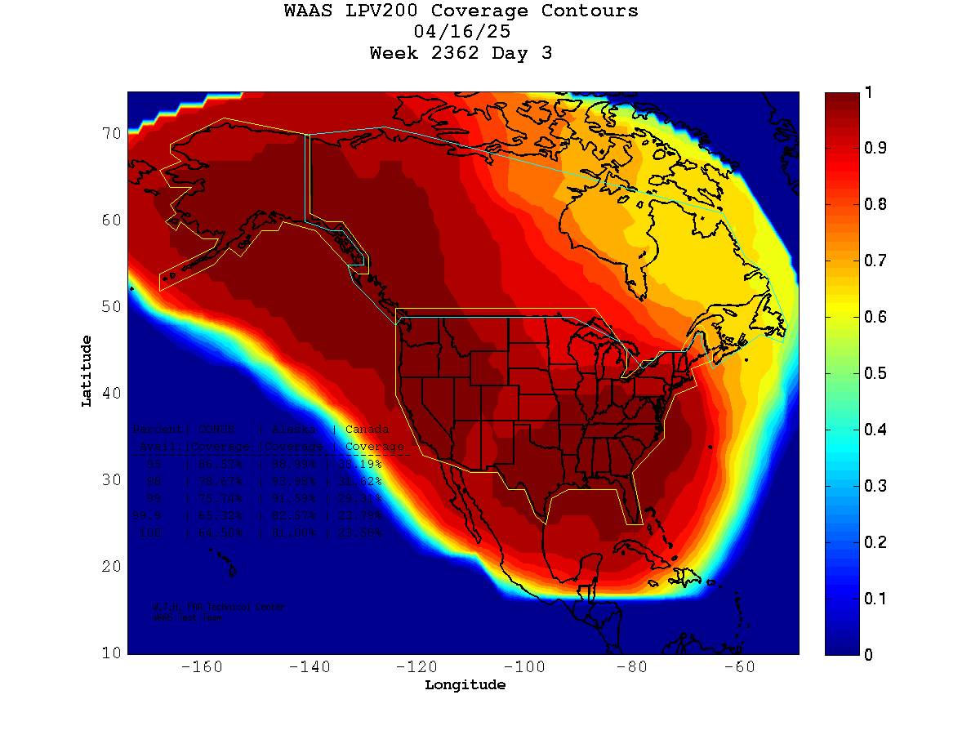
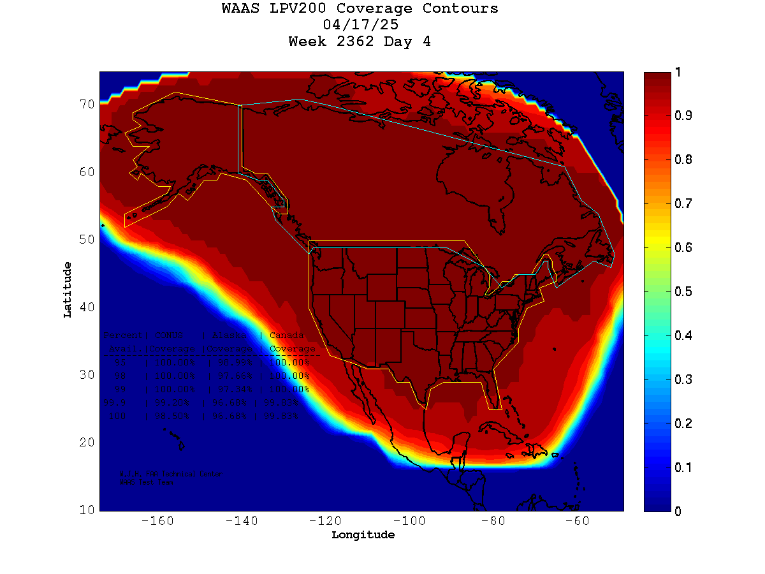
Impacts of the Ionosphere on WAAS User Performance
When WAAS detects uncertainty in the ionosphere the GIVE is increased (effect is VPLs also increase)
Higher GIVEs can cause WAAS service to be unavailable

Slide 5
WAAS Irregularity Detection
The continuous monitoring of the ionosphere by WAAS allows the system to detect ionospheric disturbances
WAAS computes an irregularity metric that determines if there is an ionospheric disturbance in WAAS
When this irregularity metric surpasses a threshold then the irregularity detector or extreme storm detector trips
The irregularity detector causes the offending IGP to be set to the maximum GIVE value (45 meters)
This might cause the VPL for a local area to exceed the alert limit and cause service to be unavailable
The extreme storm detector causes all IGPs in WAAS to be set to the maximum GIVE value (45 meters)
The ESD causes a loss of vertical service for the entire WAAS service volume

Slide 6
Days in 2024 and 2025 with Ionosphere Impact
2024
March 3 - 4, 2024
May 2, 2024
May 10-12, 2024
August 12, 2024
August 28, 2024
August 31, 2024
September 17, 2024
October 6-8, 2024
October 10-11, 2024
November 2, 2024
November 9, 2024
2025
January 1 – 2, 2025
March 8 - 9, 2025
March 12, 2025
March 21 – 23, 2025
April 12, 2025
April 16, 2025
May 17, 2025
Red = WAAS Extreme Storm Detector trip

Slide 7
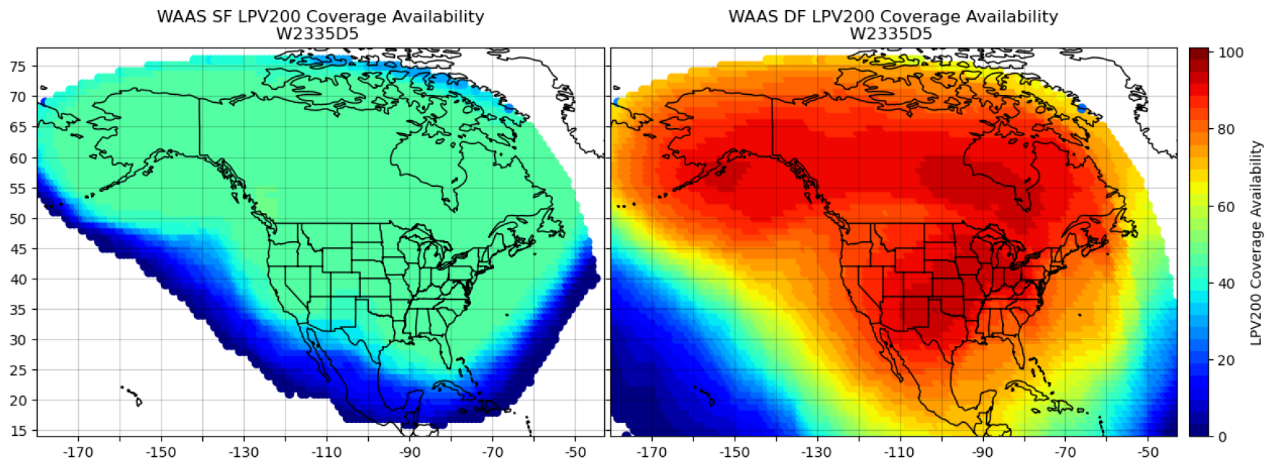
WAAS Dual Frequency Service
WAAS is being upgraded to take advantage of the second civilian frequency (L5) offered by GPS
DF WAAS will allow users to measure the ionosphere directly instead of relying on the WAAS ionosphere model
WAAS coverage on October 11, 2024

Slide 8
Recap
WAAS monitors the ionosphere and provides vertical delay and integrity information to WAAS users
When there is uncertainty in the ionosphere WAAS increases the GIVE to ensure users can safely use WAAS
WAAS irregularity detectors provide additional safeguards
On some days, WAAS has been impacted during the current solar cycle that has resulted in lower availability
The WAAS extreme storm detector has tripped three times
The FAA is upgrading WAAS for dual frequency operations
This will allow users to continue to safely use WAAS during ionosphere events

