Slide 1
Space Weather Impact on GNSS Users

Slide 2
Agenda
(All in US Mountain Time)
0900 - 0905 Introduction
0905 - 0915 Ionosphere 101 by SWPC
0915 - 0930 SWPC Product – GloTEC
0930 - 0945 Future SWPC Scintillation Product
0945 - 1000 Jade Morton, CU Boulder
1000 - 1015 Bill Wanner, FAA
1015 - 1030 Edmundo Beinecke, John Deere
1030 - 1045 Yasmine Hunter, Septentrio
1045 - 1100 Kostas Stamatiou, Zephr
1100 - 1115 David Mencin, Earthscope
1115 - 1130 Terry Griffin, Kansas State University
1130 - 1230 Open discussion

Slide 3
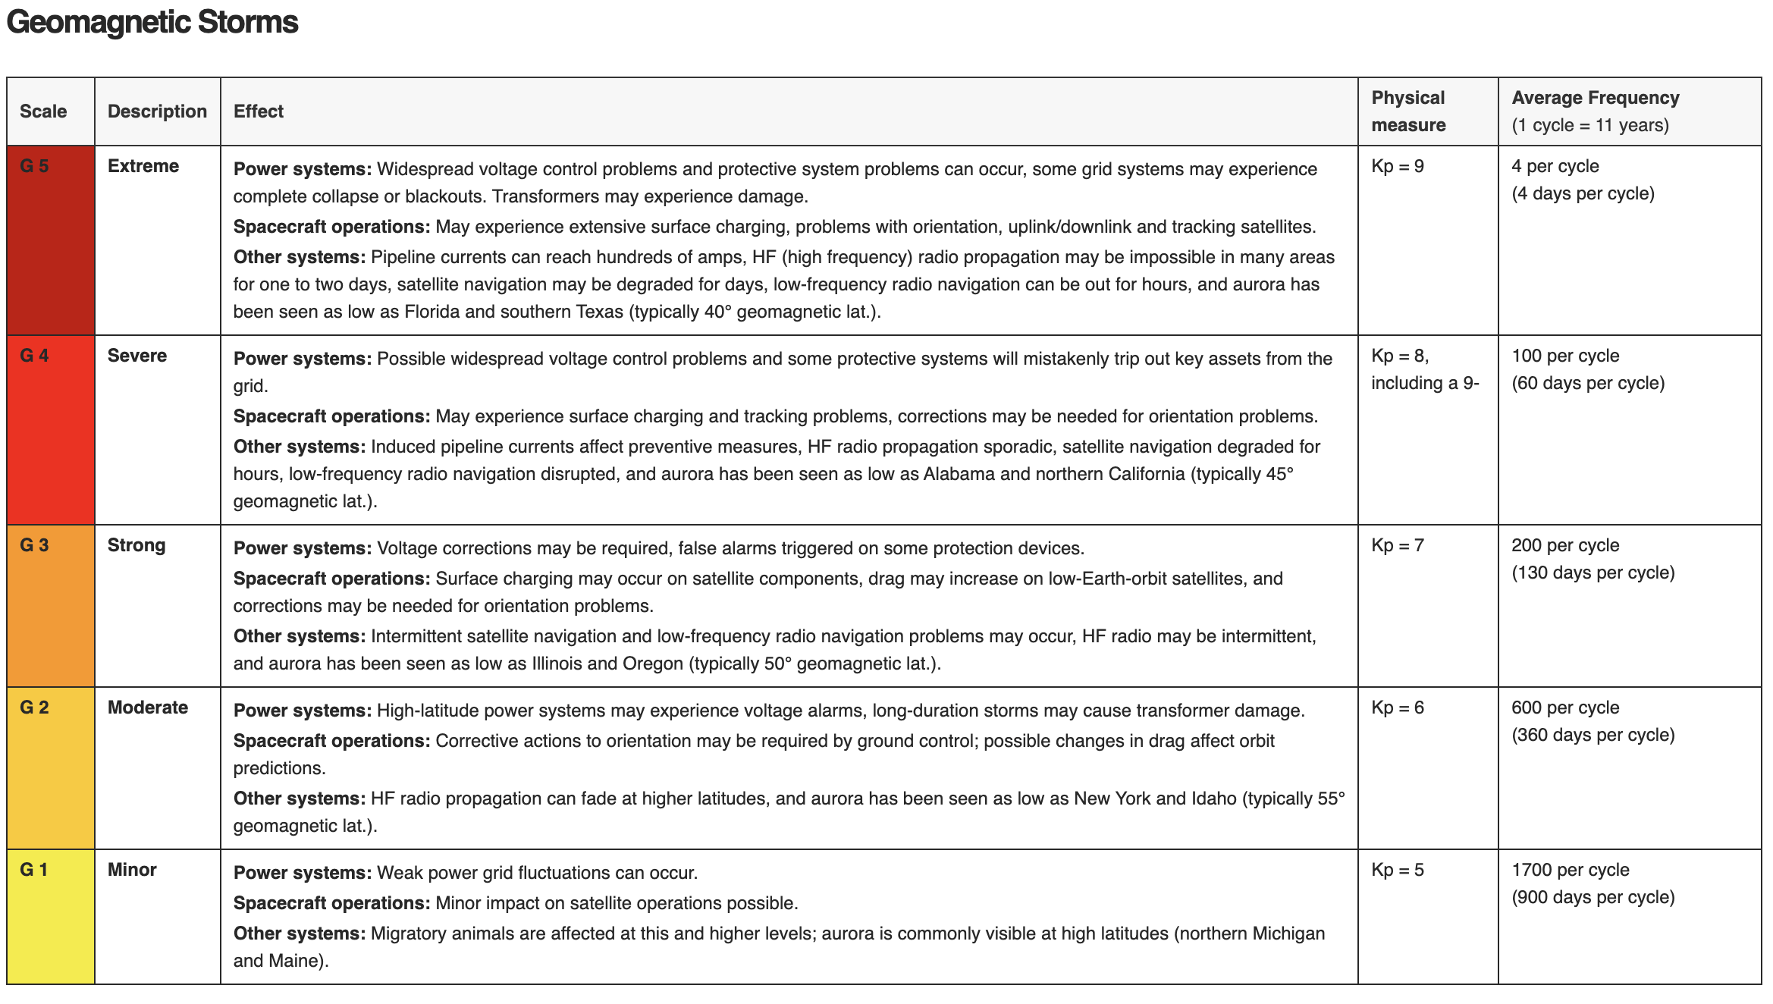

Slide 4
https://www.swpc.noaa.gov/

Slide 5
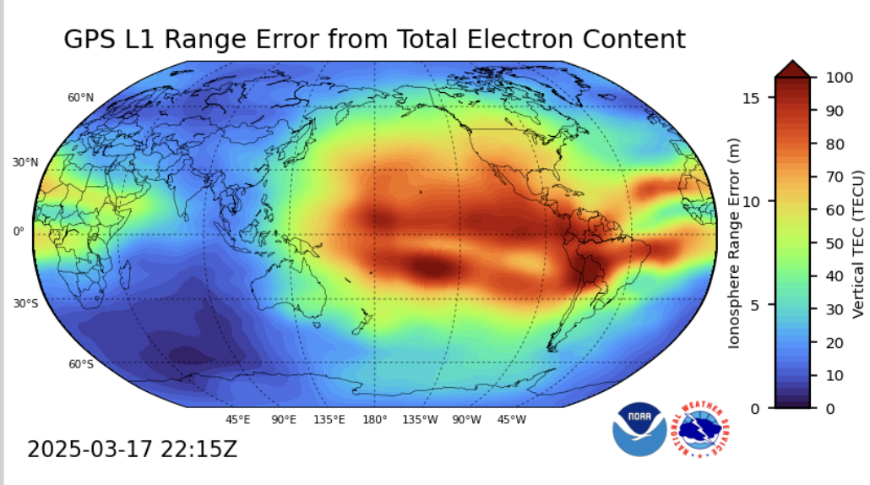
TEC (Total Electron Content)
Scintillation Index: S4 (amplitude) and Sigma Phi (phase)
Nowcast data driven model and product:
Global TEC Model – GloTEC
Upcoming Scintillation Product
Nowcast and forecast physics based model:
The coupled Whole Atmosphere and Ionosphere Plasmasphere Electrodynamics Model (WAM-IPE)

