Slide 1
GNSS User Engagement:
The Ionosphere and Space Weather Impacts
Tim Fuller-Rowell, Tzu-Wei Fang

Slide 2
Ionospheric Impacts on GNSS Trans-ionospheric Radio Wave Propagation
  GNSS precise point positioning, navigation, and timing (PNT; GPS 1575 and 1228 MHz)
    - Line of sight total electron content (TEC) delays and refracts signals
    - Plasma irregularities, structure, and gradients diffract signals, causing amplitude and phase scintillations and sometime complete loss of signal
  Satellite communications
  - Plasma irregularities cause scintillations and loss of signal

Slide 3
Content
Structure of the ionosphere
Solar driven space weather
  Solar flares – only small impact on GNSS signals
  Coronal mass ejections (CME) and geomagnetic storms – can have a significant impact on GNSS signals
  Solar proton events - only small impact on GNSS signals
  Solar radio bursts – in rare circumstances can have a significant impact on GNSS signals
Waves from the lower atmosphere and plasma bubbles at low latitudes
Challenge of forecasting ionospheric irregularities and structure

Slide 4
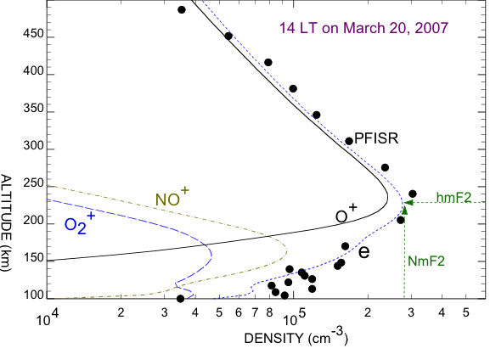
The ionosphere: plasma density structure
Plasmasphere: > 1000km
Topside ionosphere
Solar extreme ultraviolet radiation dissociates and ionizes thermosphere to create the ionosphere, less than 1% of the upper atmosphere
F-region
peak density
NmF2
F-region:
150 – 1000 km
E-region: 100-150 km
D-region: 70-100 km

Slide 5
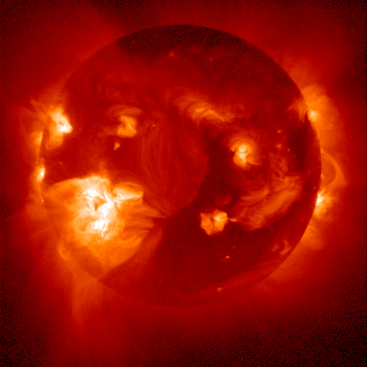
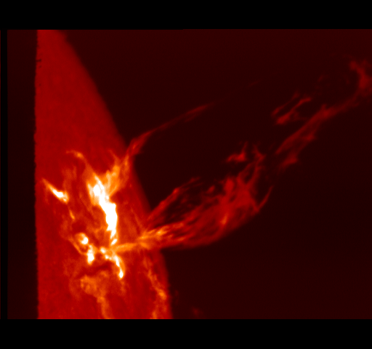
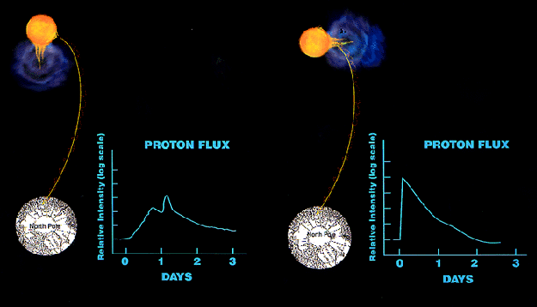
Space Weather driven by the Sun
Solar Flares (increased X-ray flux)
Arrives: 8 mins; Duration: 1-2 hrs
Impacts: D-region ionization, High Frequency (HF) radio wave absorption, geolocation, low-frequency navigation, small effect on GNSS signals
Coronal Mass Ejections (plasma)
Arrives: 1-3 days; Duration: 1-2 days
Impacts: satellite charging, drag, communication, navigation, HF communication, ground induced currents (power outages), significant impact on GNSS signals
Solar Proton Events (energetic particles)
Arrives: 15 mins to a few hours; Duration: days
Impacts: Polar HF absorption, satellite anomalies, radiation hazard, small effect on GNSS signals

Slide 6
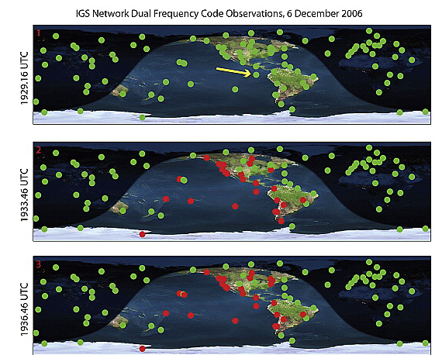
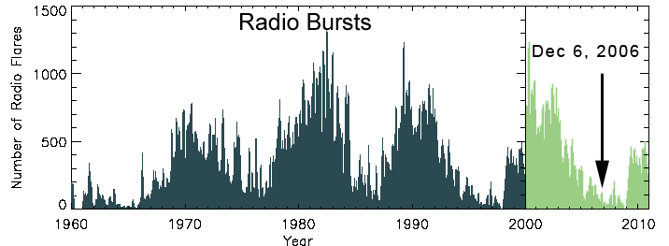
Impact of a Solar Radio Burst on GNSS signals – a rare occurrence
A solar radio bursts (SRB) is an intense burst of radio waves emitted by the Sun often during solar flares
If the SRB is close to a frequency used by GNSS and the Sun is in the field of view of the receiver, it can impact GNSS operational systems
The SRB can act as background noise, interfering with the weak GNSS signals received receivers. This interference can degrade the GNSS signals, leading to reduced accuracy or temporary signal loss.
repeat of previous cycle
Photo by Gary Palmer

Slide 7
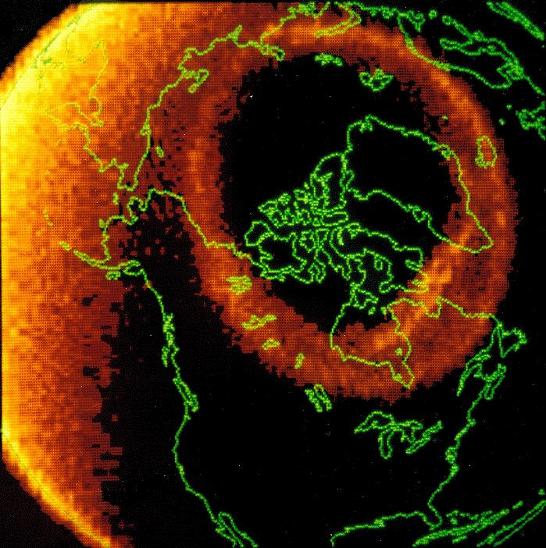
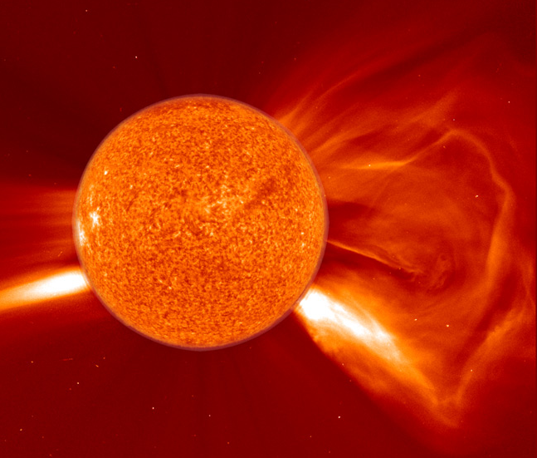
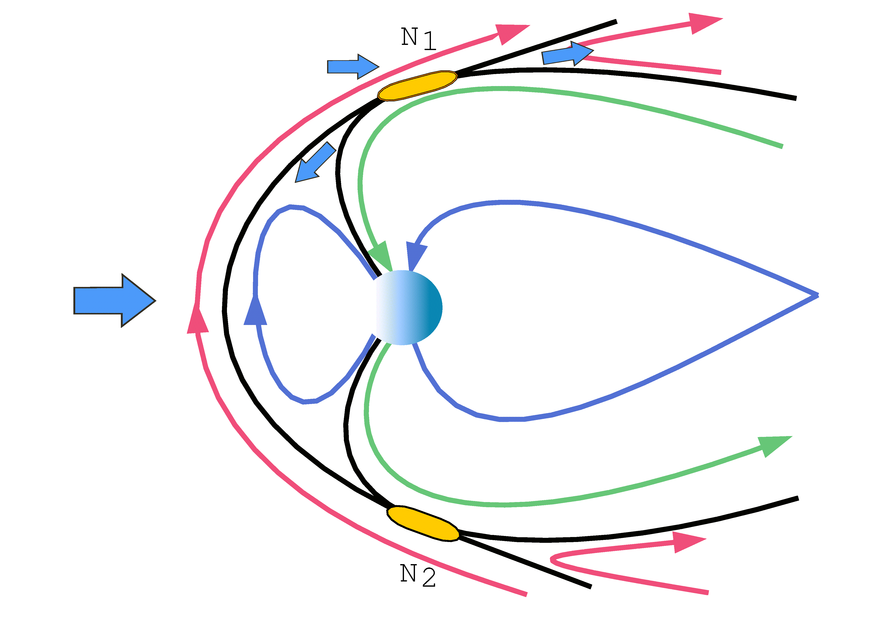
Coronal Mass Ejection Striking Earth
Drives a geomagnetic storm at Earth if the interplanetary magnetic field (IMF) is southward
Arrival time 1-3 days
Duration 1-2 days
Effects:
- Atmospheric heating, expansion and increased satellite drag
- Increases in ionospheric plasma density and structure can disruption of HF Communications and compromised GNSS Positioning, Navigation, and Timing
- Induced currents/power outages
- Satellite anomalies
Users: power companies, satellite operators, HF operators, satellite communication, GNSS, PNT, etc.
CME southward Interplanetary magnetic field (IMF)
B

Slide 8
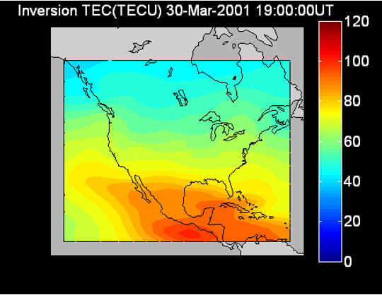
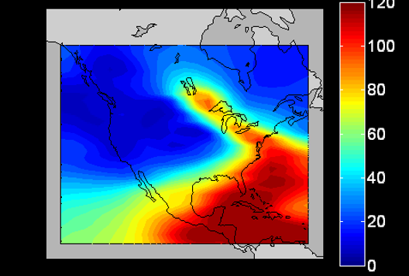
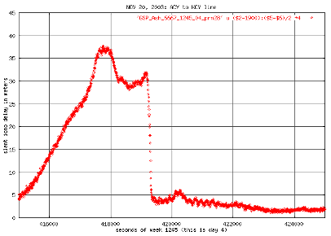
Total Electron Content (TEC) and Steep Gradients
at mid-latitudes during geomagnetic storms impacts GNSS
Quiet
Disturbed*
(* see later
Glo-TEC product)
Storm Enhanced Density (SED)
During a geomagnetic storm SED features can develop. Steep gradient at the edges of the SED are “walls” of TEC, which compromise integrity of navigation signals. Example to the right shows 130 TEC units over 50 km, ~20 m of GNSS delay. Caused the outage of the FAA Wide Area Augmentation System (WAAS).

Slide 9
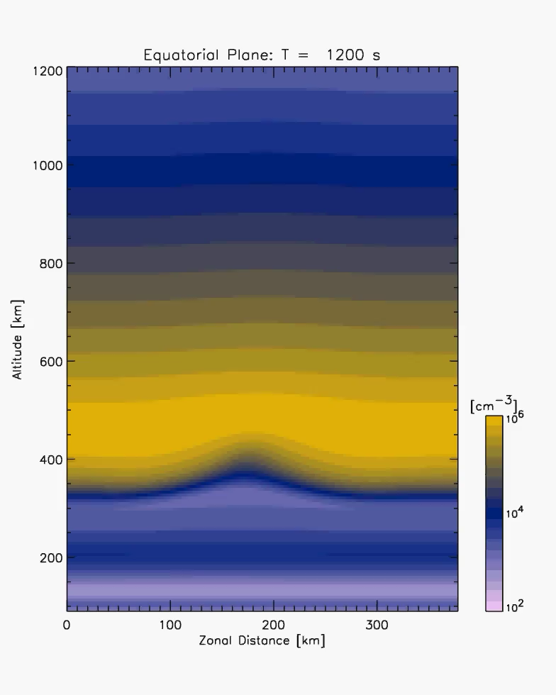
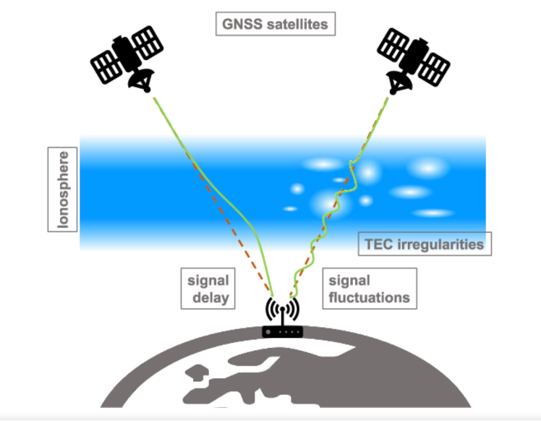
Small-scale Ionosphere Perturbations at Low Latitudes
- example of space weather driven from below at any time-
(* see later
irregularities products)
T. Yokoyama

Slide 10
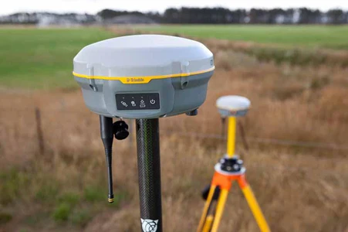
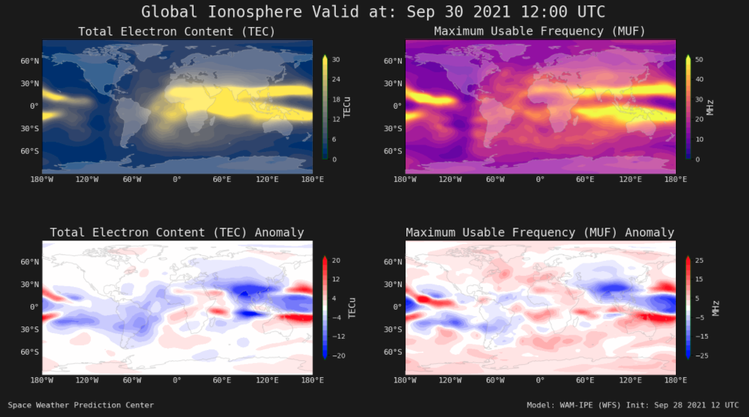
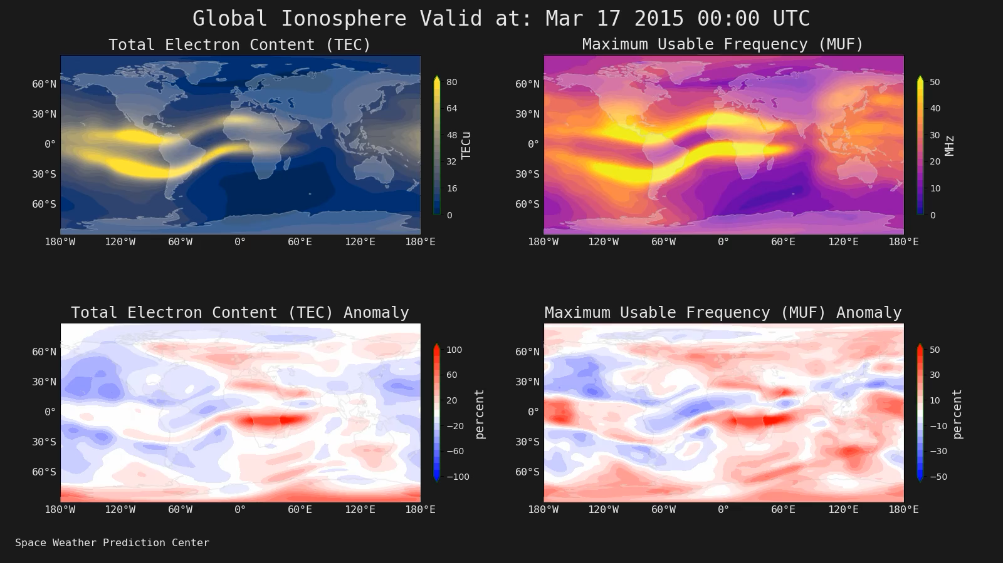
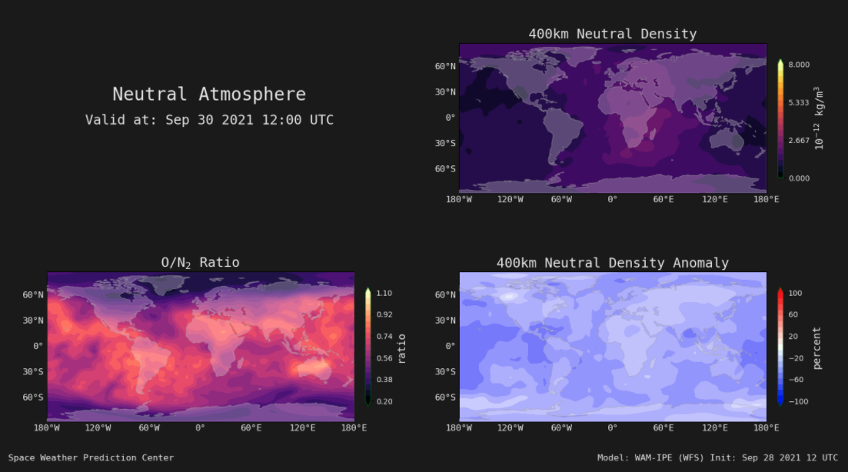
The challenge of forecasting ionospheric irregularities
WAM-IPE
WAM-IPE is a physics-based model of the atmosphere and ionosphere. WAM is an extension of the US weather model up to ~600 km altitude and is coupled with an ionospheric plasma component
WAM includes all the lower atmosphere weather, which is the source for the waves that drive the ionospheric irregularities at low latitude
The physical model also models the ionospheric response to geomagnetic storms and the SED features
The model forecasts the ionospheric conditions leading to irregularities impacting GNSS users a day or two in advance. Dependent on reliable forecasts of the arrival of CMEs from the Sun, and accurate propagation of the waves from below from “tropospheric weather” drivers
https://www.swpc.noaa.gov/products/wam-ipe

Slide 11
Summary
Solar flares and solar proton events affect HF radio waves but have little impact on GNSS signals
GNSS can be affected by the ionospheric response to CMEs including mid-latitude gradients, auroral or plasma transport induced structure, and low latitude ionospheric response
Solar radio burst can impact GNSS signals if the Sun is in the field of view during and event – a rare event
Ionospheric irregularities can also be driven by waves propagating from the chaotic lower atmosphere
Sporadic-E layers can also impact GNSS radio occultation (RO)

