Slide 1
Impact of ionospheric activity on (Septentrio) GNSS receivers NOAA SWPC User Engagement Workshop
Y. Hunter

Slide 2
Content
Context
Goal
How does ionosphere impact GNSS signals?
What are disruptive ionospheric phenomena?
Receiver-level impact and observations
How does a (Septentrio) RTK engine handle ionosphere delays?
Overview of consequences and illustration with customer use cases
Mitigation strategies
Conclusion

Slide 3
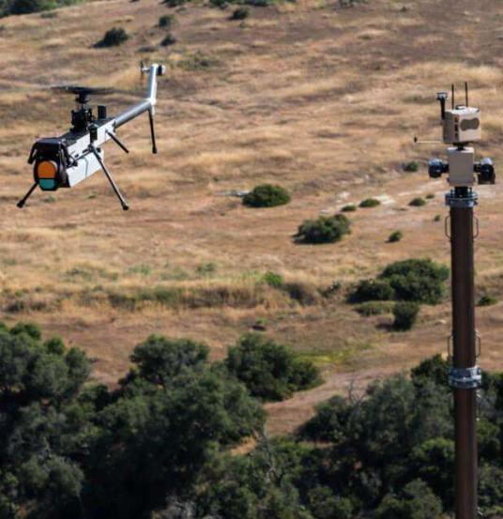
Why study ionospheric impact on GNSS?
Goal
Explore how ionospheric activity disrupts signal quality and positioning performance
Focus on high-precision GNSS receivers, particularly Septentrio, and real-world impact during disruptive events
Why does it matter?
Ionosphere remains a significant and unpredictable error source for GNSS
Increasing dependency on high precision GNSS in critical infrastructure (precision agriculture, timing, autonomous machine control,…)
→ RTK interruptions, position drifts cause operational outages, increased inefficiency and costs for users

Slide 4
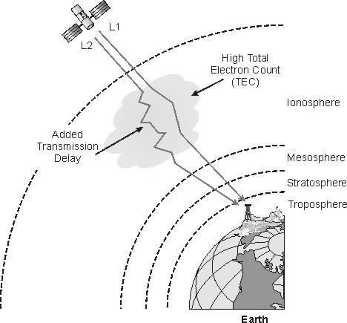
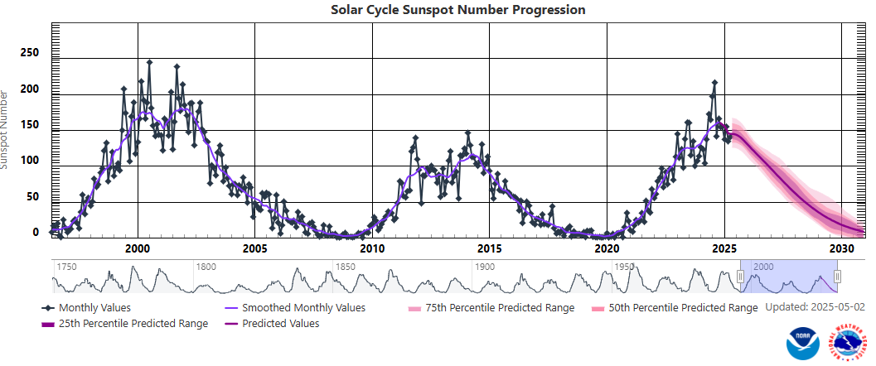
Ionosphere impact on GNSS signals
Layer of ions dampens, absorbs, refracts and diffracts signals passing through → for GNSS frequencies this mostly introduces delays
Signal propagation delays
are a function of TEC and carrier frequency
cause position errors (up to several meters) if not compensated for
Geographical and temporal dependency can be modelled/estimated by the receiver’s PE, but there are more disruptive/unpredictable events that are difficult to compensate for and they do occur more regularly with high solar activity
sources (1); (2)

Slide 5
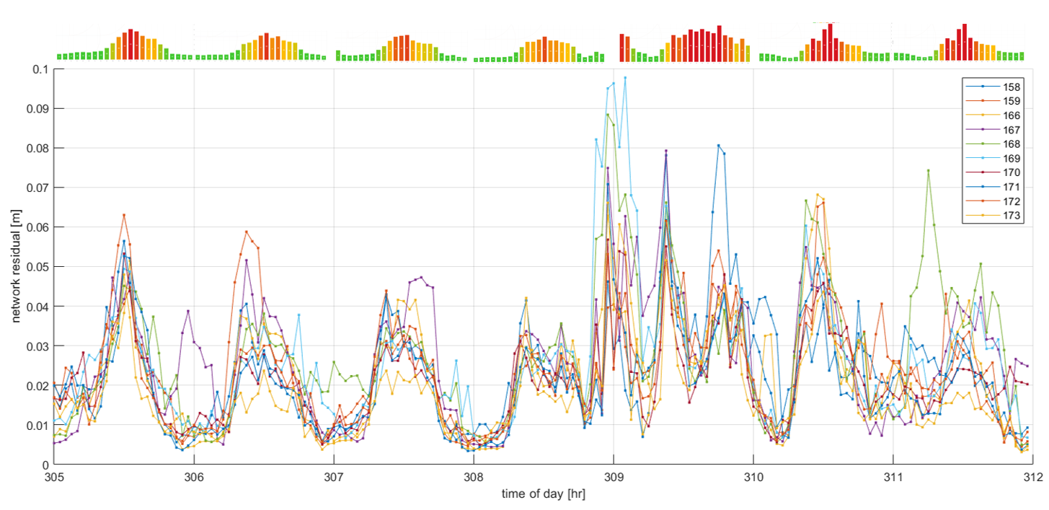
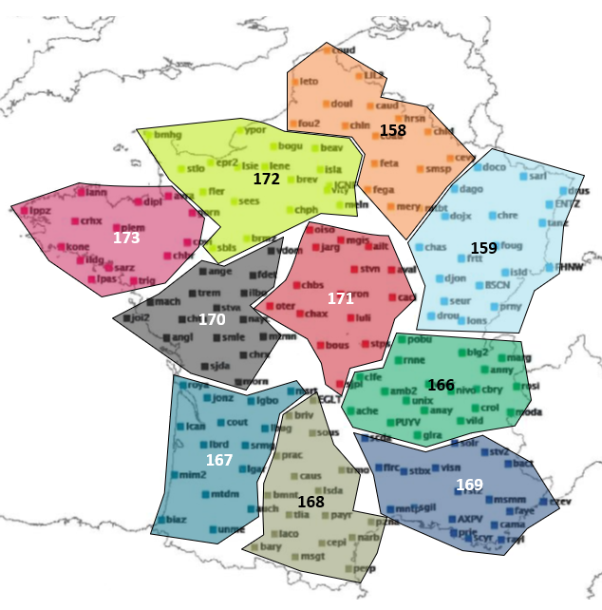
Why is multi-frequency less efficient during solar max?
RTK using a reference station
ionosphere delay at user significantly different from ref station
VRS-RTK
network cannot accurately predict ionosphere at user location
additionally
disruptive ionosphere variation
scintillation
Network residual [m]
data courtesy of Teria
DOY
sources (1)

Slide 6
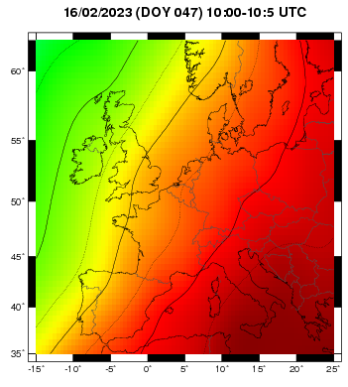
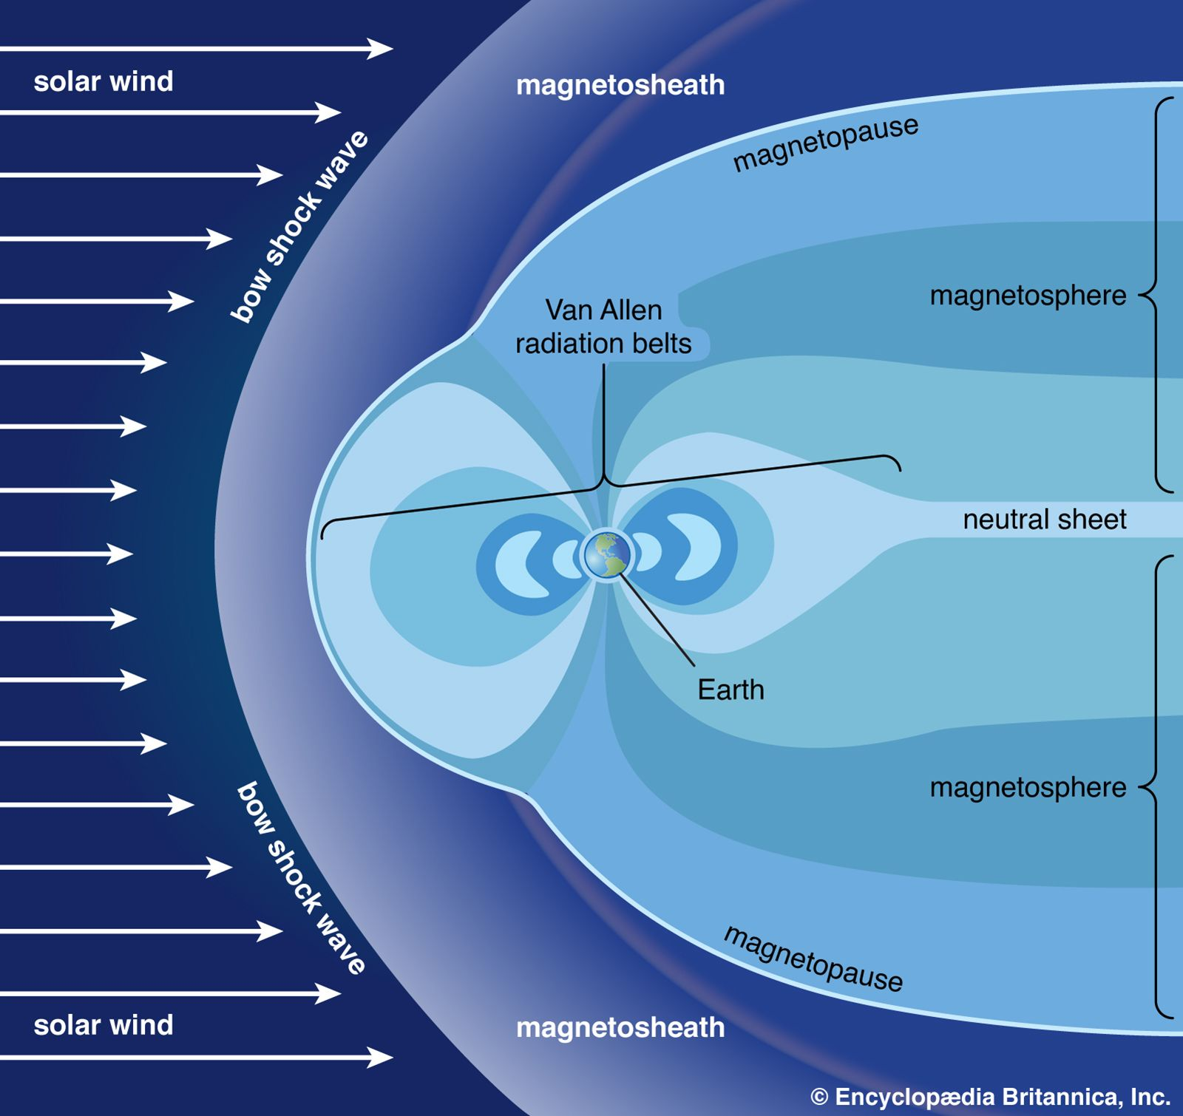
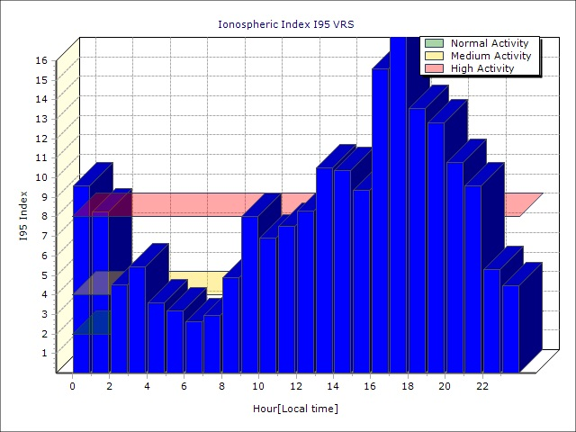
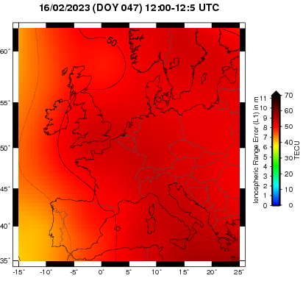
Ionosphere challenges to RTK during solar maximum
split over three distinct physical disruptive phenomena:
a) increased residual ionospheric delay over RTK baseline,
b) scintillation-causing ionosphere plasma bubbles moving over the user,
c) rapidly changing ionosphere conditions between both ends of RTK baseline.
Impact applies to both physical and virtual baselines: latency in RTK network communication results in partial mitigation
Feb 16 2023 : no flare
sources (1); (2); (3); (4)

Slide 7
(Septentrio) RTK : handling ionosphere errors
sunset
Position engine estimates ionosphere per satellite
residual ionosphere between user & reference: spatial decorrelation
limitation due to fixed error models
trade-off time-to-fix at longer baselines
Temporal decorrelation
assumed ionosphere rate-of-change exceeded under high solar flux & TIDs (travelling ionospheric disturbances)
short RTK outages and/or dm-level positioning errors
development: adaptive ionosphere error model
scintillation disrupts ionosphere estimation, causing RAIM resets
on-board detection & handling of scintillating satellites
ionosphere delay rate
nominal
high ROT
scintillation
RTK with all satellites fixed
RAIM resets ambiguities due to unmodelled rapid ionosphere change
SI driven ionosphere noise model increases resilience

Slide 8
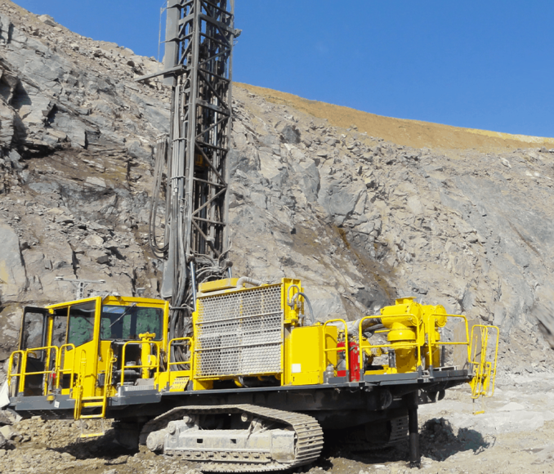
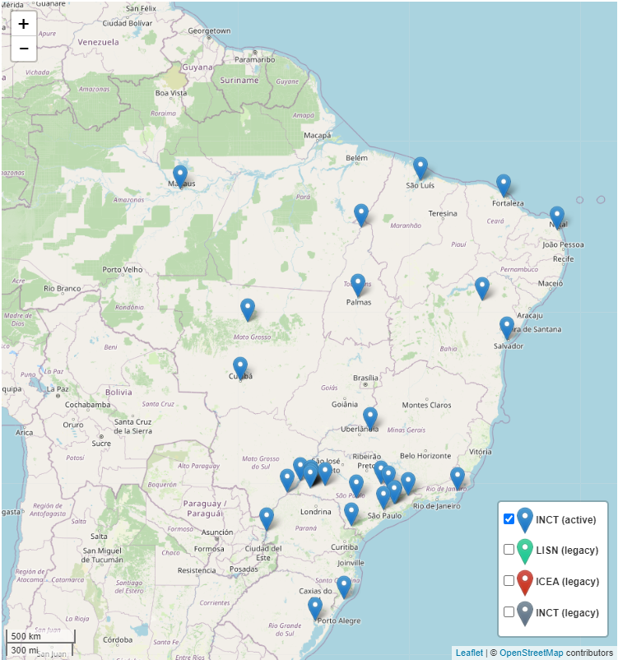
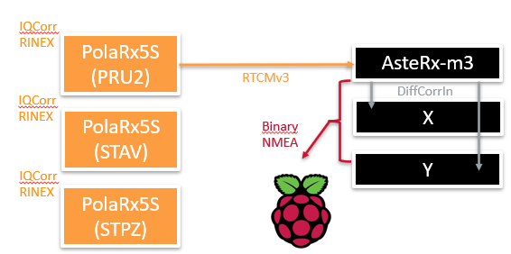
… data-driven development & validation
Customer data iono hotspots
Equatorial use cases: Peru mining, Philippines dredging and Brazil logistics
Data campaigns in Norway with several construction customers
Scientific data archive
Recent CIGALA data
partnering with UNESP for logging long-term RTK baseline data (~ 4m of data during equatorial seasonal maximum)
IGS public database to inspect specific high I95 cases
Px5S combined with RTK network data with Scandinavian partners
Cooperation with RTK network providers
8
sources (1); (2); (3)

Slide 9
Real-world Implications (1)
🌀 Scintillation (amplitude/phase irregularities, small-scale)
🌊 TIDs (Travelling Ionospheric Disturbances, medium-scale)
☀️ Storm-time TEC Gradients (large-scale, abrupt changes)
Observable consequences on measurement level
Effect | Description | Main cause | User Impact
Cycle Slips | Loss of carrier phase lock due to rapid phase changes or weak signal | 🌀 🌊☀️ | Requires reinitialization → slower convergence (RTK/PPP)
Loss of Lock | Temporary tracking loss (esp. L2/L5 during scintillation) | 🌀 ☀️ | Drop in satellite count, loss of fix
C/N₀ Oscillations | Rapid fluctuations in signal strength (e.g. fading during amplitude scintillation) | 🌀 | Reduced tracking robustness, degraded quality of observables
Increased Noise | Higher variability in pseudorange and carrier-phase measurements | 🌀 🌊☀️ | Reduced precision, noisier positioning
Tracking Loop Stress | Receivers may mis-track or lose sync due to aggressive iono-induced dynamics | 🌀 ☀️ | Leads to cycle slips or complete signal loss

Slide 10
Real-world Implications (2)
🌀 Scintillation (amplitude/phase irregularities, small-scale)
🌊 TIDs (Travelling Ionospheric Disturbances, medium-scale)
☀️ Storm-time TEC Gradients (large-scale, abrupt changes)
Observable consequences on position level
Effect | Description | Main cause | User Impact
RTK Fix Dropouts | Loss of fixed solution due to insufficient signal quality or inconsistent ambiguities | 🌀 🌊☀️ | Application stalls, loss of precision
Degraded accuracy (RTK/PPP) | Gradual degradation, sudden jumps (bias jump due to missed cycle slip or undetected phase change), higher RMS,… | 🌀 🌊☀️ | Navigation errors, lower-quality geodetic data
Delayed Convergence | Longer time to achieve fix (RTK) or stable solution (PPP) | 🌊☀️ | Workflow inefficiency, increased mission time
Navigation Outage | Position quality drops below usable application threshold | 🌀 🌊☀️ | Triggers system fallback or stops motion

Slide 11
Brazil machine automation use cases
Application: Customer using Septentrio receivers for autonomous operations in Brazil (mining, logistics). Accuracy and reliability of solution critical, fallback system relies on relative positioning techniques which is not optimal.
Reported RTK outages and position errors on a regular basis a couple of hours after local sunset:
Oscillations in C/N0, frequent losses-of-lock
Timing of issues quite repeatable
Amplitude scintillation identified as main cause
Updating set-up and firmware improved availability
Improved availability with set-up and FW updates
Old FW New FW
Old FW New FW
Rapid oscillations in C/N0 for specific satellites
Old FW New FW

Slide 12
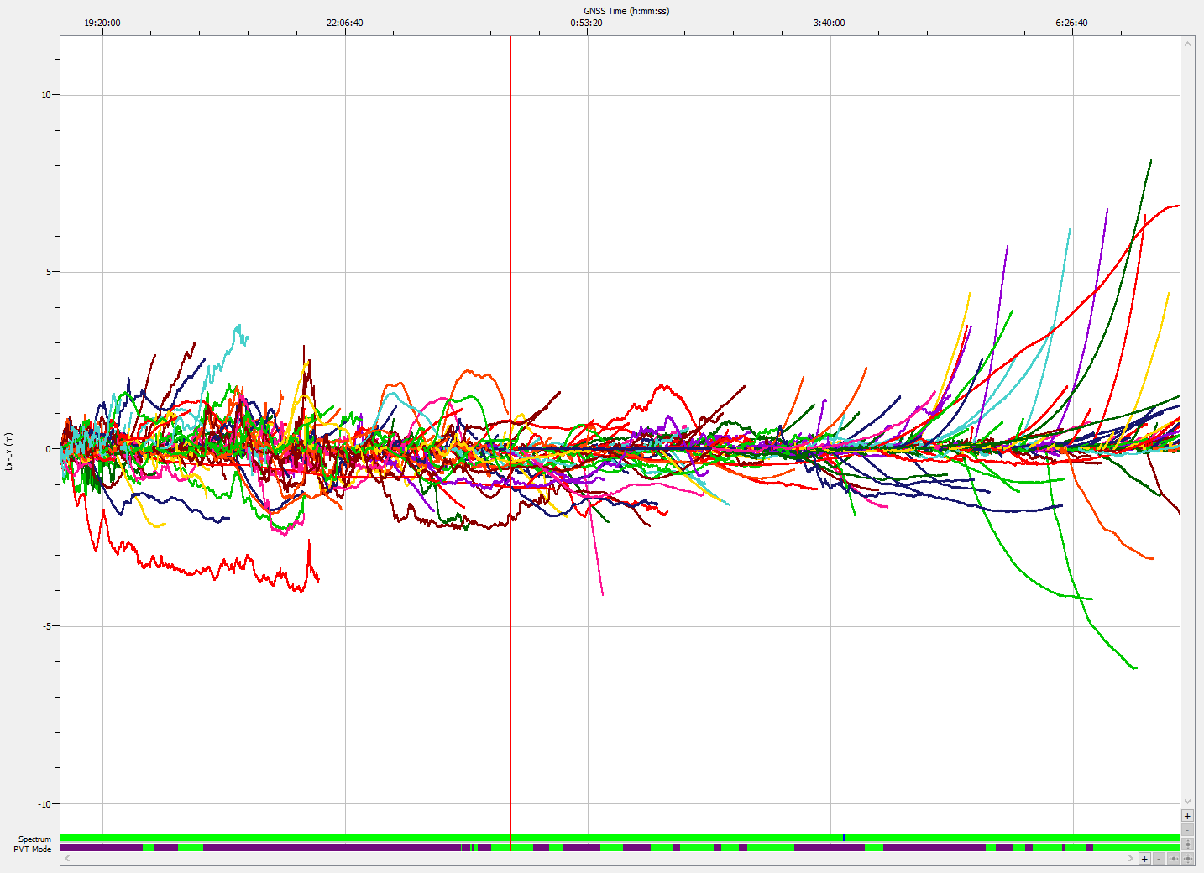
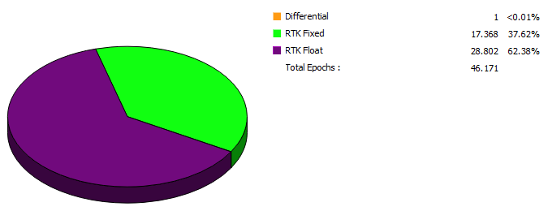
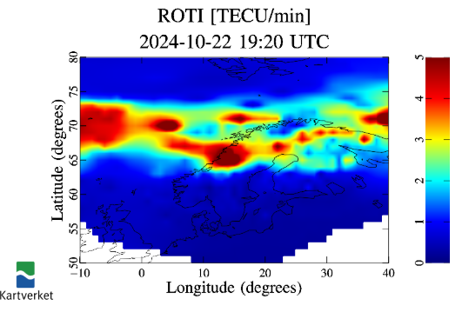
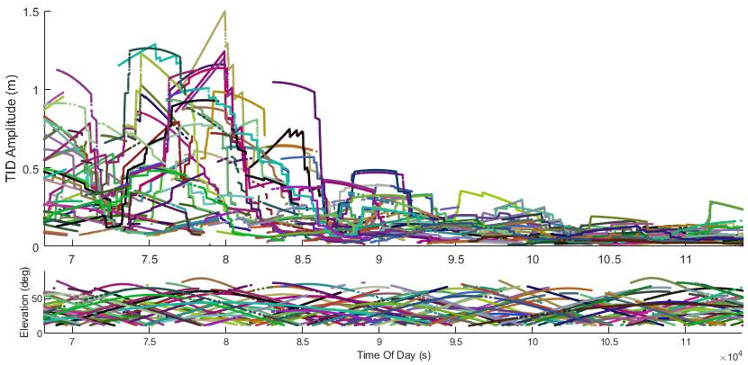
Northern Sweden robotics use case
High variation in phase combination plot → active ionosphere
Application: Customer using Septentrio receiver in Northern Sweden (~ 67° lat.). Receiver provides autonomous navigation in robotics application and cm-level accuracy is critical.
Reported various issues with low RTK Fixed rate:
Low and noisy C/N0
Phase combination plot showed high variation as well as several loss-of-lock events
High multi-path, but especially active “TIDs” (travelling ionospheric disturbances) caused position degradation which is exacerbated by the long baselines (~50km here) used
Recommended to use VRS-based corrections
Low RTK Fixed availability
1,5m TID
Relatively nominal ROTI
1,5m TID
source: (1)

Slide 13
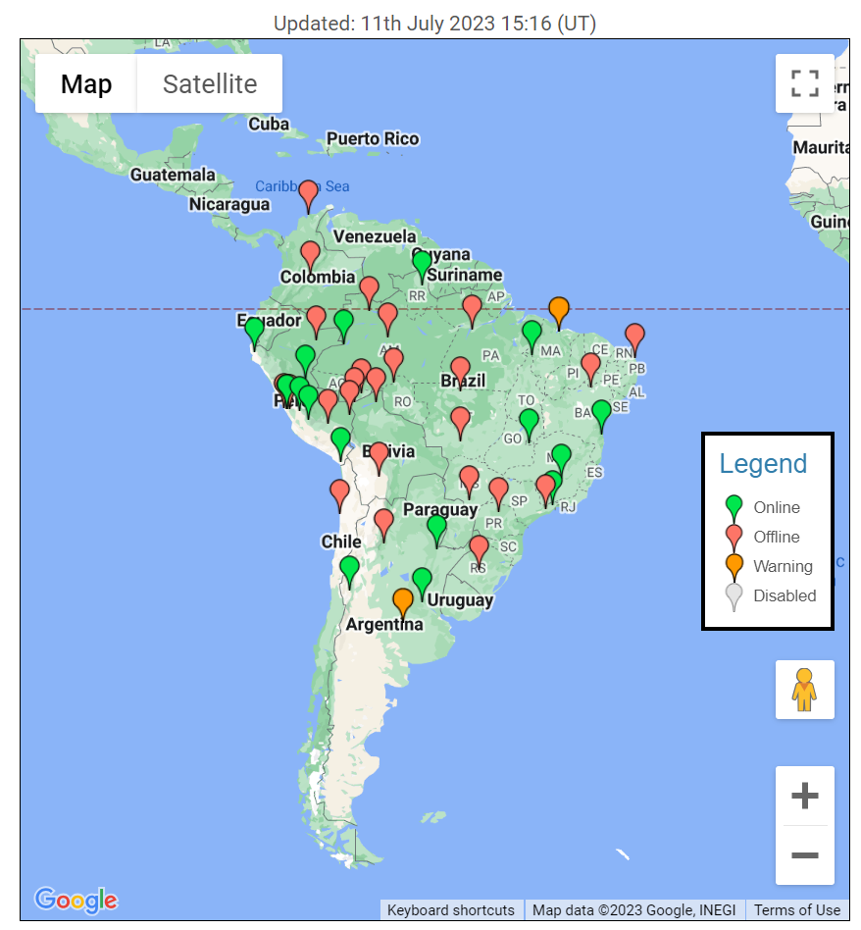
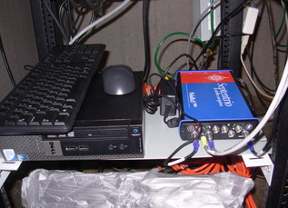
Mitigation strategies
On algorithm level*:
Adaptive tracking loops to reduce losses-of-lock and increase availability of code and phase observables
Extend ionosphere modelling capabilities and optimize outlier detection mechanisms
On user level:
Increase awareness of potential disruptive phenomena (with on-board receiver detectors, scintillation monitoring receivers, space weather monitoring services, etc.)
Optimize receiver configuration to exploit multi-frequency aiding and spatial diversity
Multi-sensor approach (IMU, visual systems as back-up for GNSS)
(*) ~ receiver manufacturers. This focuses on Septentrio
sources (1); (2)

Slide 14
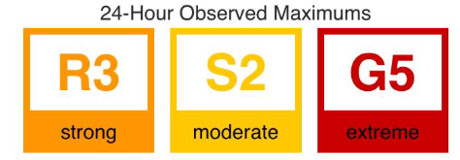
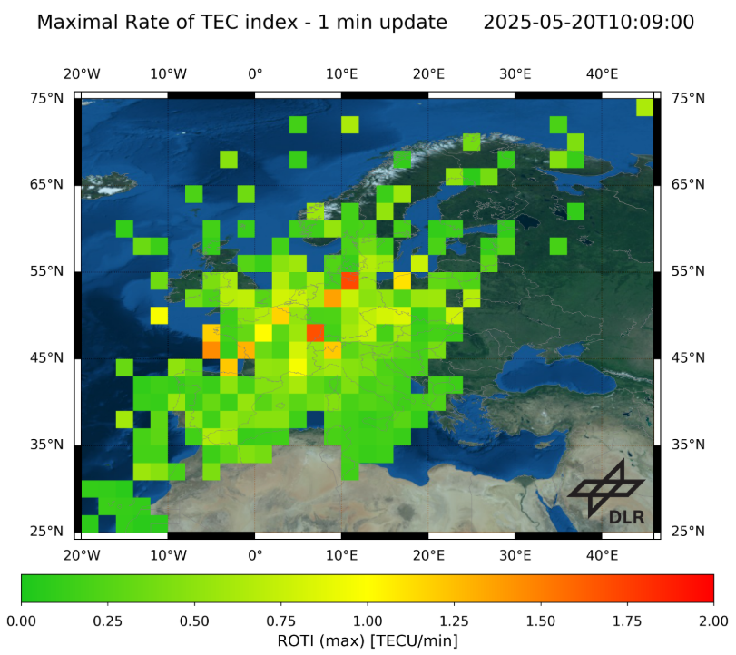
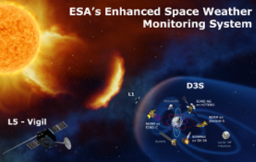
Conclusion
Ionospheric disturbances affect all precision GNSS from measurement to position to application level
(Septentrio) high-precision receivers include built-in features to monitor and (partially) mitigate ionosphere effects
Data-driven validation is key in aiding development efforts
Awareness is a first step in understanding impact and mitigation strategies
Common standards and/or shared tools help scale awareness to users
Pushing insights to users supports autonomy, safety and integrity of GNSS-based solutions
sources (1); (2); (3)

