Slide 1
Impacts of Space Weather Events on Tropical Precision Agriculture
May 21, 2025 Edmundo Beinecke
beineckeedmundo@johndeere.com

Slide 2
Tropical Precision Agriculture

Slide 3

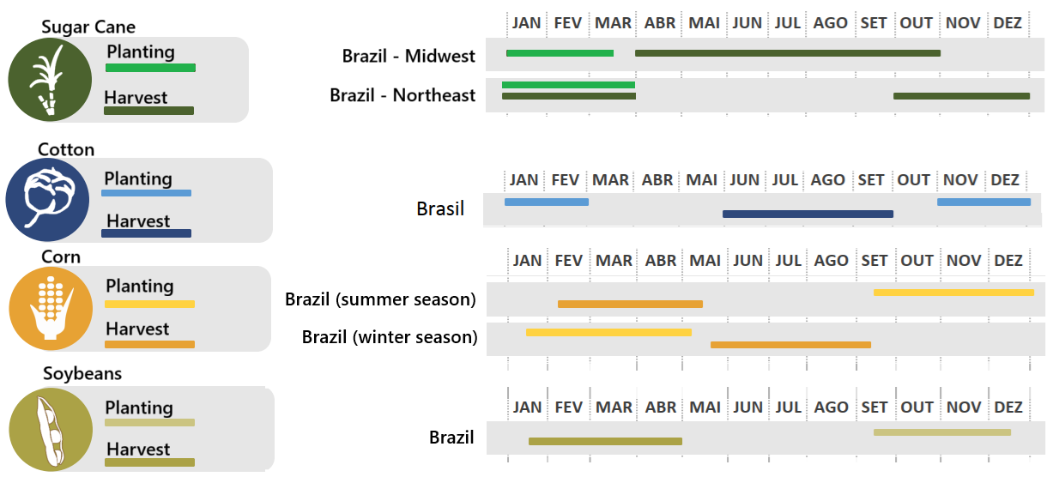
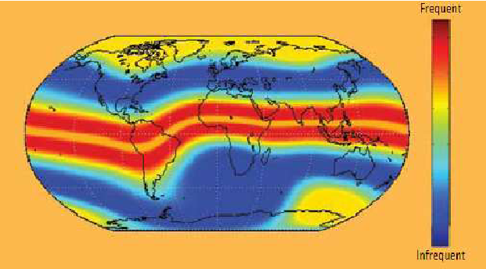
Tropical Precision Agriculture
  Mainly two, sometimes three crops per year;
  Large crop areas
  Logistics intense operation
  Large use of pesticides fungicides
  Large use of fertilizer
  High tech Operation/logistics (GNSS driven)
  Tight operation window between planting/harvesting
Brazil Crop Calendar Chart
Source:
https://mercadosagricolas.com.br/inteligencia/calendario-de-safra/
https://www.researchgate.net/figure/onospheric-scintillation-map-which-shows-the-effects-of-a-solar-maximum-in-different_fig2_242600989

Slide 4

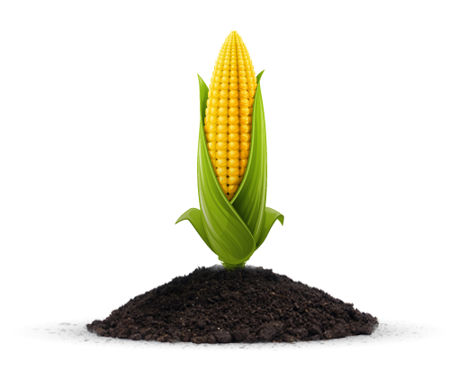
Grains Job Mapping

Slide 5
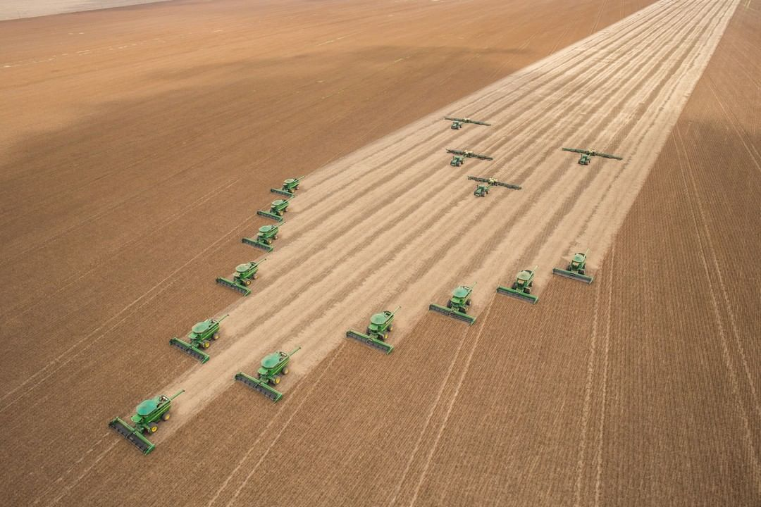
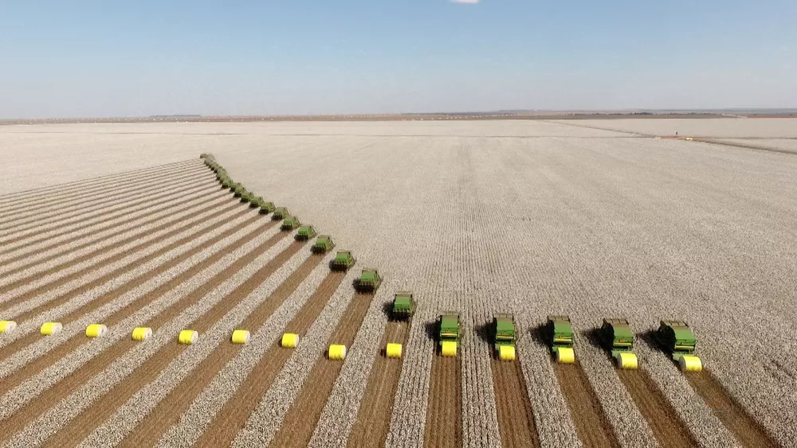
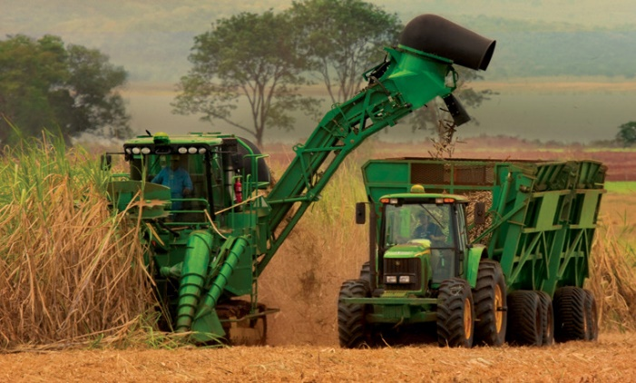
Tropical Precision Agriculture
Cotton Harvest / 2tons per roll
Soybean Harvesting / Planting operations
Sources:
https://www.linkedin.com/pulse/4-a%C3%A7%C3%B5es-vitais-para-otimizar-log%C3%ADstica-da-colheita-de-rodrigues/
https://www.comprerural.com/novo-rei-da-soja-tem-mais-de-581-mil-hectares-veja-o-video/
https://www.comprerural.com/forca-tarefa-30-colheitadeiras-na-colheita-do-algodao-em-fazenda/
Sugar Cane Harvesting

Slide 6
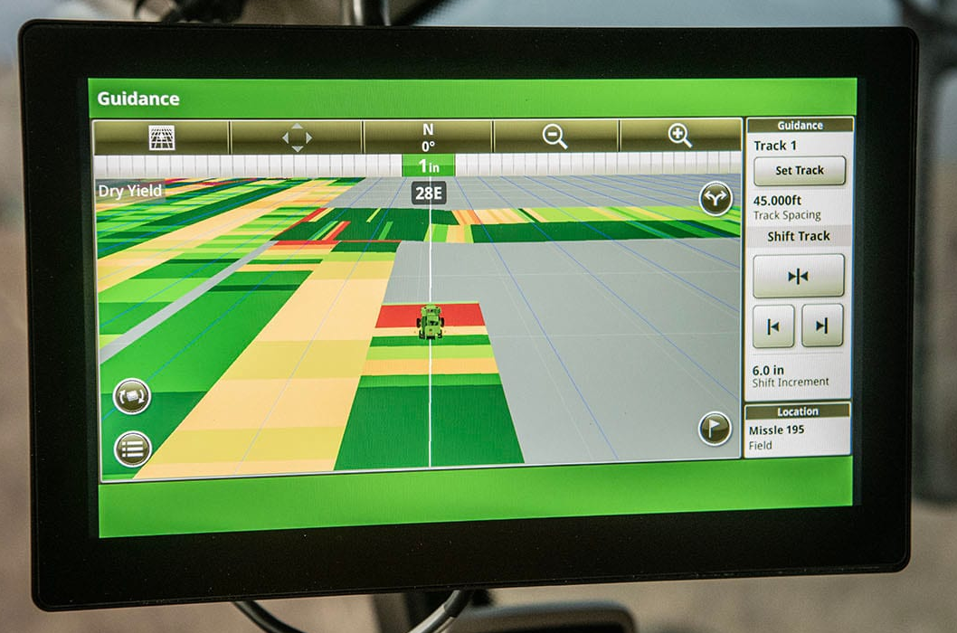
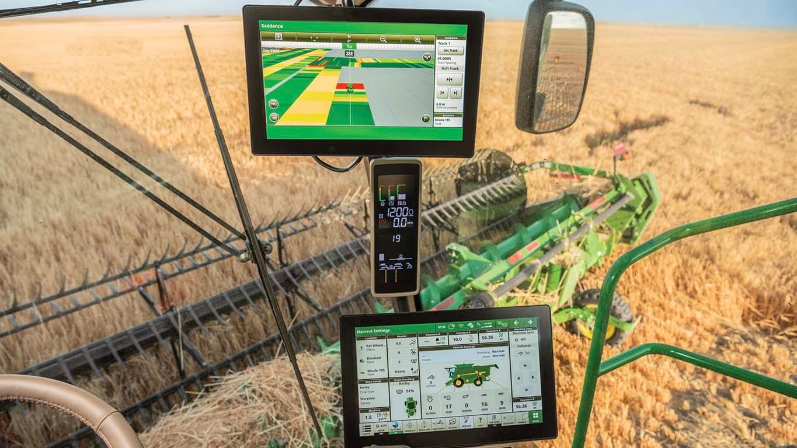
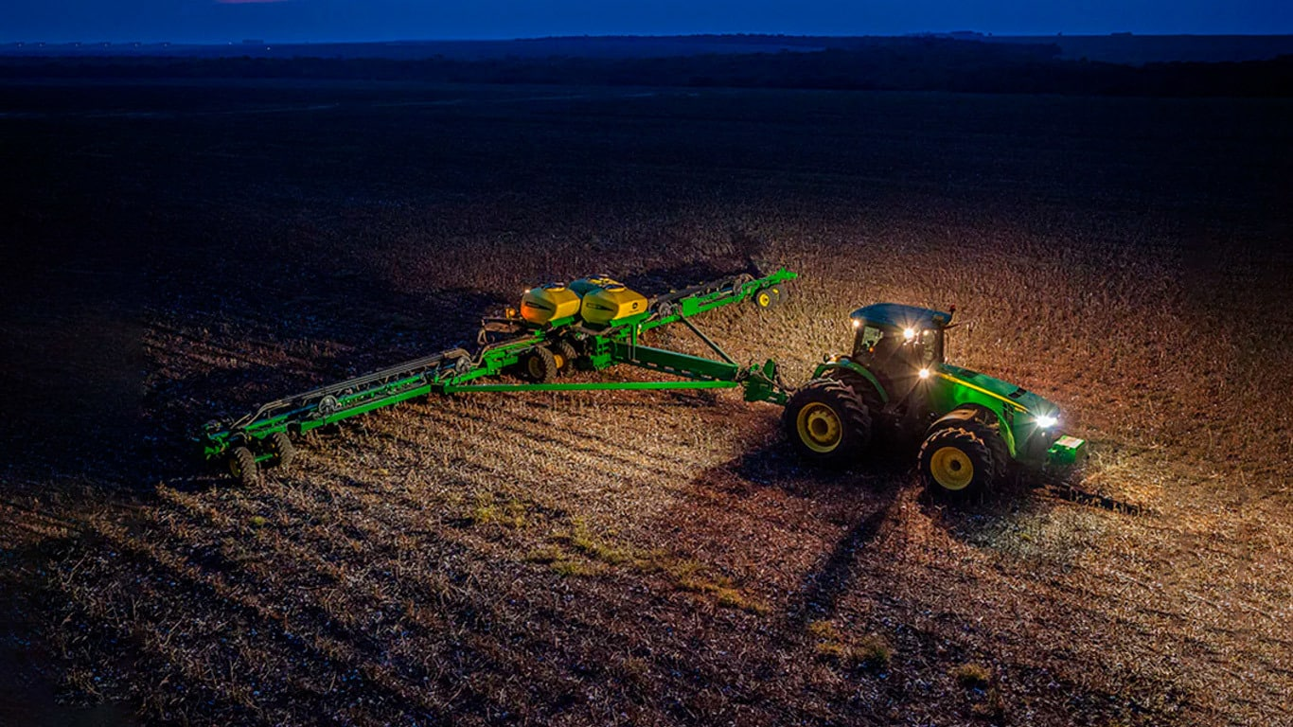
Feet on the Ground
  Fields are georeferenced
  Vehicles use Guidance Lines for tracking, avoiding soil compaction (this allow roots to grow freely)
  Planting operation will rush on a 24/7 until work is complete
  Nocturnal Operations !
  Inch to sub-inch precision
  RTK and PPP users
Sources:
https://www.vrafy.com/how-to-view-data-side-by-side-in-ops-center/

Slide 7
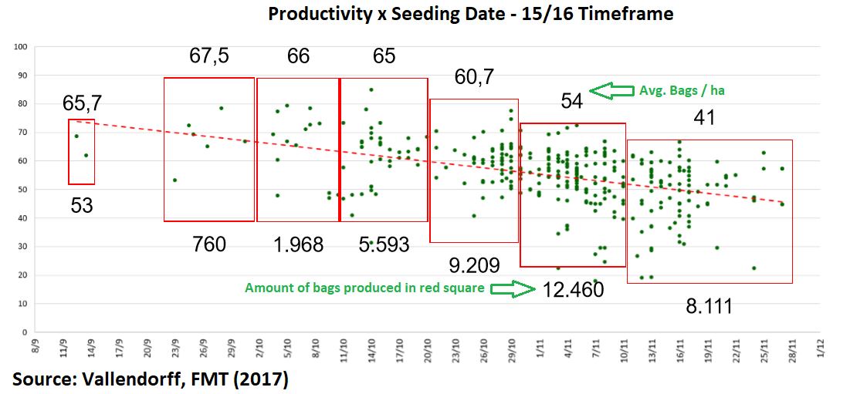
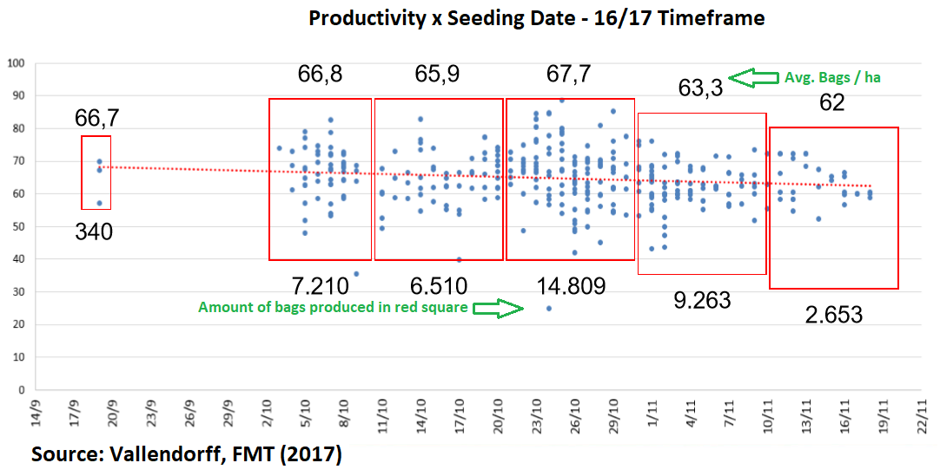
Impacts of Late Planting on Yield
Productivity x Seeding Date – 2015/2016 Season
  Right conditions for planting will include
    Enough soil humidity
    Good Weather forecast ahead
    Soil well prepared with nutrients, etc.
  Lack of conditions will cause
    Seedlings to die due lack of water
    Postponing planting will cause planting/Harvesting
    Window even tighter, forcing uses of dissecants
    causing reduced yield
    Can also cause more passes of defensives
    passes if humidity is too high due to spread of fungus
    and insets
38154 bags (-6.45%)
Productivity x Seeding Date – 2016/2017 Season
40785 bags

Slide 8
Space Weather Impacts on Precision Ag

Slide 9
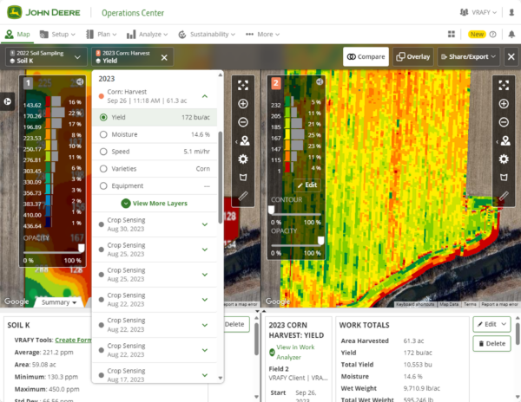
Space Weather Impacts
  Scintillation can affect the operations up to 6 hours per night
  Customer needs to decide between stopping the machine or driving manually (not always possible in the night shifts)
  Difficult to diagnostic by a machine operator, even if it does when is it safe to return to operate?
  Impact on yield documentation as it may not reflect the real positioning of the vehicle.

Slide 10
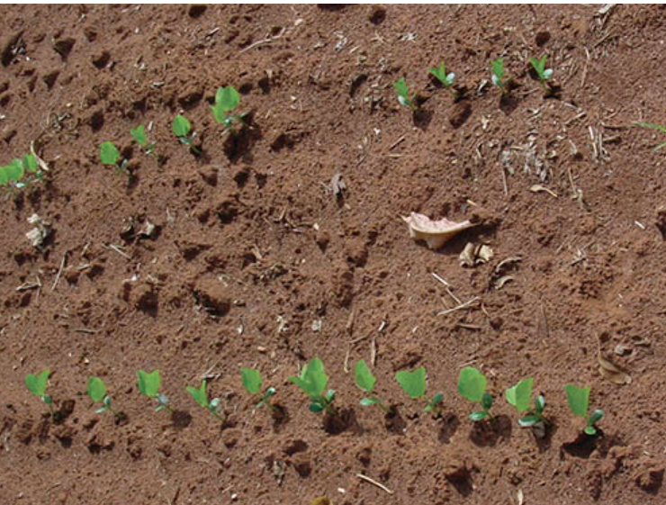
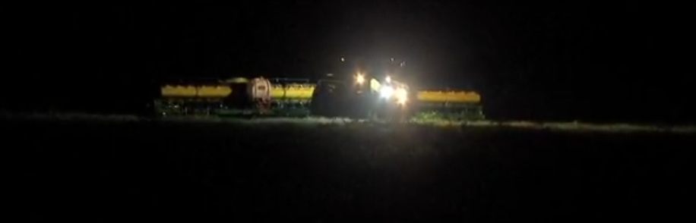
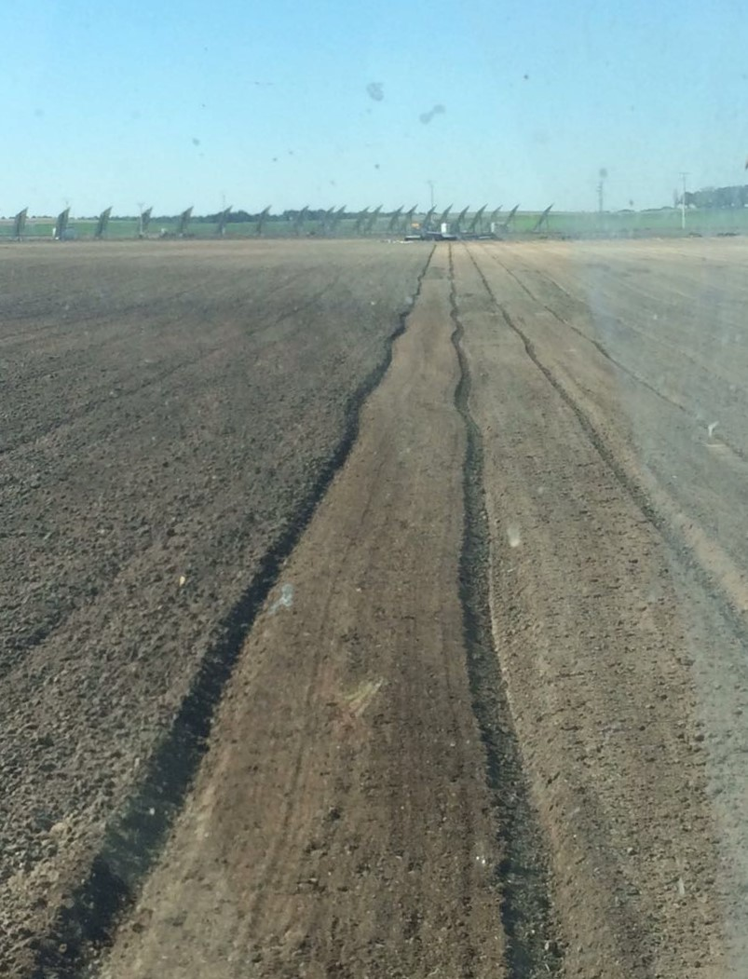
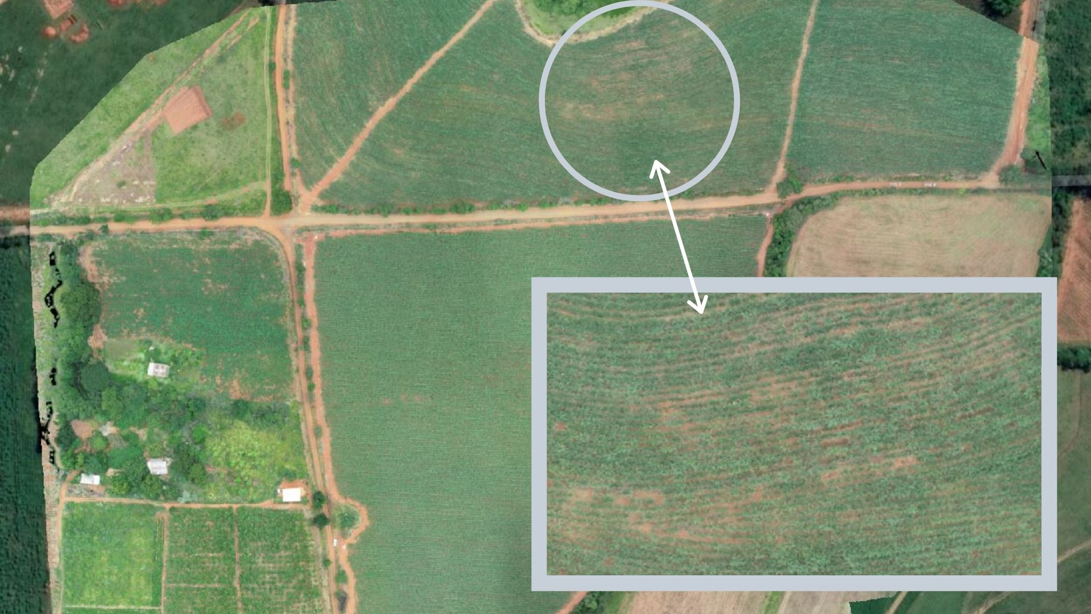
Sources:
https://gps.stanford.edu/resources-overview/sbas-ionospheric-working-group
https://seednews.com.br/artigos/2461-falhas-e-duplos-na-produtividade-edicao-novembro-2008
https://mappa.ag/blog/identificar-falhas-de-plantio-ferramentas/
https://globoplay.globo.com/v/3735136/
Space Weather Impacts
  Most affected operation is planting
  Post-sunset operations are affected as it is hard to see vehicles drifting out of the guidance line
  Seedlings growing out of the guidance line will compete resources, or will be smashed in subsequence operations, causing yield losses.
  RTK rovers may experience up to one-meter drifts
Poorly seeded
Overly seeded

Slide 11
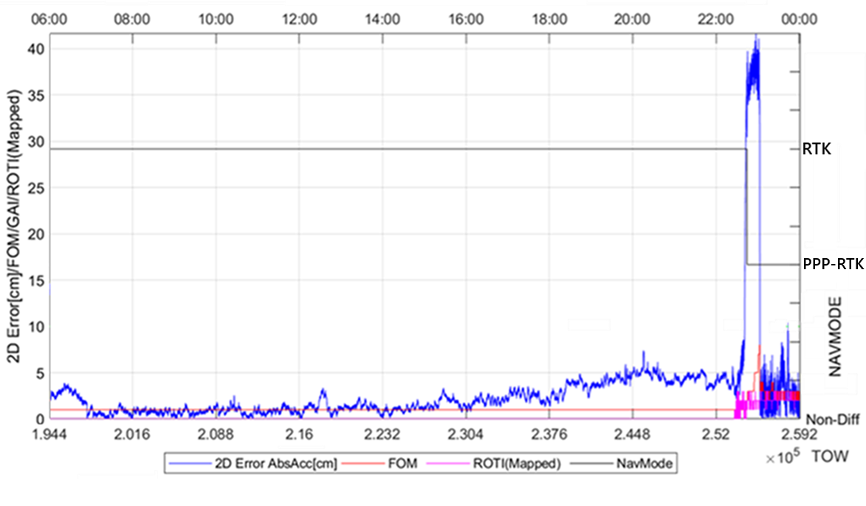
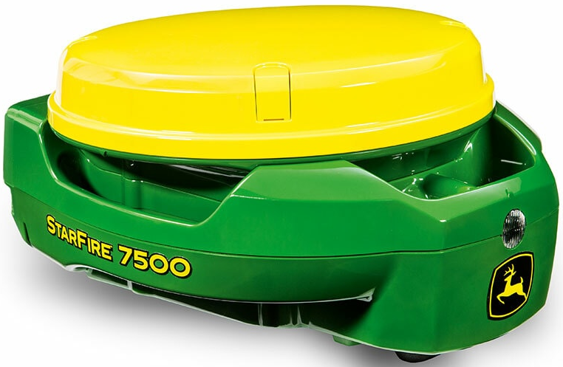
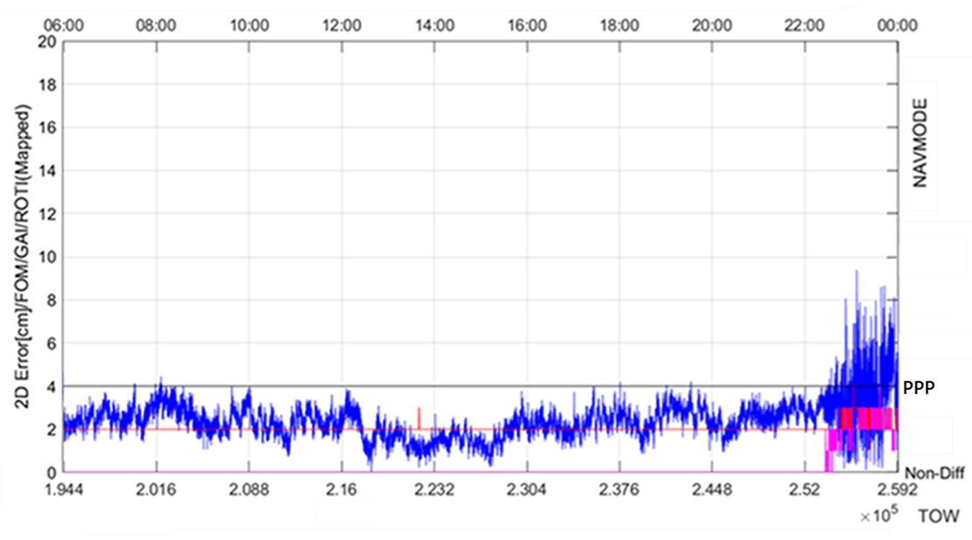
Season x Season
  Adoption of Multi Constellation Multi Frequency receivers has greatly increased uptime during low / mid events of scintillation (up to 60%)
  Stronger, more robust signals such as L2C, L5, E5a&b etc. also contributed with the signal reacquisition time
  Advances on GNSS augmentation techniques will future benefit on GNSS outages and GNSS denied environments.

Slide 12
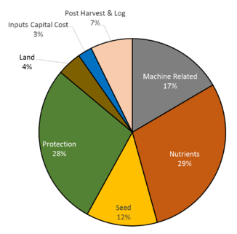
Small Grains Study proposal
How much one additional day of late planting due scintillation will cost to a 30.000 ha (74000 acres) farm? Assume 16 days to complete normal the seeding operation.
* Where:
1 bag = 60kg ~ U$ 22.86

