Slide 1
May 2024 Storm Impact on GNSS on the Ground and in Space
Jade Morton
University of Colorado Boulder, USA

Slide 2
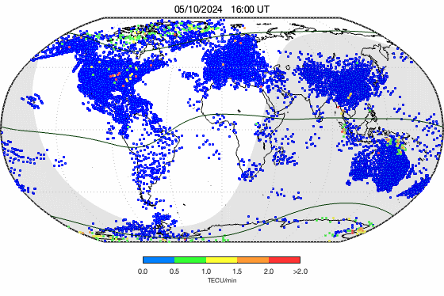
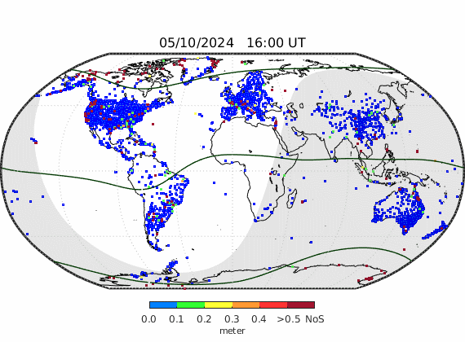
May 10-11, 2024 Storm
ROTI
Precise Position Error

Slide 3
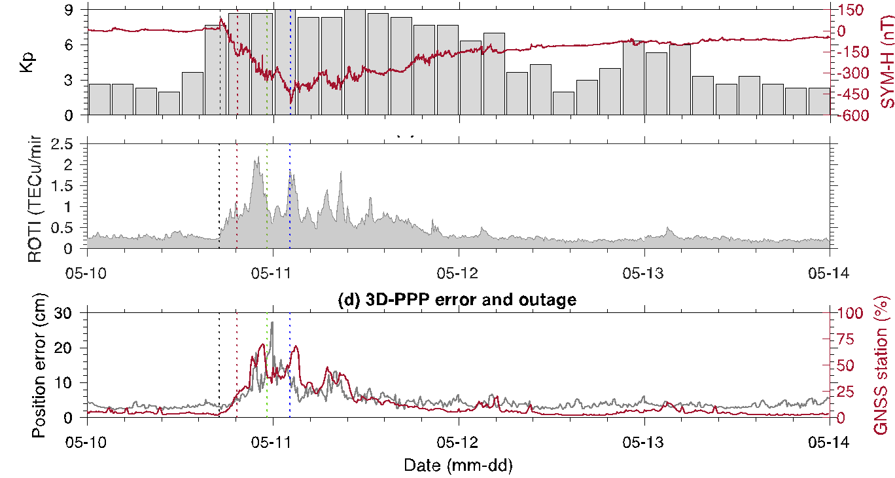
GNSS PPP Software Performance (5800 Stations)

Slide 4
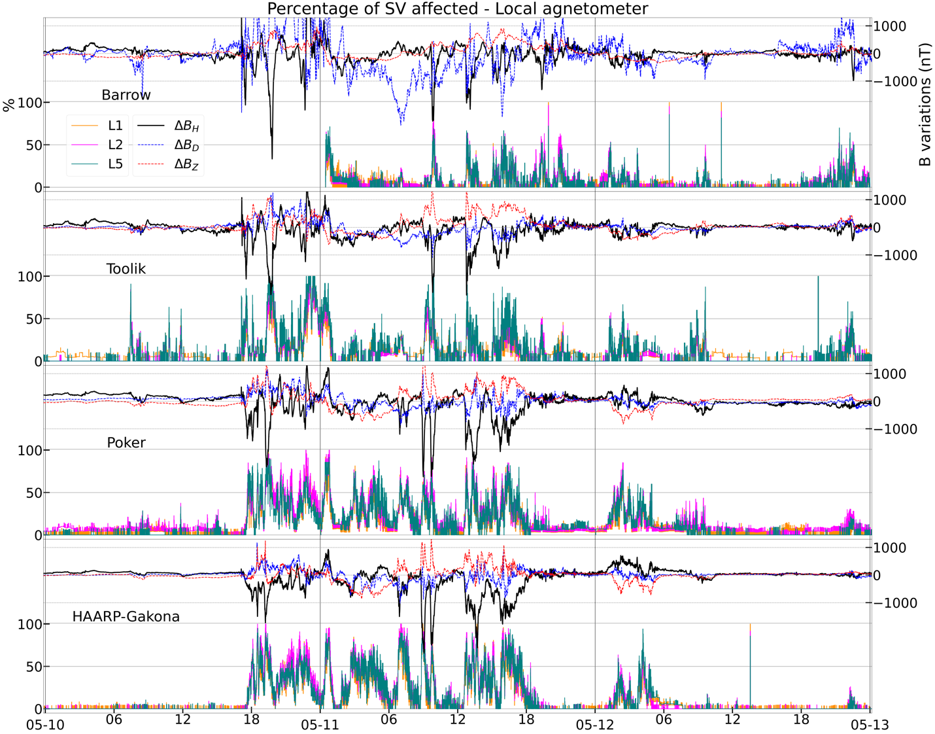
Barrow
Barrow
Toolik
Toolik
Poker Flat
Poker
HAARP
HAARP

Slide 5
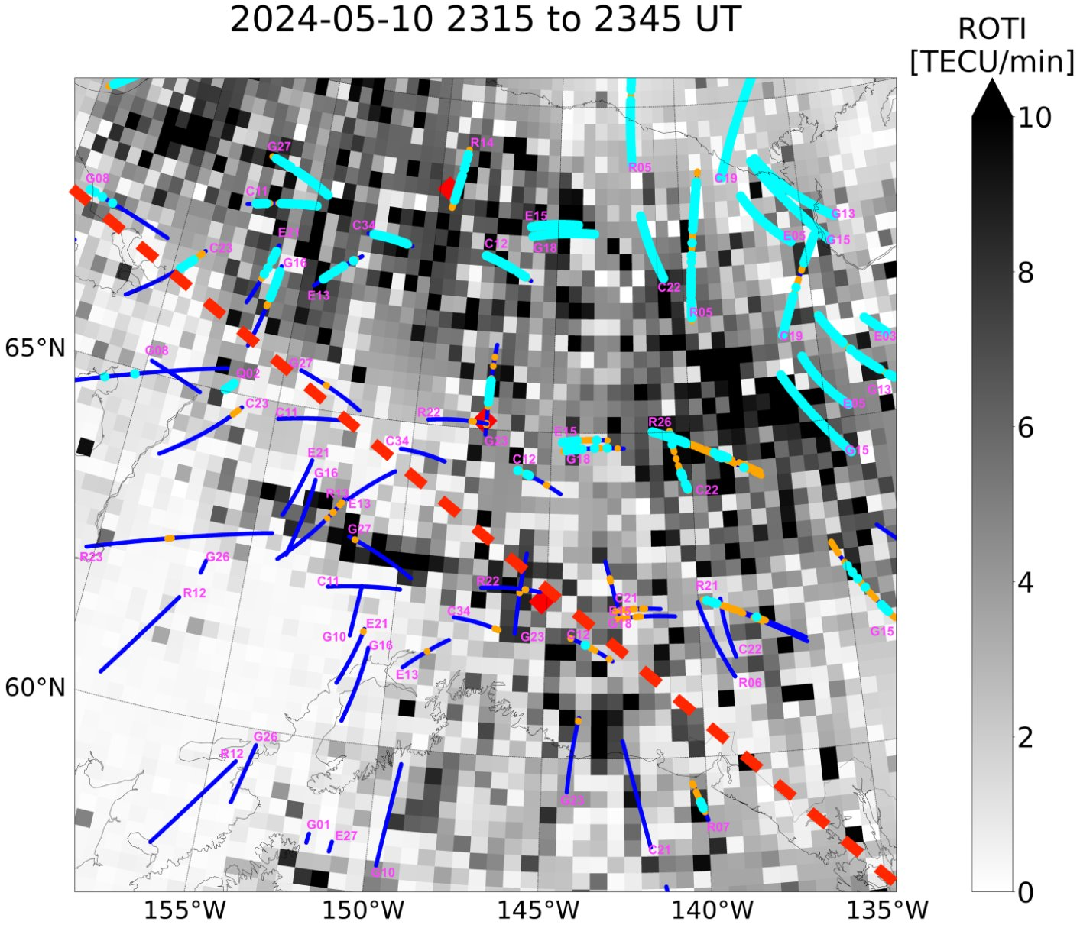
Scintillation
and
High ROTI Correlation

Slide 7
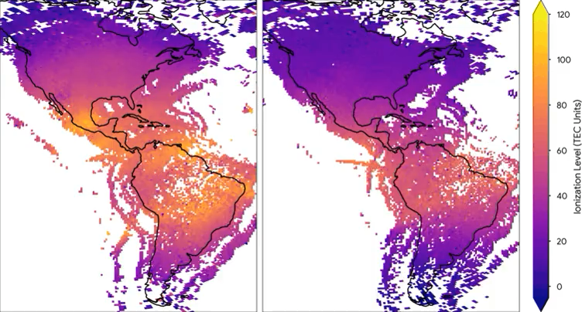
May 10, 2024
18 UTC

Slide 9
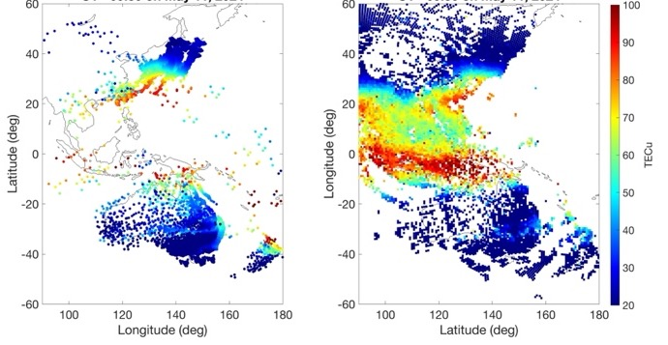
Cell Phone Data Fills Ground Station Gap
May 11, 2024 09:30UT
Cell
Phone
Madrigal

Slide 10
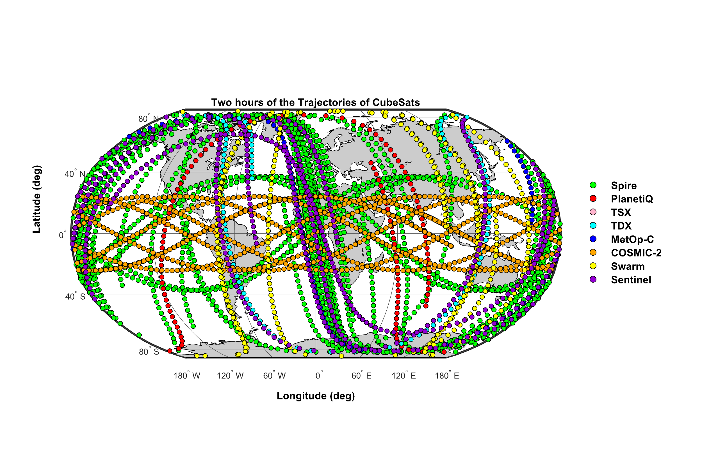
POD Observed Topside Ionosphere TEC Disturbance
1-Hour LEO Satellite Track

Slide 11
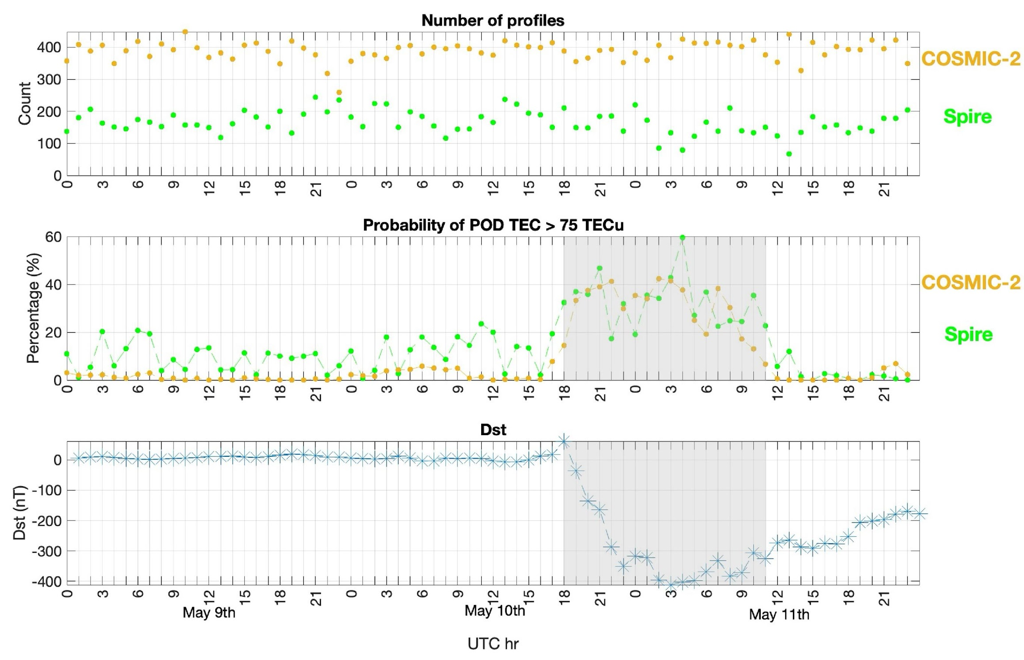

Slide 12
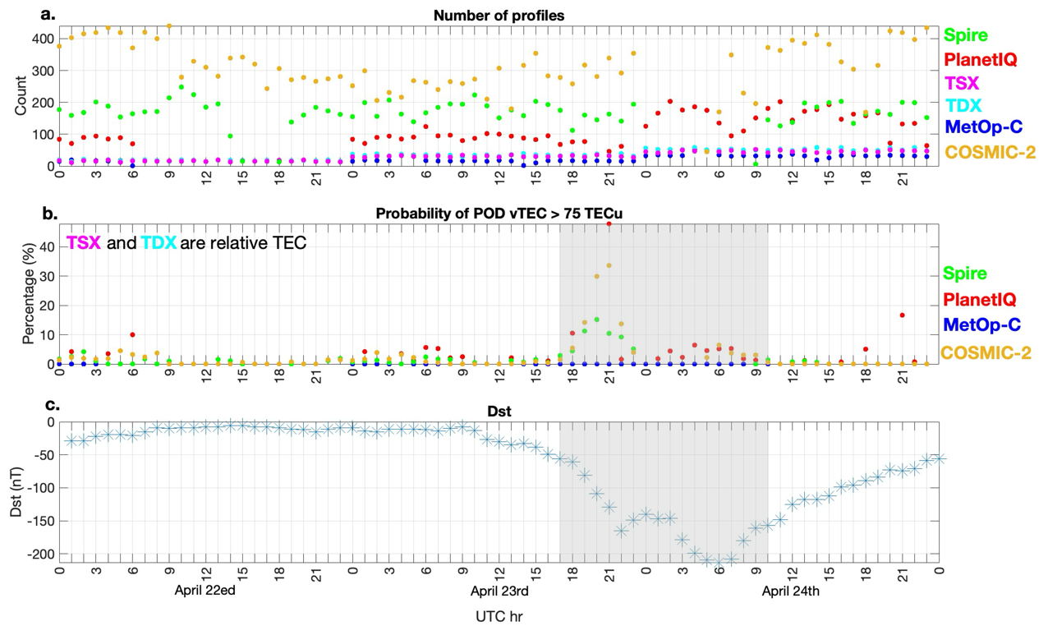

Slide 13
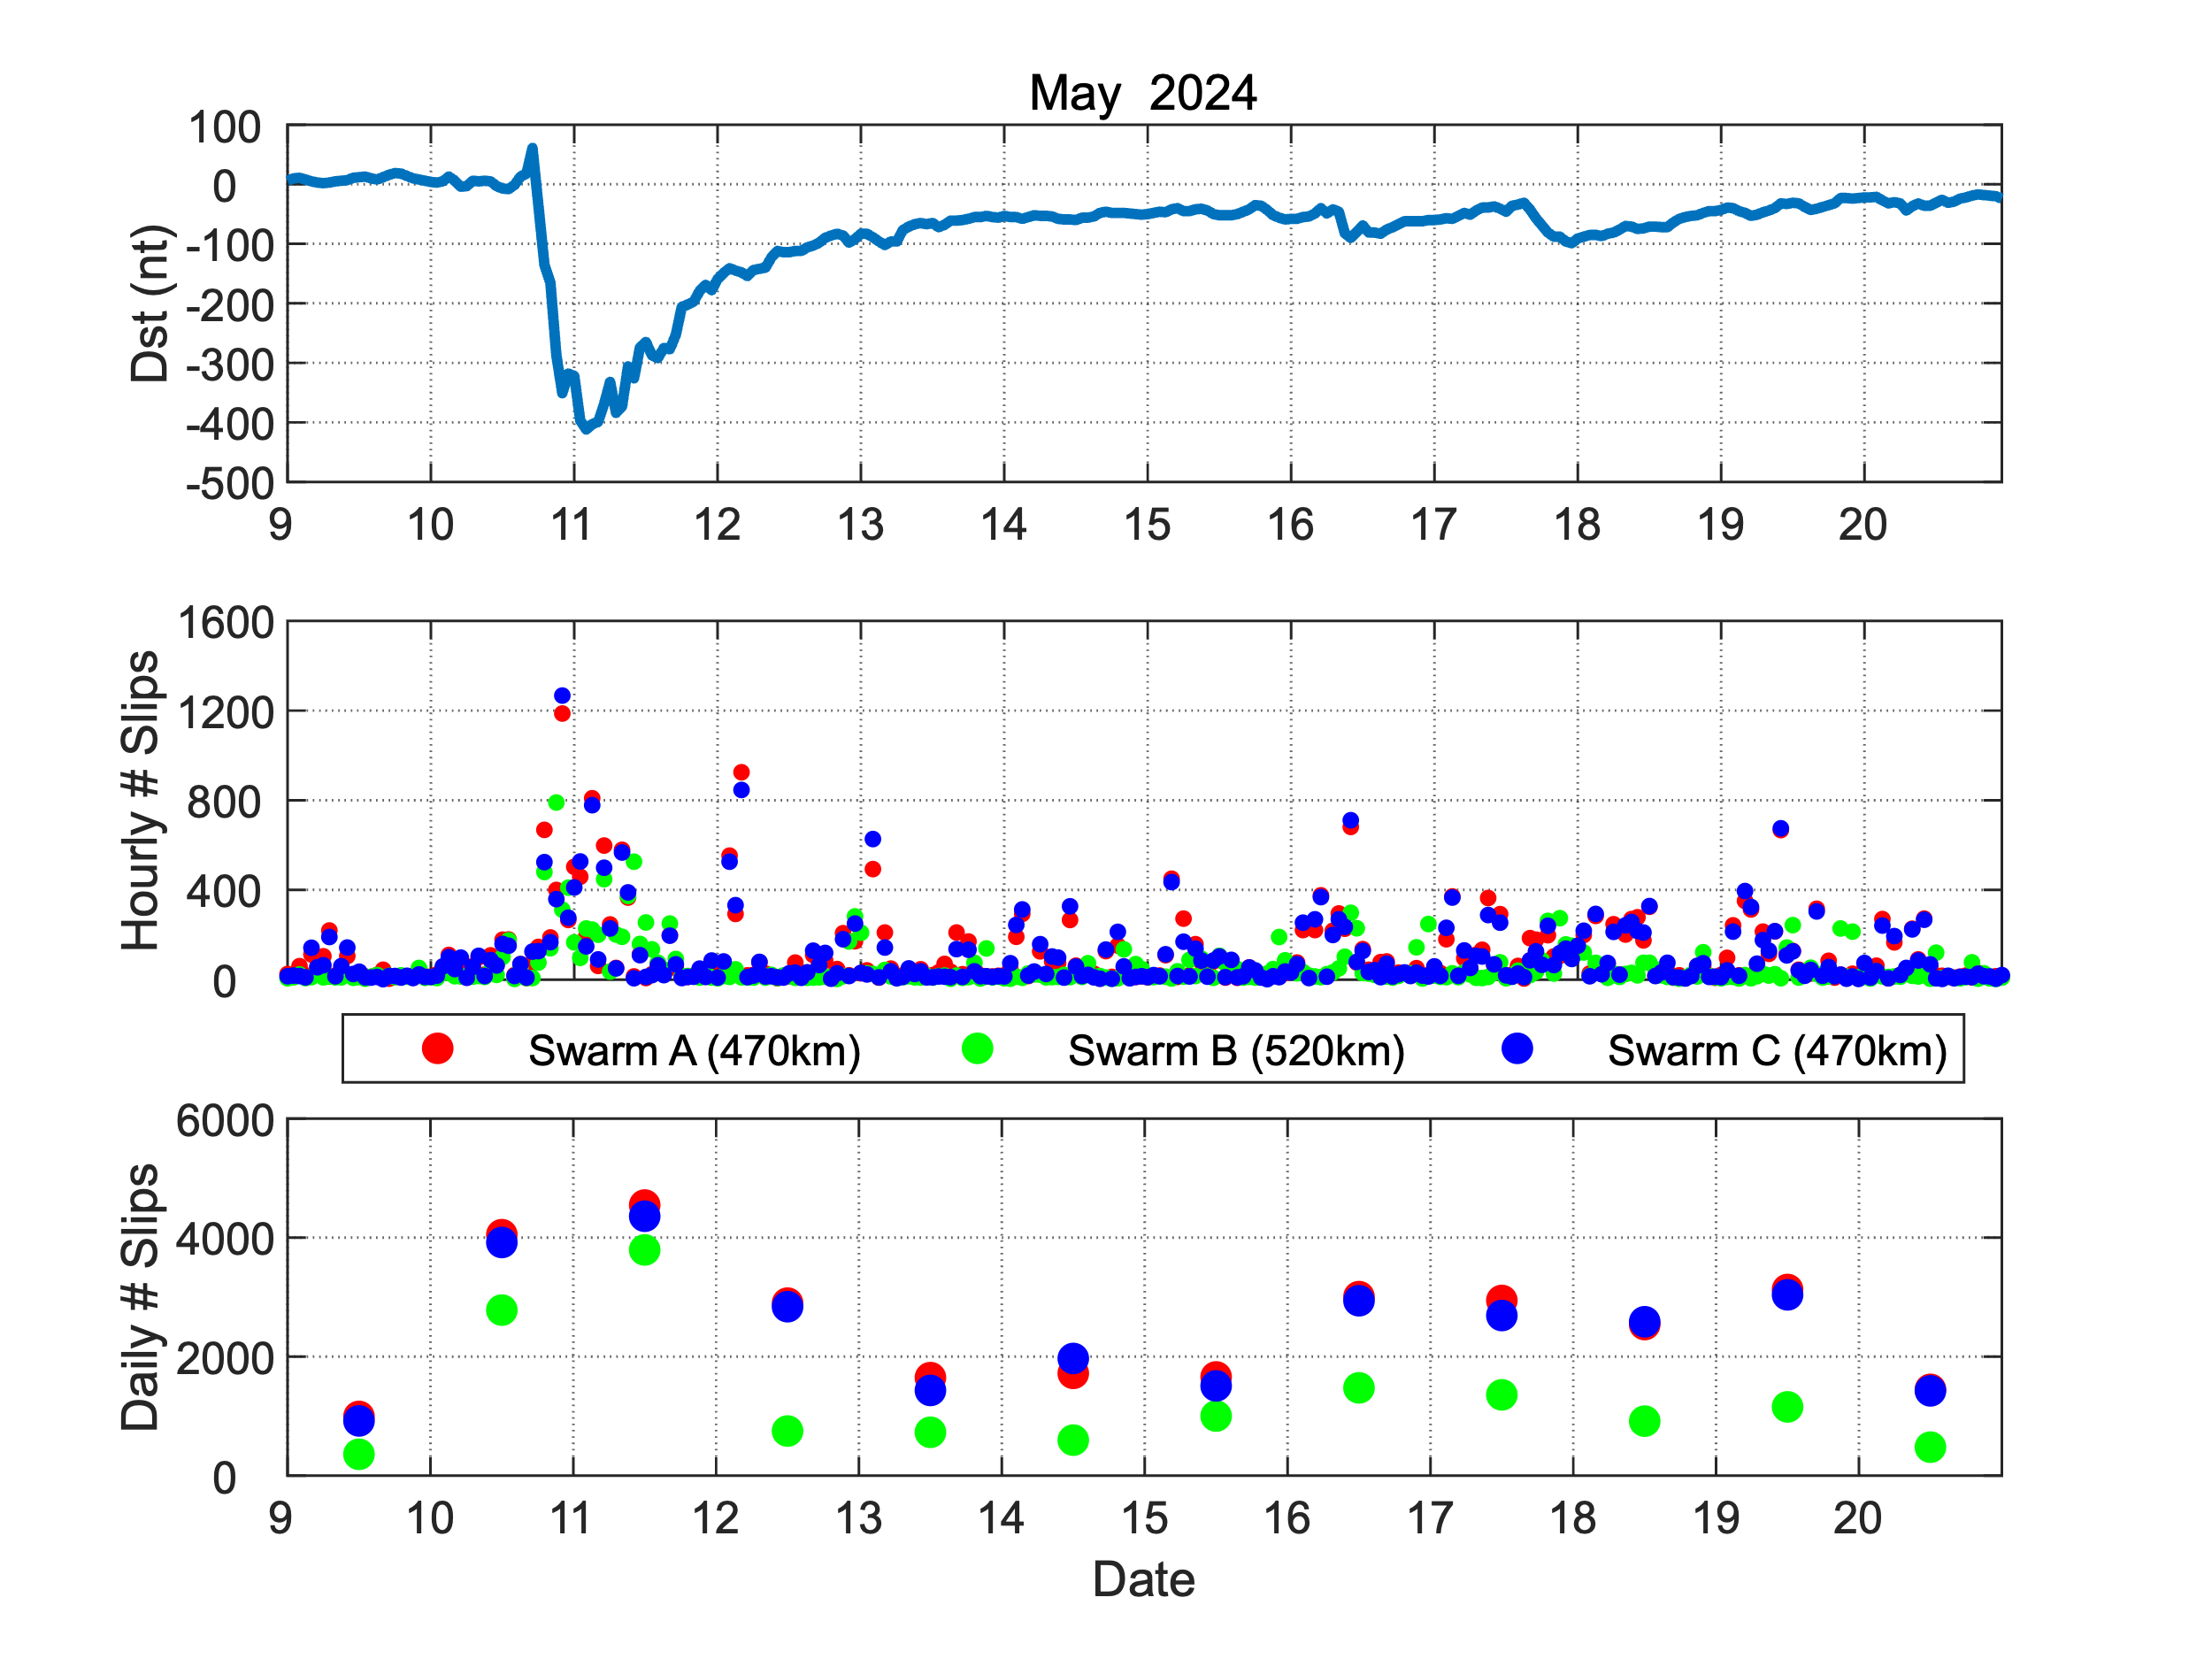
Swarm Satellite Zenith Antenna Cycle Slips

Slide 14
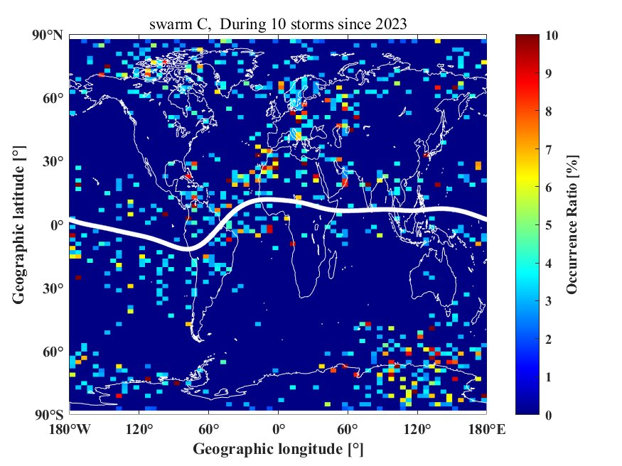
LEO Satellite
Loss of Lock:
Space Weather
or Jamming?

Slide 15
Summary
Ground:
Seriously impacted high precision ground GNSS receivers worldwide.
High latitude scintillation is highly correlated with high ROTI
Cell phone-based TEC maps captured detailed ionosphere structures
Space:
LEO satellite POD (zenith) TEC accuracy compromised
Number of measurements not affected as much as earlier storms
Cycle slip occurrence elevated during the storm.
Need to identify source of GNSS receiver impact (space weather, jamming/spoofing, satellite attitude, GNSS signal anomalies)

Slide 16
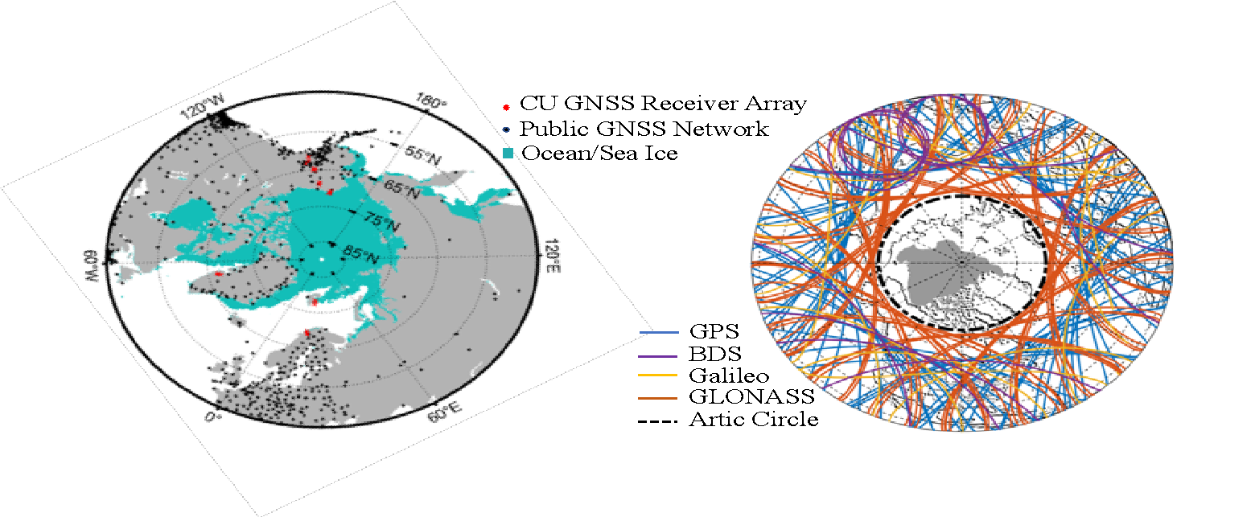
Data Gaps Over Polar Regions
No GNSS Satellites Overhead for Ground Receivers

Slide 17
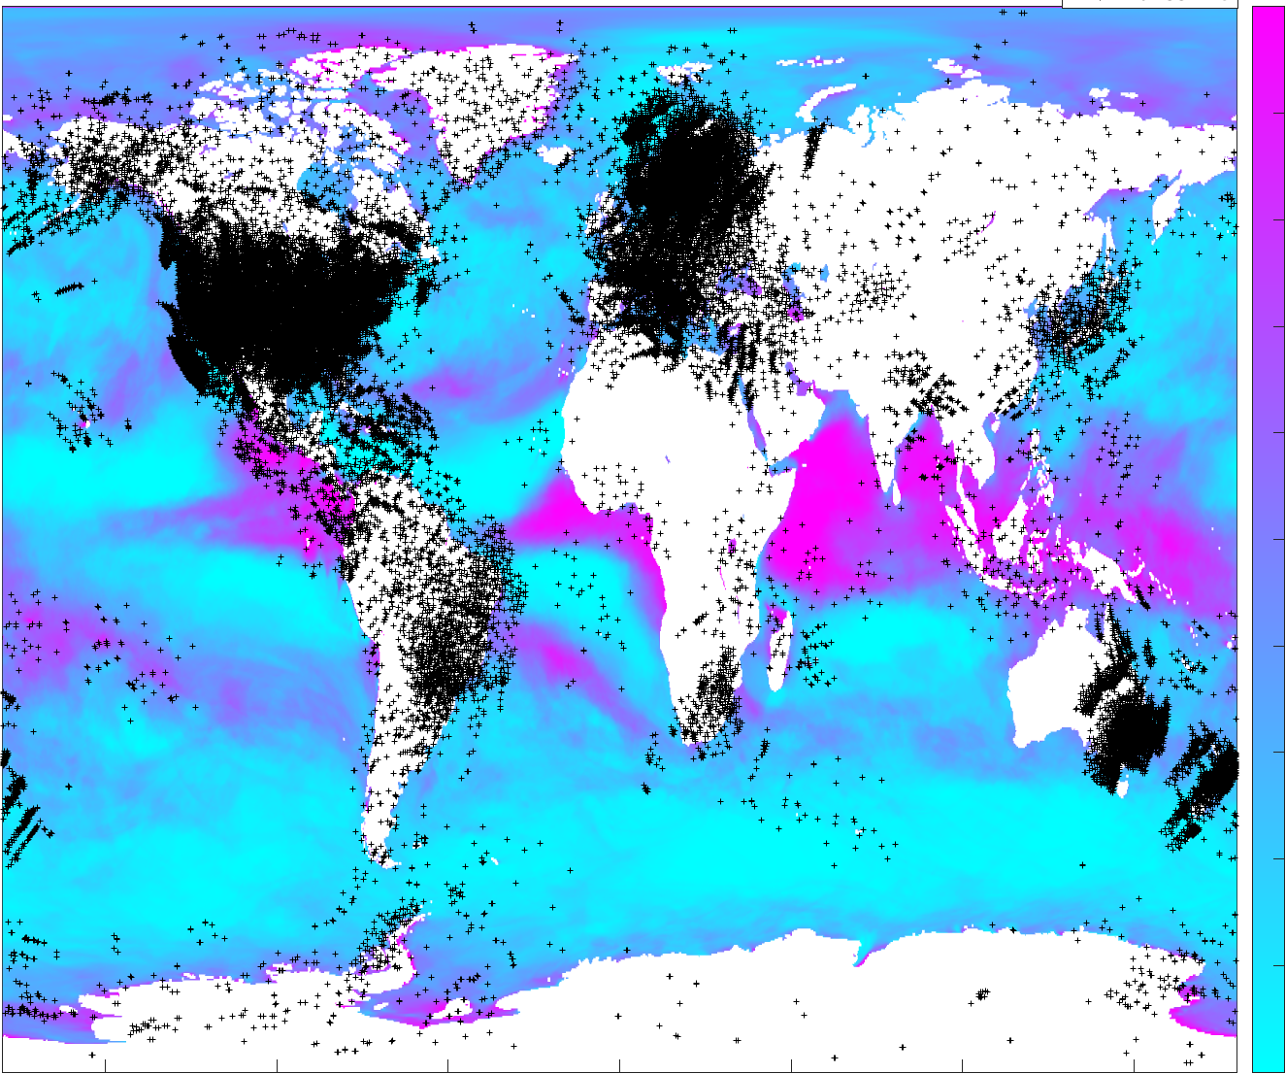
Data Gap Over Oceans
100
75
50
25
0
Probability of Wind Speed <5m/s
Equatorial Oceans Are In General Calm 🡪 Good Reflectors

Slide 18
GNSS-R for Altimetry and Ionosphere Applications
Pseudorange | Carrier Phase
Absolute | Relative
Noisy | Precise
Robust | Fragile
Altimetry: Surface Height
Ionosphere: TEC and scintillation
Wang, Y., Y. Morton, “Coherent GNSS reflection signal processing for high-precision and high-resolution spaceborne applications,” IEEE Trans. Geosci. Remote Sensing, DOI:10.1109/TGRS.2020.2993804, 2021
Wang, Y., Y. Morton, “Ionospheric TEC and disturbance observations from space borne coherent GNSS-R measurements,” IEEE Trans. Geosci. Remote Sensing, DOI: 10.1109/TGRS.2021.3093328, 2021.

Slide 19
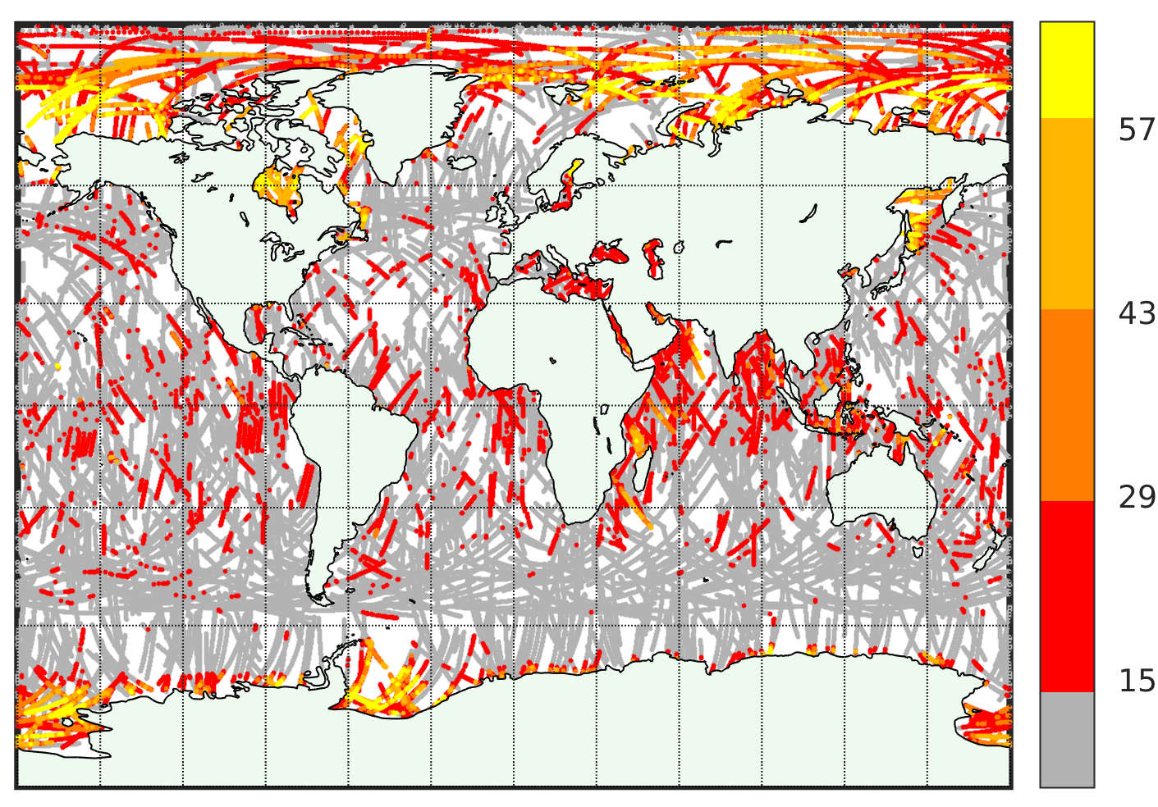
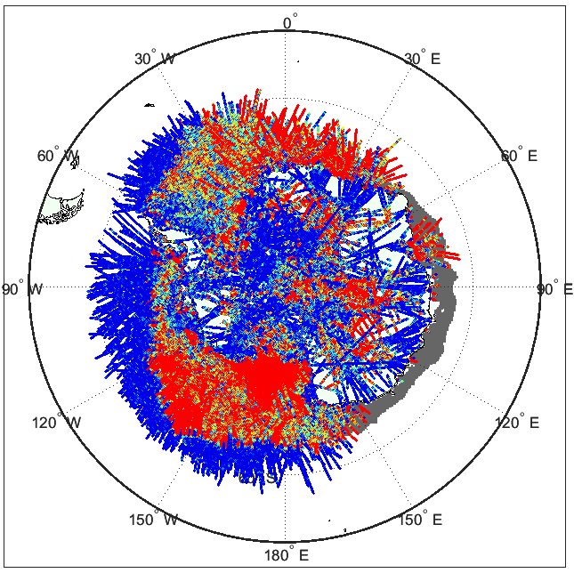
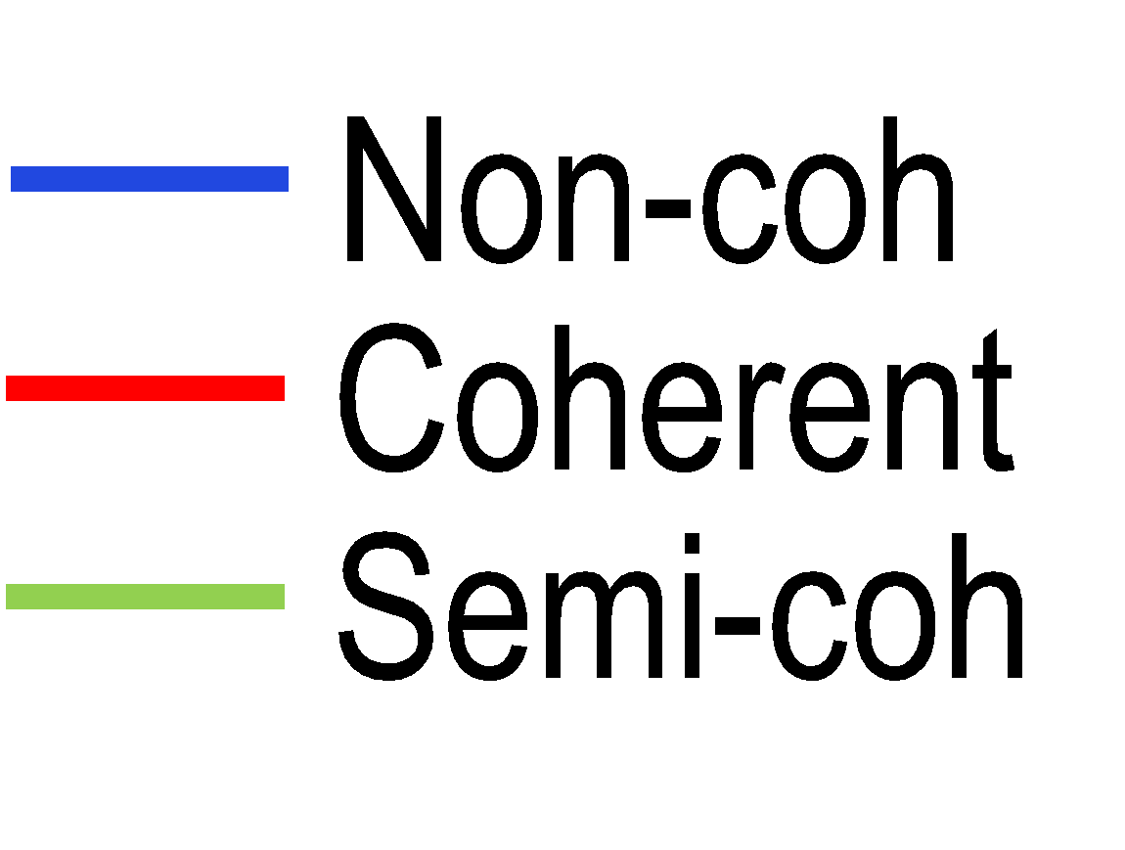
Carrier Phase Measurements: Only Available Over Ice and Calm Waters – Coherent Reflection
Jan-Apr. 2019
Spire Global Data
Oct. 2021
Good reflection signals from poles and equatorial oceans

Slide 20
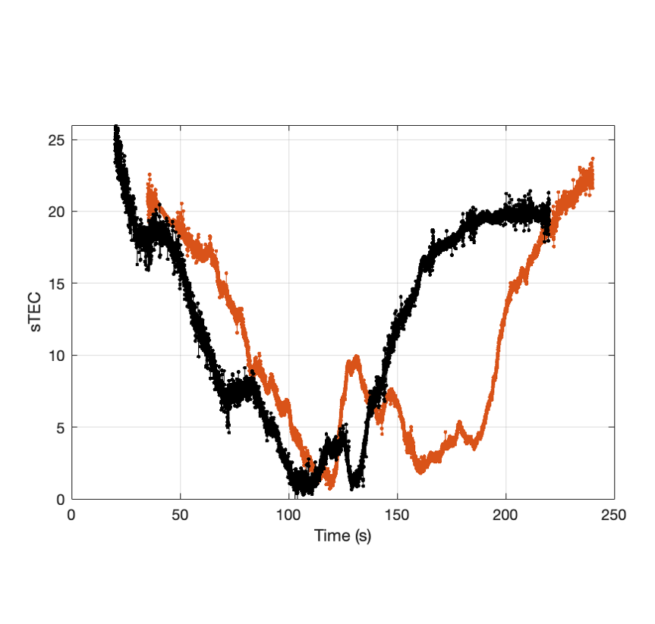
GNSS-R Captures Polar Structures 5/12/2022
14-51-50 UT Spire CubeSat FM101-GPS PRN 17 15-15-23 UT Spire CubeSat FM125-GPS PRN 09
SP
IPP2
IPP1
Captures dynamic plasma patterns
Separate contributions from incident and reflection ray: math framework published!
Hardware bias calibration

