Slide 1
Space Weather Impacts on Agricultural Uses of GNSS: Estimation of Losses due to Signal Degradation and Valuation of Duration Forecast Space Weather Prediction Testbed 2025 GNSS User Engagement, Boulder, Colorado, USA 21 May 2025
Terry W. Griffin, Ph.D.
twgriffin@ksu.edu
@SpacePlowboy

Slide 2
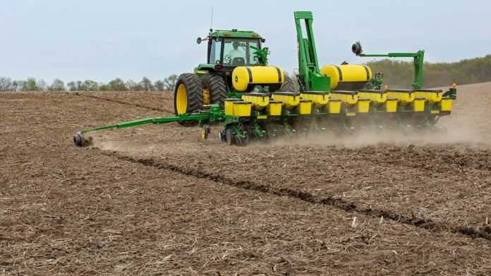
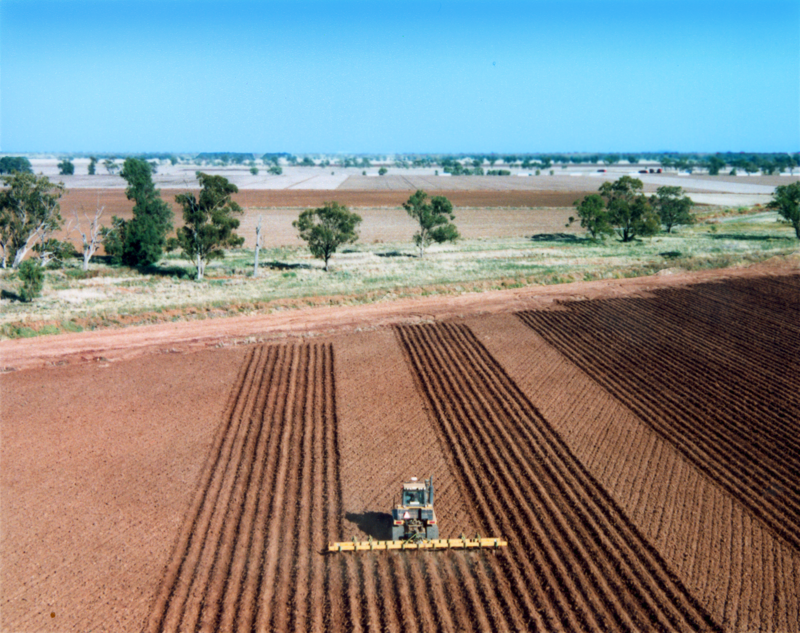
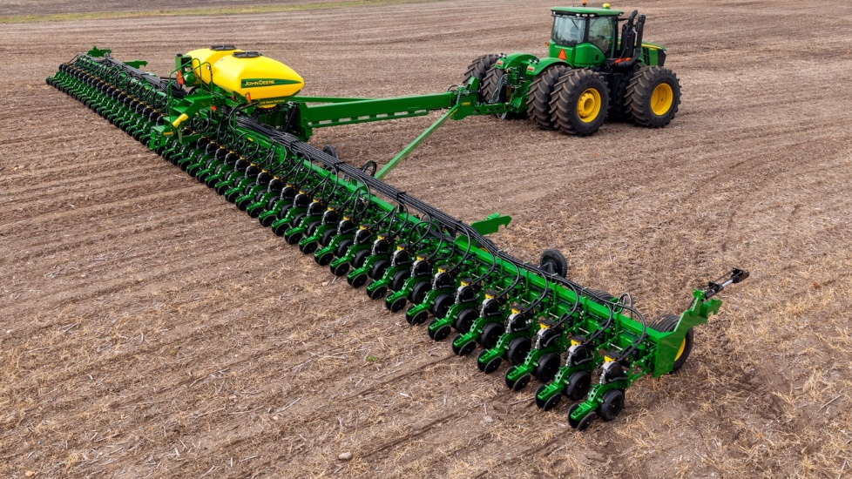
Because of GNSS…
1995
2005
2015
Physical row markers
No physical row markers
Since row markers not needed…

Slide 3
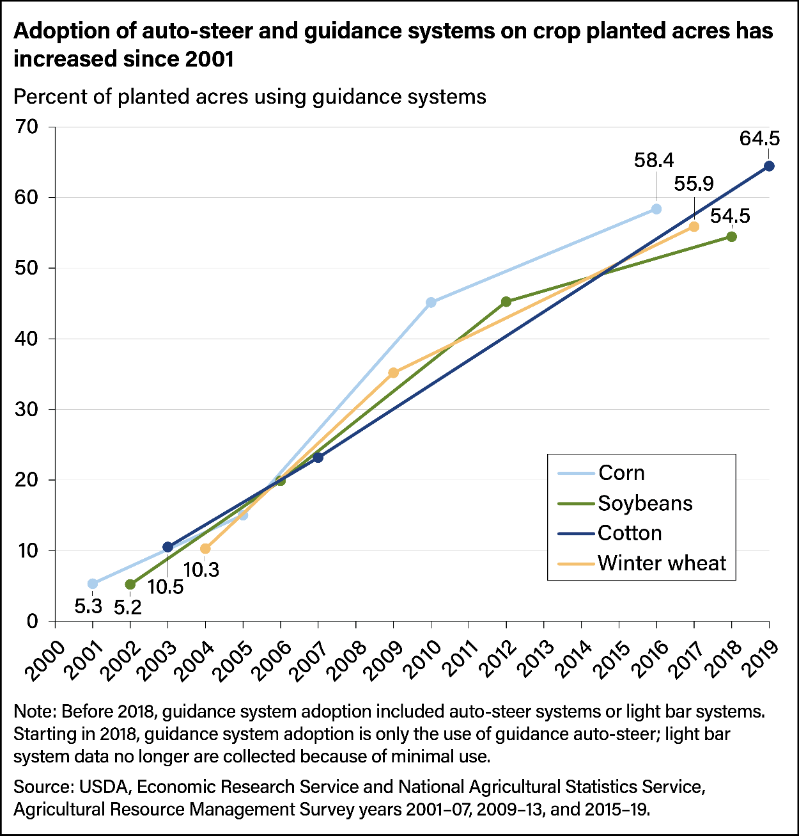
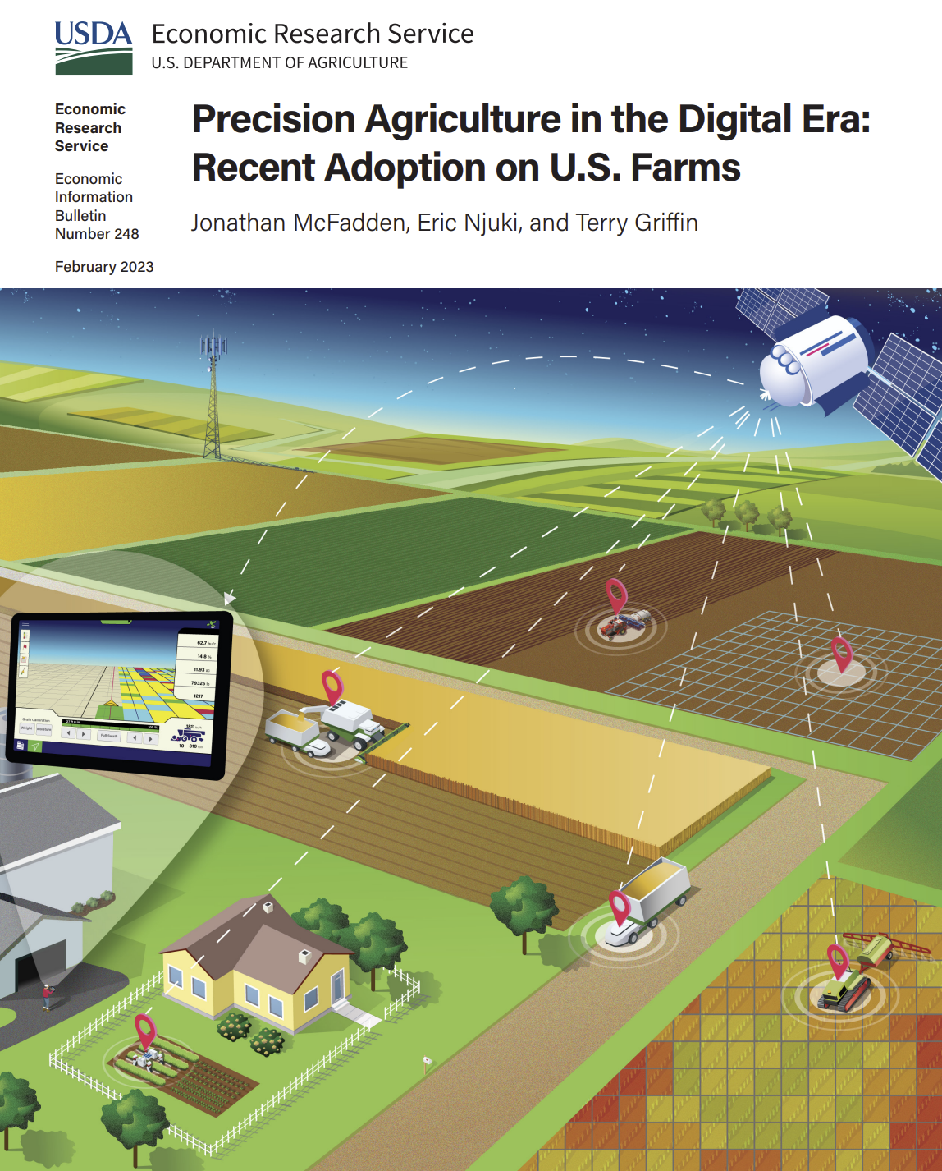
https://www.ers.usda.gov/publications/pub-details/?pubid=105893

Slide 4
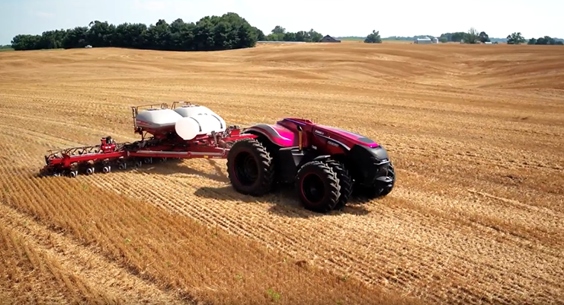
Guidance: manual to automated to autonomous

Slide 5
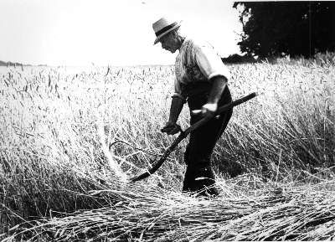
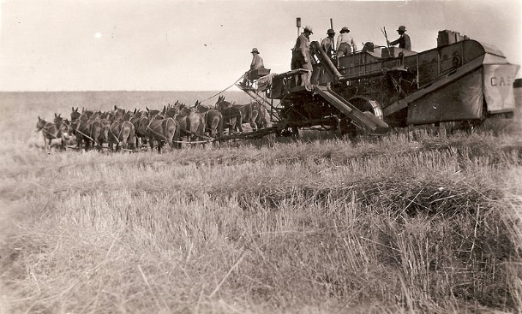
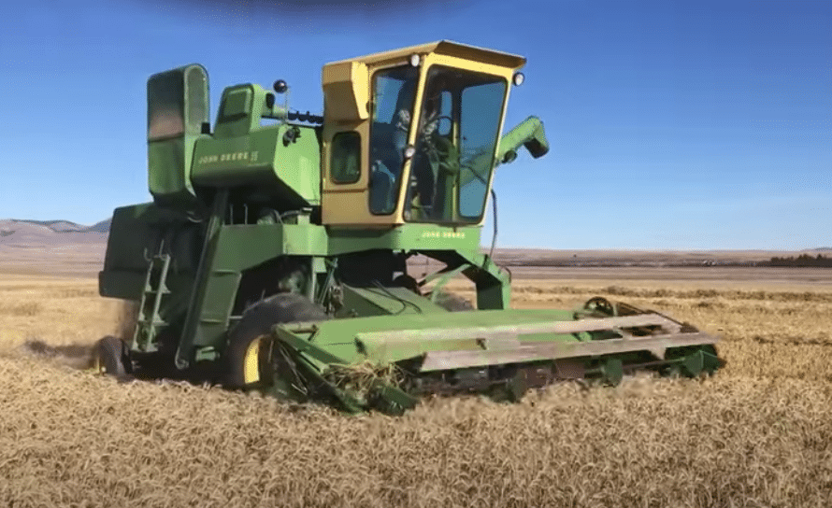
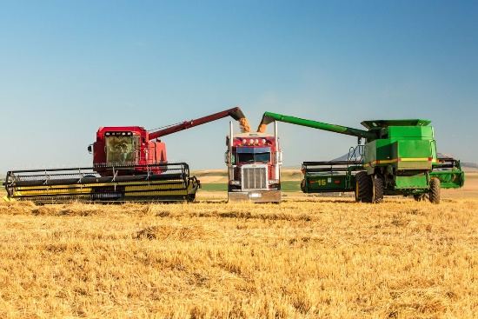
?
Source: Glen Rains, UGA

Slide 6
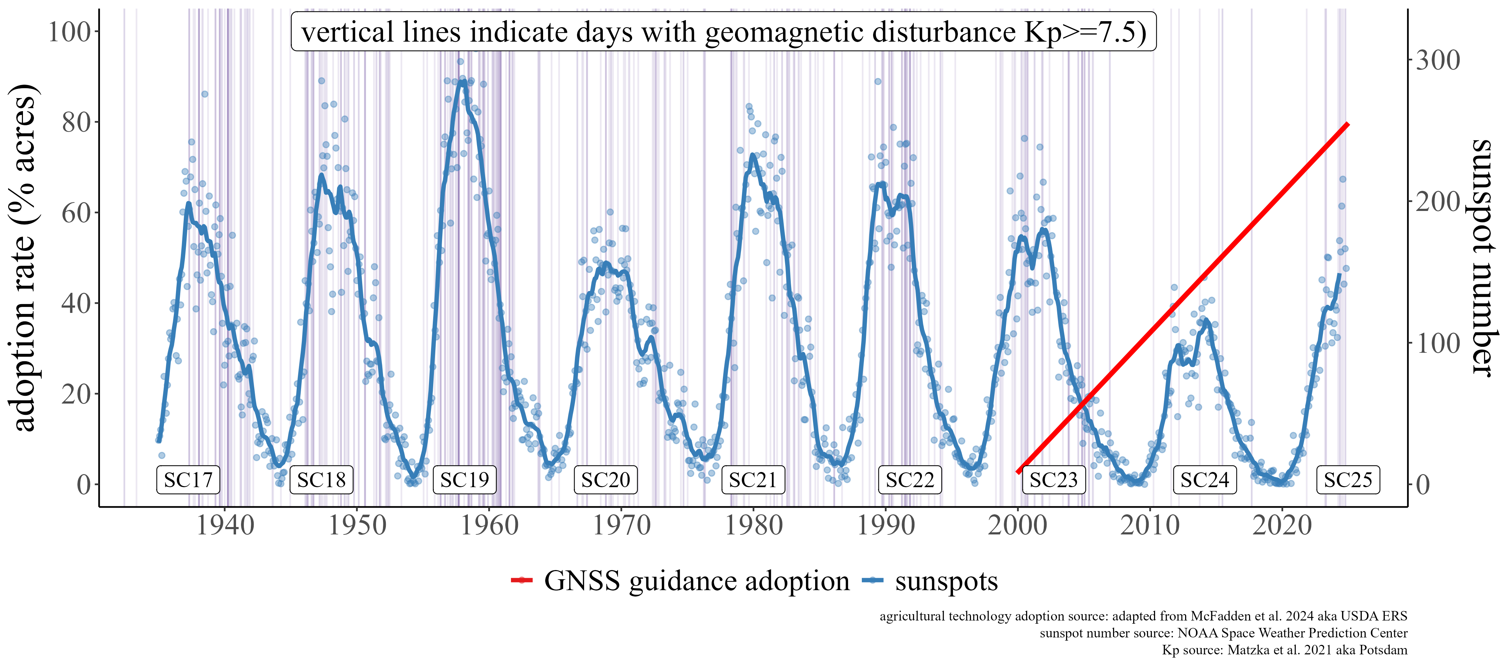
Solar sunspot cycles before and during the precision agriculture era
https://shiny.agmanager.info/Kp/

Slide 7
https://shiny.agmanager.info/Kp/

Slide 8
Agricultural sensitivity to timing of GNSS signal degradation, corn

Slide 9
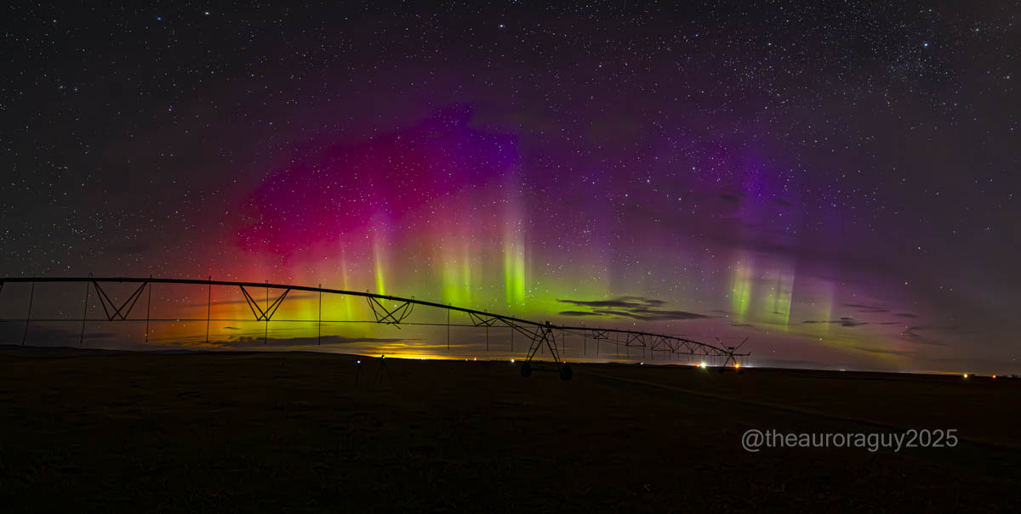
Agricultural sensitivity to timing of GNSS signal degradation, corn
Impact of the Gannon Storm on Corn Production Across the Midwestern USA.
Knipp, Shank, Skov, McIntosh, Leamon
$53.2M to $1.7B across USA
Conservative estimate of $500M

Slide 10
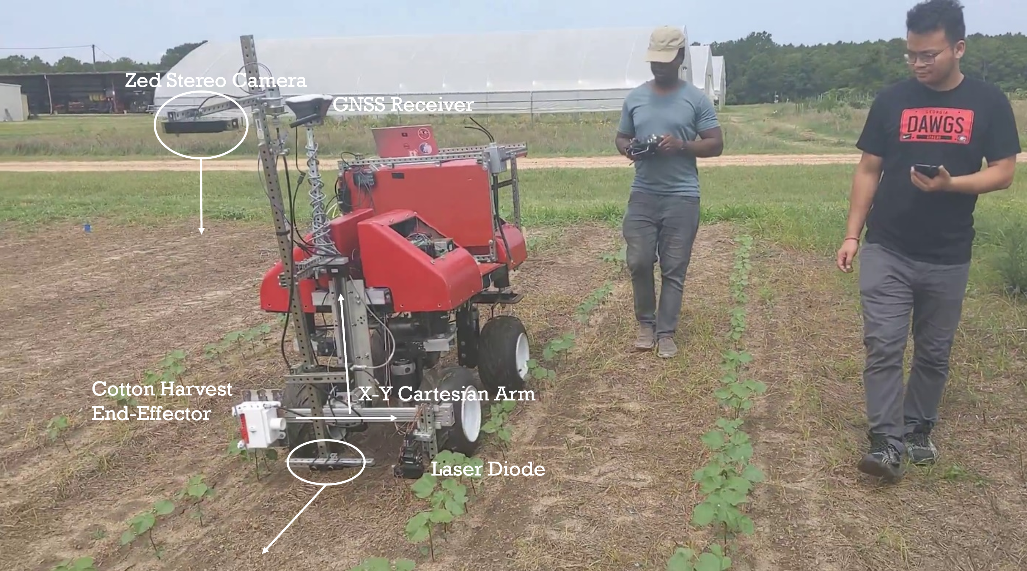
Agricultural sensitivity to GNSS signal degradation, cotton
Cost of Reliance on GNSS for Autonomous Cotton Harvest: Assessing Potential Vulnerability of Autonomous Navigation Systems to a GNSS Outage
$13K penalty per 2000-acre farm
https://agmanager.info/management-finance/precision-agriculture/cost-reliance-gnss-autonomous-cotton-harvest-assessing

Slide 11
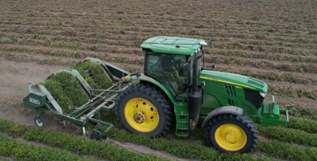
Agricultural sensitivity to GNSS signal degradation, peanuts
Value at risk > $100M
Sans RTK-GPS, 11% digging penalty
Wait for RTK, delay penalty
A.W. Griffin, W. Porter, & T.W. Griffin
peanut digging at UGA/ABAC 4D Farm

Slide 12
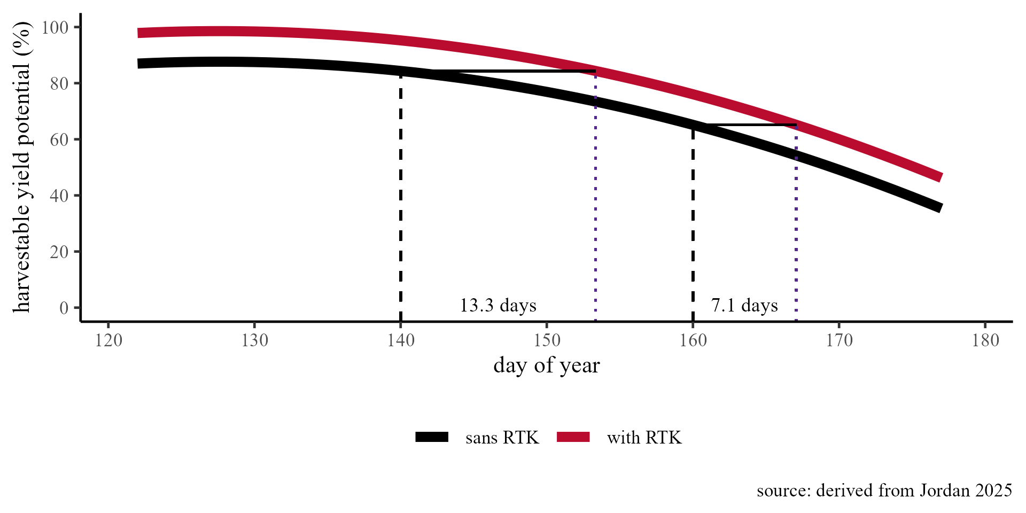
peanut digging at UGA/ABAC 4D Farm
Reliable GNSS forecast informs decision:
continue (accept 11% digging penalty)
or
wait (accept delay penalty)

Slide 13
Agricultural sensitivity to timing of GNSS signal degradation, peanuts
assumes 10% digging penalty; and planting and digging continue without RTK

Slide 14
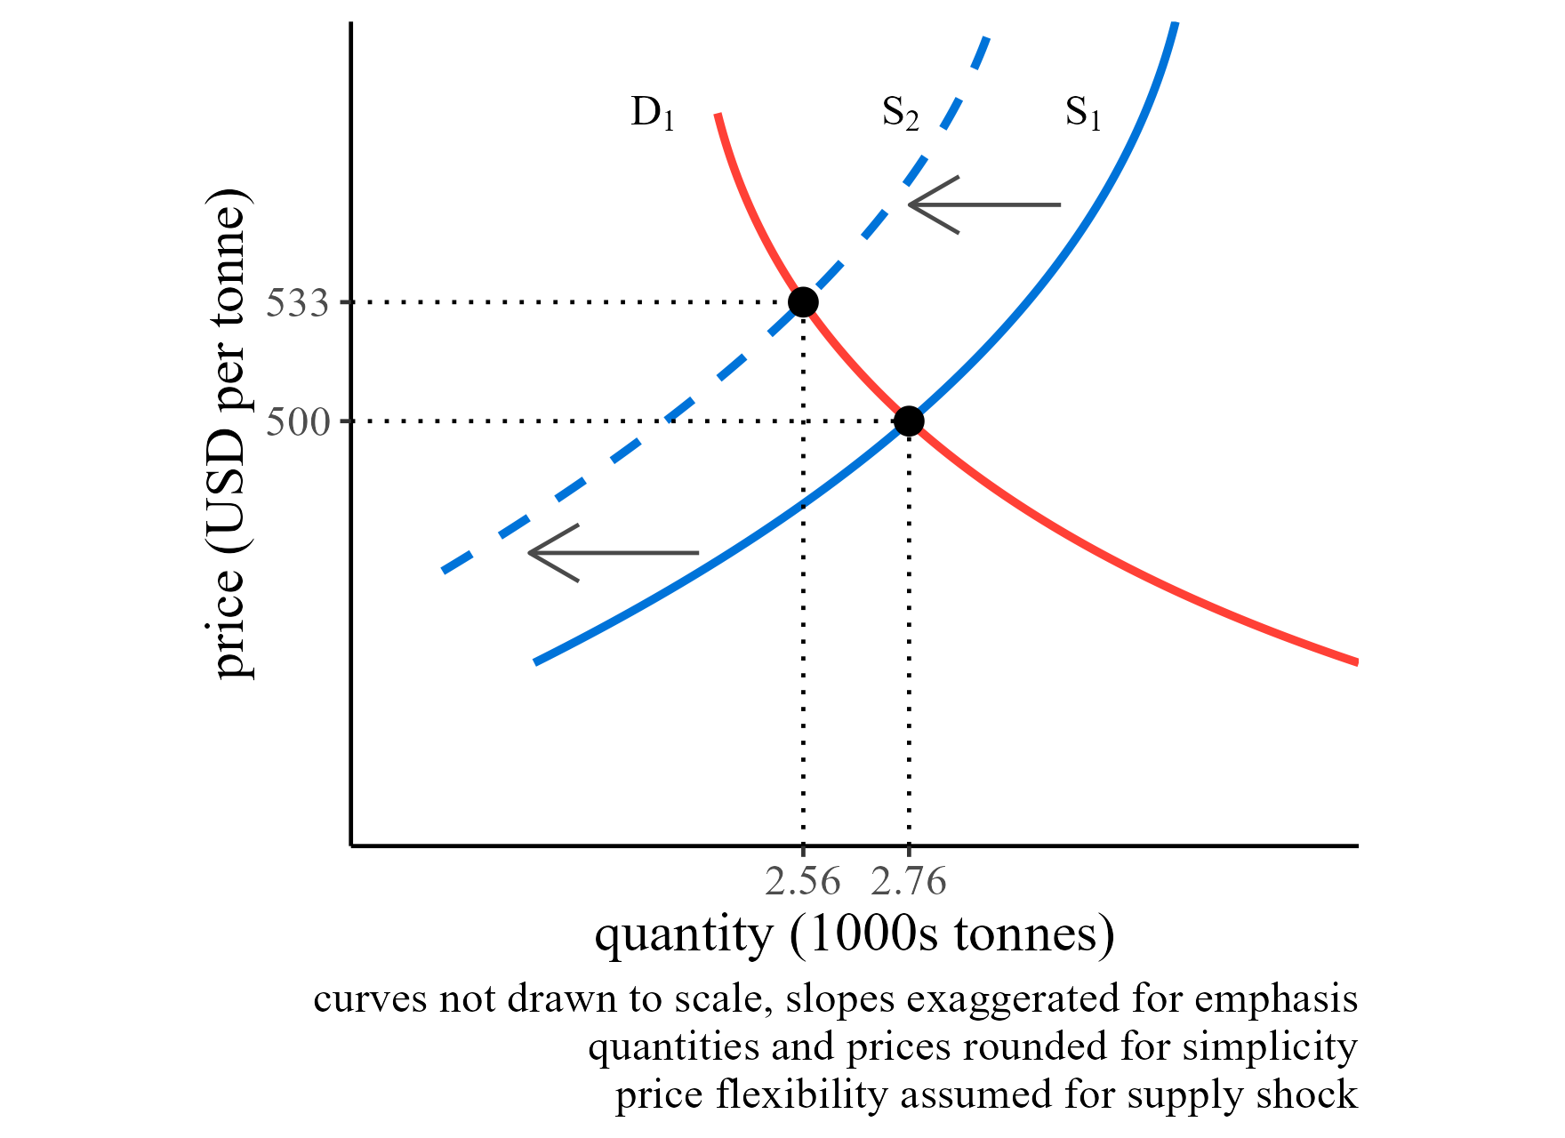
Price implications for farmers and consumers
Hypothetical equilibrium price as quantity declines

Slide 15
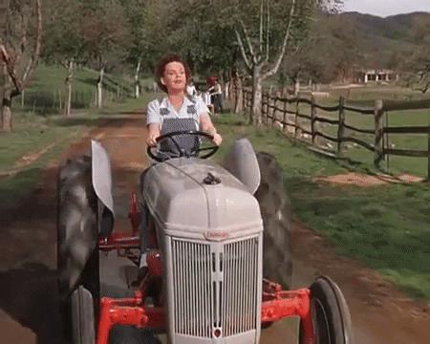
Ongoing and future work
Foregone farm data valuation, sensor data not georeferenced
On-farm experiments negated if data not collected at any phase
Joint utility and quality-of-life implications of rural household
Automated guidance reduces fatigue
Allows aging farmers w/ neck problems operate equipment
When technology does not work as expected = frustration
Valuation of reliable GNSS outage forecast

Slide 16
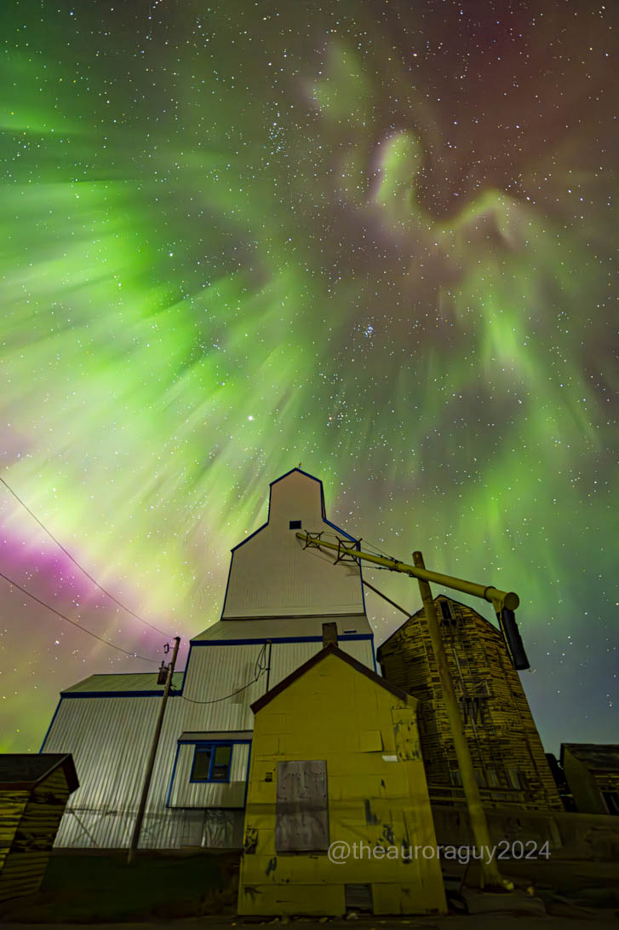
Acknowledgements
This material is based upon work that is supported by:
National Institute of Food and Agriculture, U.S. Department of Agriculture under award number 2023-68016-39403
Cotton Incorporated through Agreement 18-475 “Economics of Whole-farm Swarm-Bots for Cotton Production in the US”
https://4dfarm.org

Slide 17
PROSWIFT Act - Overview
Basic Elements
60601 Space weather
Role of Federal Agencies
Interagency Working Group (SWORM)
Space Weather Advisory Group (SWAG)
60602 Integrated strategy
60603 Sustaining and advancing critical observations
60604 Research activities
60605 Space weather data
60606 Knowledge transfer and information exchange (NASEM Roundtable)
60607 Pilot program commercial sector
60608 Benchmarks
Notes:
While I’m not going to go through all the elements in the PROSWIFT Act, there are a few items I would like to highlight:
Section 60601 codifies roles and responsibilities for the Federal Departments and Agencies, clearly defining roles in support of observations, research, and operations. Note that this includes the DOD, and know that DOD is an important player in SWORM, so the SWAG should keep that in mind as issues of national security come up.
Section 60601 also codifies the SWORM and OSTP’s role to coordinate the activities of the SWORM. This is important because SWORM, it’s membership, and OSTP’s role are all now codified in law.
And of course 60601 directs the formation of the Space Weather Advisory Group.
I should also point out that Section 60602 calls on SWAG to advise SWORM on the development of a strategy for coordinated observation of space weather, and Section 60604 advises that SWORM, “upon consideration of the advice of the advisory group”, develop formal mechanisms for R2O2R.
Section 60606 calls for the NASEM roundtable.

Slide 18
PROSWIFT Act - SWAG
ESTABLISHMENT - The NOAA Administrator, in consultation with other relevant Federal agencies, shall establish a Space Weather Advisory Group (SWAG) for the purposes of receiving advice from the academic community, the commercial space weather sector, and space weather end users that informs the interests and work of the White House interagency working group (Space Weather Operations, Research, and Mitigation Committee – SWORM).
Conduct a comprehensive user needs survey to identify:
space weather research
observations
forecasting
prediction
modeling advances required to improve space weather products
Notes:
PROSWIFT Act requires SWAG to have 5 members each from the academic, commercial sector, and end users communities.
Although administered by NOAA it advises the SWORM (interagency working group).

Slide 19
GNSS Sector user survey by SWAG
Overall goals:
What is the GNSS degradation threshold considered to be an outage that adversely impacts a community?
Can space weather events exceed that threshold?
Note: Equally important if space weather does or does not impact a community
Survey:
Combination of individual in-depth key informant interviews and focus groups
general perception of space weather impacts (focus groups) and specific susceptibility (key informants)
Survey questions are a combination of baseline and sector specific questions
Participants may be a combination of advisors to end users (dealers and consultants) and technologists (developers/engineers)
Other Suggestions?

Slide 20
Contact information
Terry W. Griffin, Ph.D.
Professor and Extension Economist
twgriffin@ksu.edu
@SpacePlowboy

