Slide 1
Global Real-Time TEC Product from NOAA SWPC
Dominic Fuller-Rowell^{1,2} , T. Fang¹, T. Durgonics^{1,2}, and T. Fuller-Rowell^{1,2}
1. NOAA Space Weather Prediction Center, USA
2. CIRES, University of Colorado Boulder, USA

Slide 2
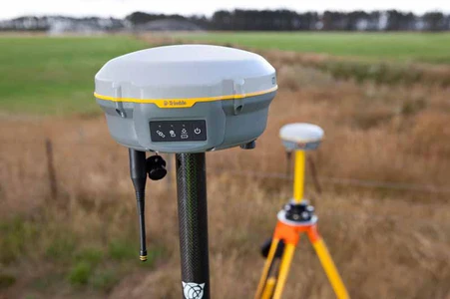
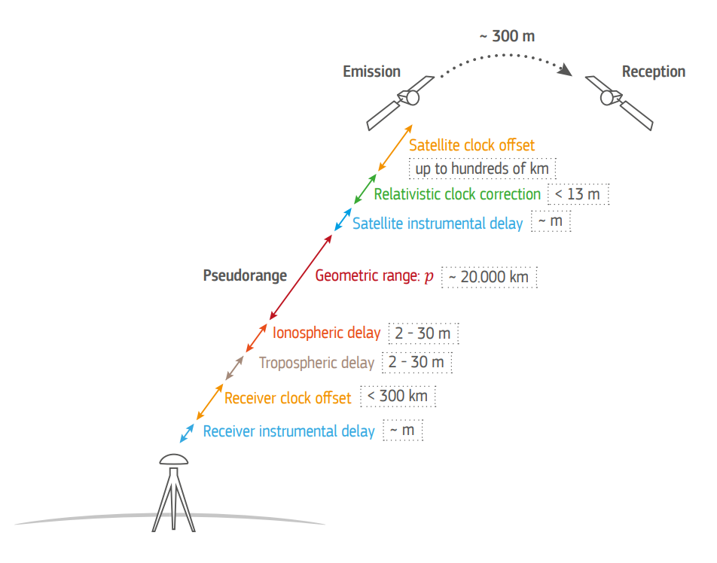
Impacts of TEC on Radio Frequency Propagation
Radio Frequency Delay: TEC causes RF delays and signal distortions, degrading performance in GNSS, HF communication, and satellite links especially during geomagnetic storms. Klobuchar model is insufficient.
Broad User Base: Aviation, maritime, military, and emergency response operations depend on accurate TEC data to maintain reliability and safety in critical communication and navigation systems.
Consequences of Inaccuracy: Without reliable ionospheric insights, navigation and timing errors can unknowingly degraded operations, communication links may fail, and economic or safety risks increase for sectors relying on GNSS technology.
Main error sources and their magnitudes in GNSS positioning

Slide 3
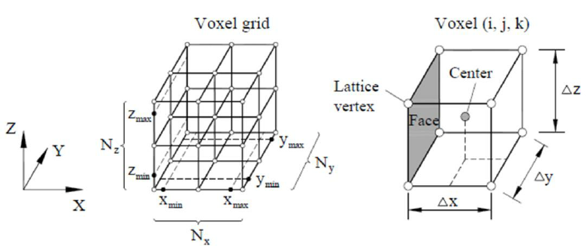
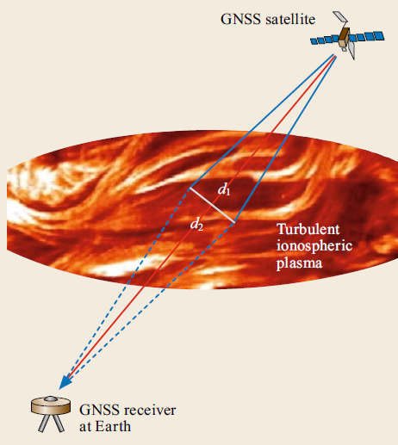
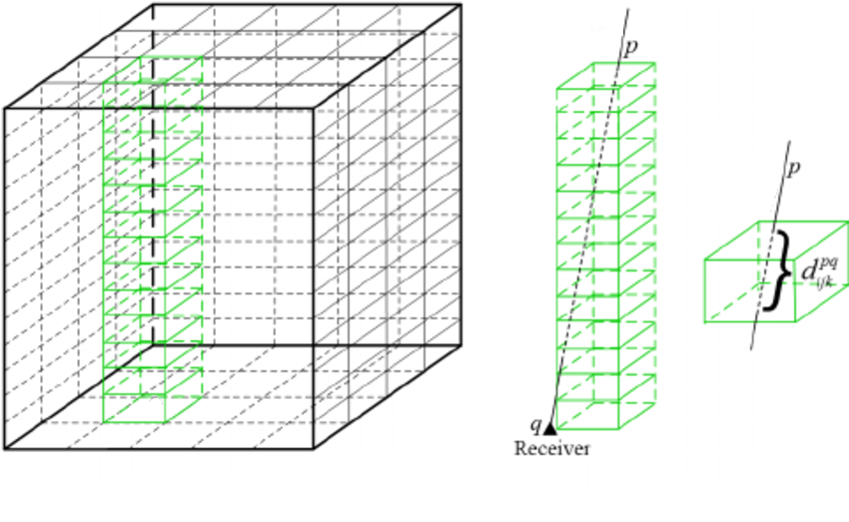
GloTEC – A Voxel-Based Data Assimilative Ionospheric Model
Purpose: Delivers real-time ionospheric situational awareness for users relying on trans-ionospheric signals, such as GNSS, HF, and satellite communications.
Approach: 3D electron density data assimilation scheme using all observations available in real-time.
Voxel Grid: Uses a 2.5° latitude × 5° longitude horizontal grid with variable vertical voxel sizes - 20 km below 500 km in the F-region and larger in the topside ionosphere.
TEC Product: Generates global Total Electron Content (TEC) products to estimate signal delays caused by ionospheric plasma every 10 minutes.
NmF2 and hmF2: Peak density is calculated and provided in data products. Use with caution.

Slide 4
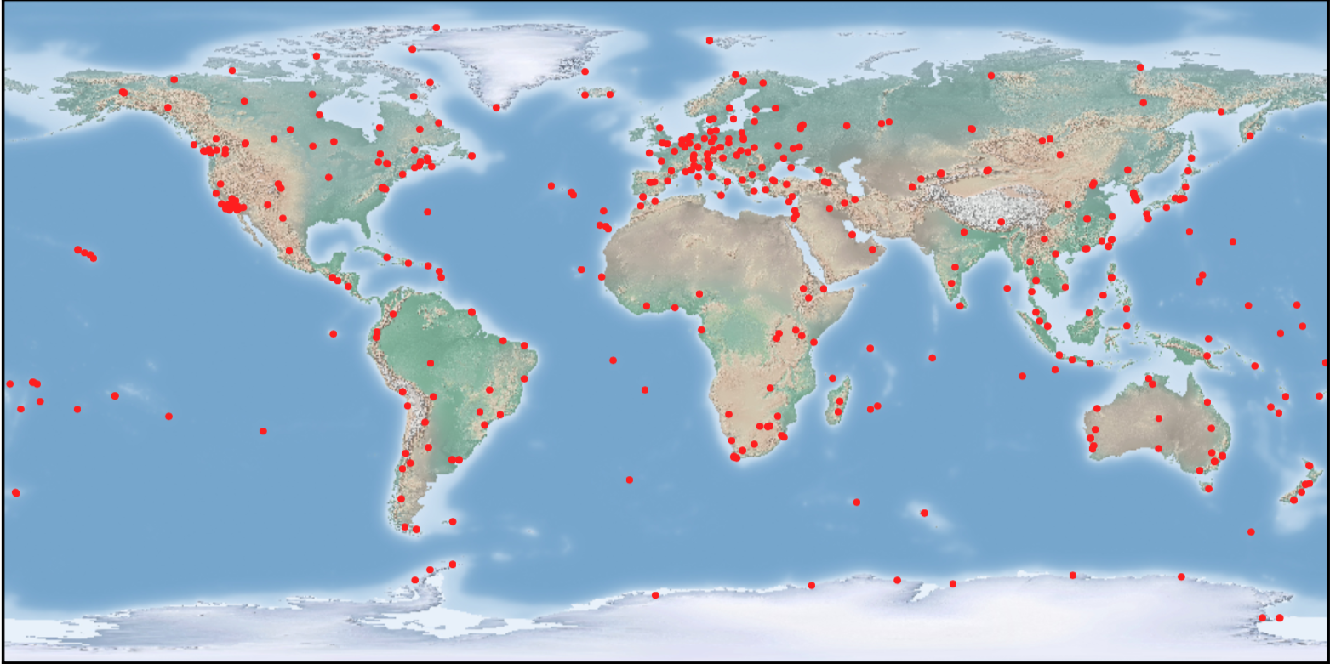
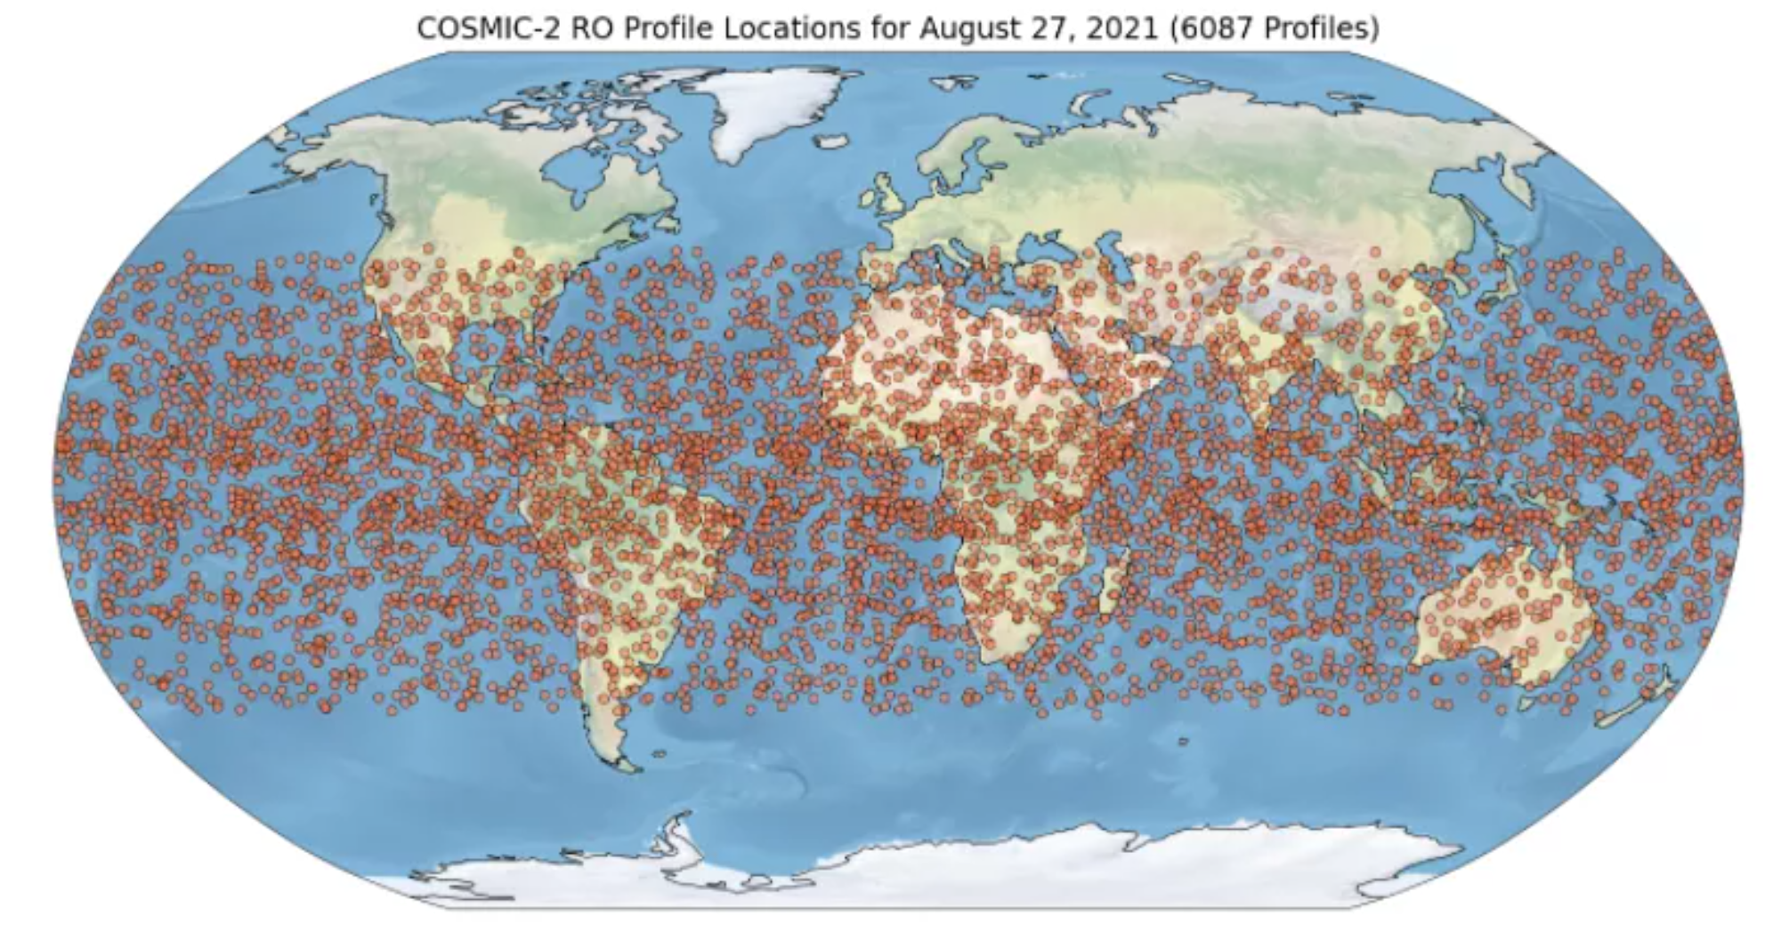
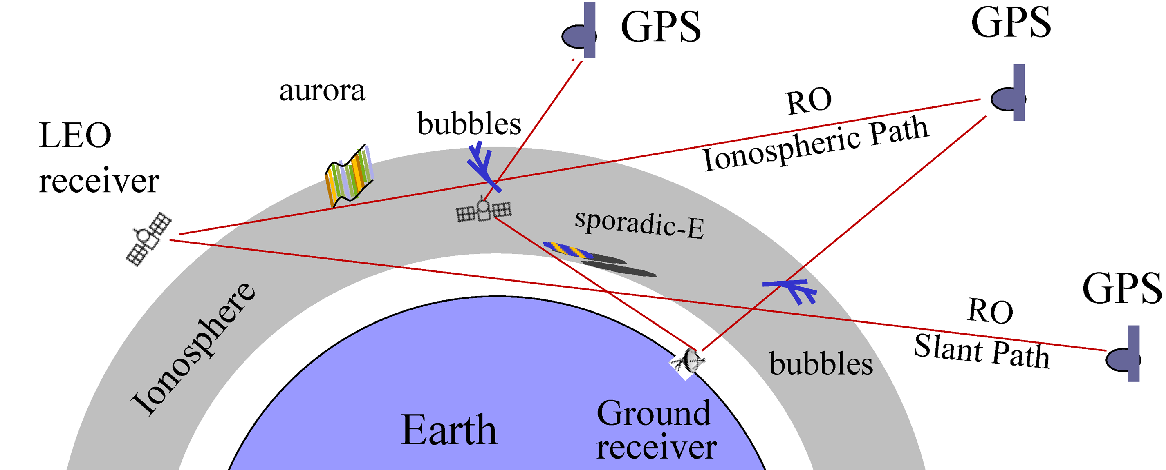
GloTEC Data Sources
Ground-based
Space-based (one day)
Geodetic ground receiver networks
COSMIC-2 radio occultation coverage

Slide 5
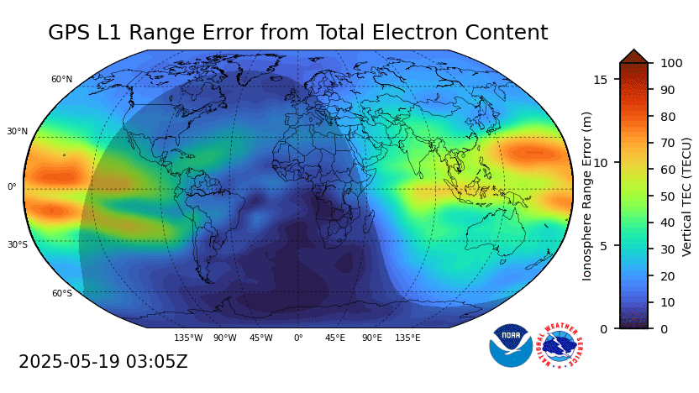
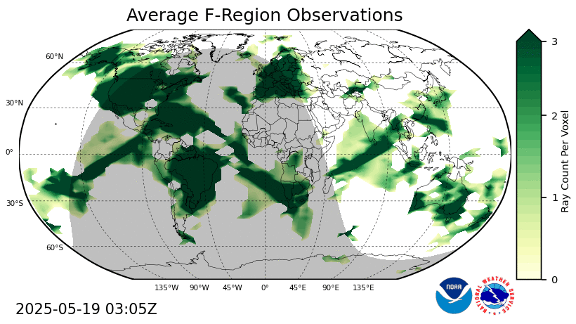
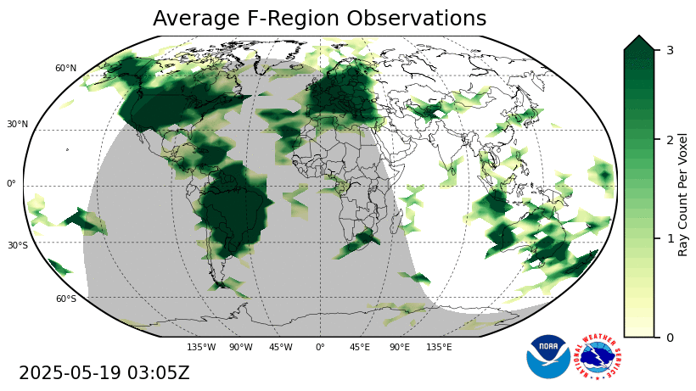
GloTEC Data Coverage
TEC on a typical quiet day – ionization in the sunlit side and recombination at night
Real-time COSMIC-2 median latency of >30 minutes, which reduces ingest rate into 15-minute latency model run
OSSE ongoing to explore options to increase the RO ingest rate
Average observations is equivalent to quality_flag
IRI background model where there are no observations
Real-Time (~10%)
100%

Slide 6
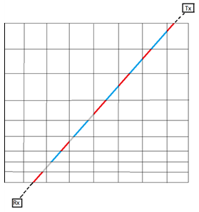
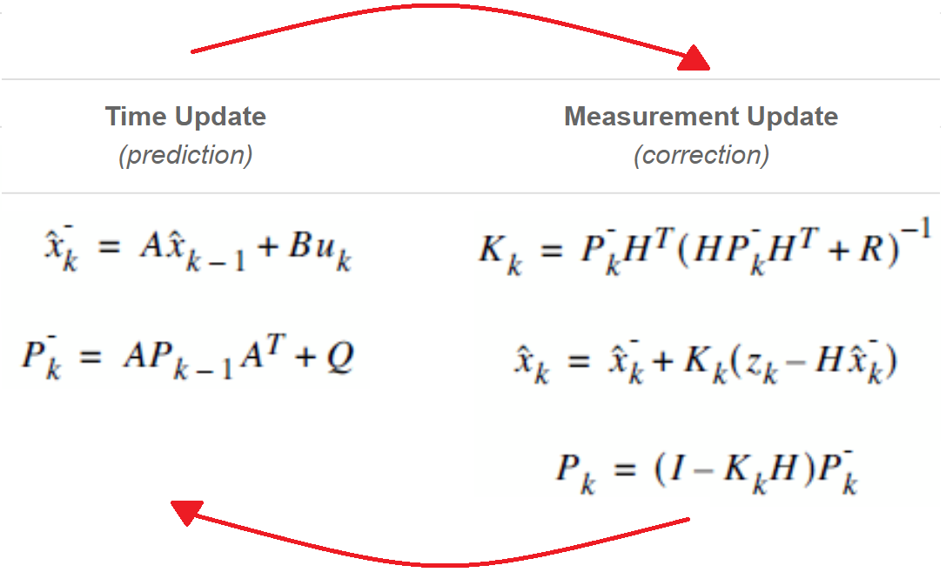
GloTEC Kalman Filter
1. Build Observation Matrix (Forward Model)
Integrate each slant TEC ray through the 3D grid to form an observation matrix (H), mapping observation space to state space.
Initially climatological model -- Internation Reference Ionosphere 2016 (IRI)
2. Calculate Observation Residuals
Subtract the TEC derived from the a priori state estimate from the measured TEC.
Exclude observations if their residuals exceed 3σ.
3. Kalman Gain
Use a Gauss-Markov Kalman filter with a GMRES iterative solver to optimally estimate the Kalman gain and minimize residuals across all observations.
4. State Update and vTEC Output
Update the 3D electron density state with the Kalman filter solution.
Integrate vertically to produce a vTEC (vertical Total Electron Content) map.
5. Forecasting the Next A Priori State
Extrapolate the updated state using a weighted average of trends in the IRI 2016 background model (Gauss-Markov).
Use this forecasted state as the a priori input for the next assimilation cycle.
6. Repeat for Each Time Step

Slide 7
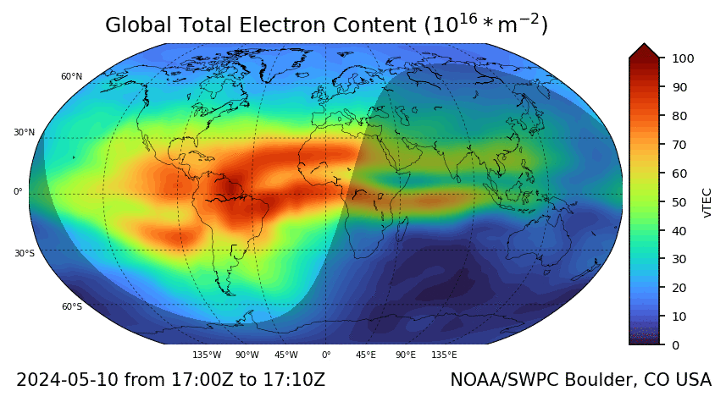
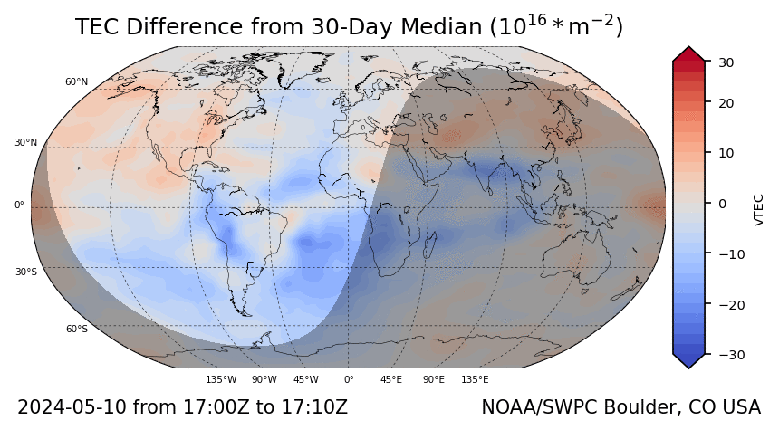
GloTEC – A Voxel-Based Data Assimilative Ionospheric Model
Real-time 3D Density Assimilation: Uses a Gauss-Markov Kalman filter with GMRES solver with the International Reference Ionosphere (IRI) model as the background model.
Data Sources: Ground-based GNSS networks (IGS, UNAVCO, IBGE, NRCan, RAMSAC, CDDIS, and AUSCORS) and space-based receivers (COSMIC-2). Commercial RO data (Spire, PlanetIQ) can also be ingested.
Coverage: RO data significantly expands global/oceanic coverage.
Product: TEC maps generated every 10 minutes, with ~15-minute latency. Provides more accurate TEC mapping than empirical models.
Website: https://www.swpc.noaa.gov/products/glotec NCEI Archive: https://www.ncei.noaa.gov/products/space-weather/ionospheric-program/total-electron-content

Slide 8
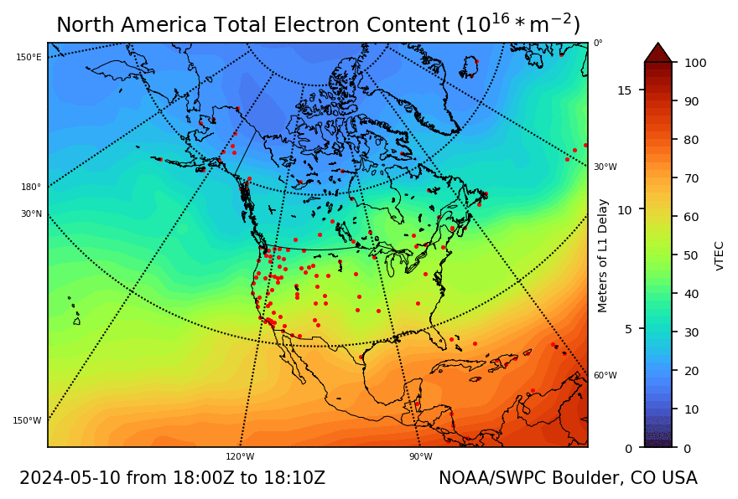
Mid-Latitude Ionospheric Storm Enhanced Density
May 10th Gannon storm response over the CONUS
Storm onset at ~18:00UT
Peak TEC observed: ~180 vTECU ( nearly 30 meters)
SED feature with sharp gradient – enhancements next to depletions
Links to GNSS satellites from a single receiver impacted oppositely
First order Klobuchar corrections are inadequate
Tongue of ionization over Canada

Slide 9
END

