Slide 1
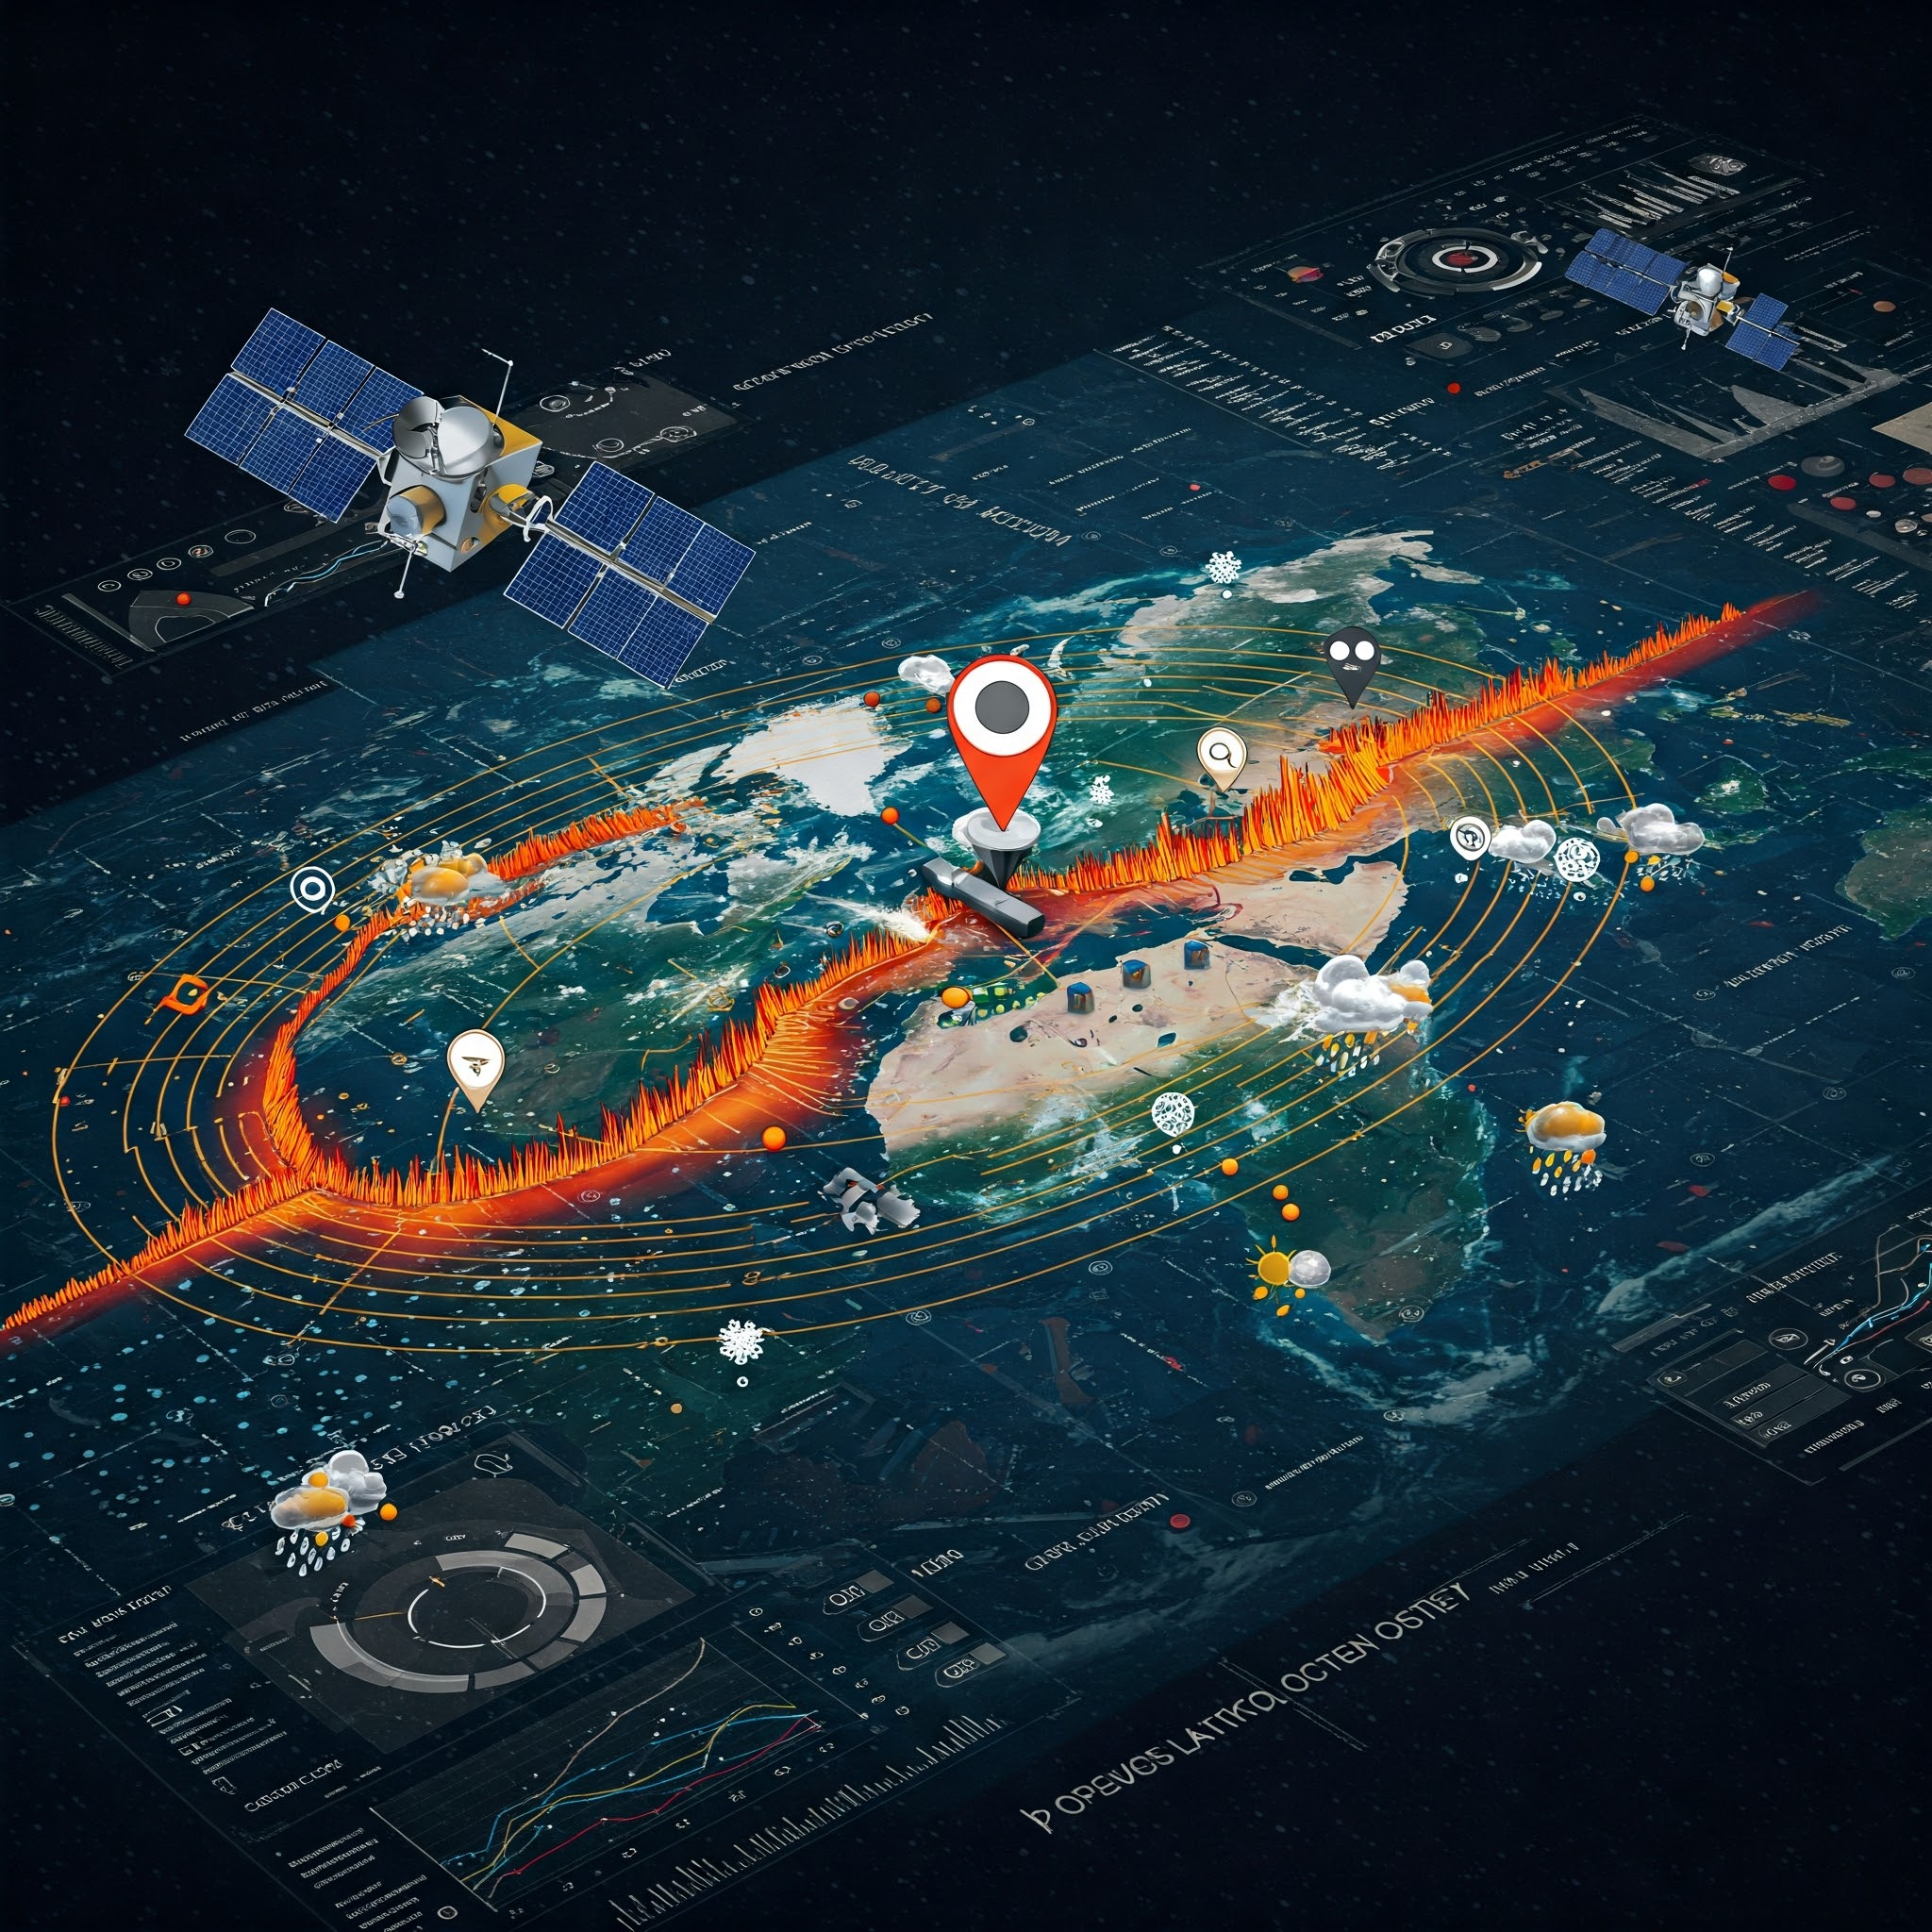
EarthScope GNSS and
Space Weather
David Mencin
and EarthScope Staff

Slide 2
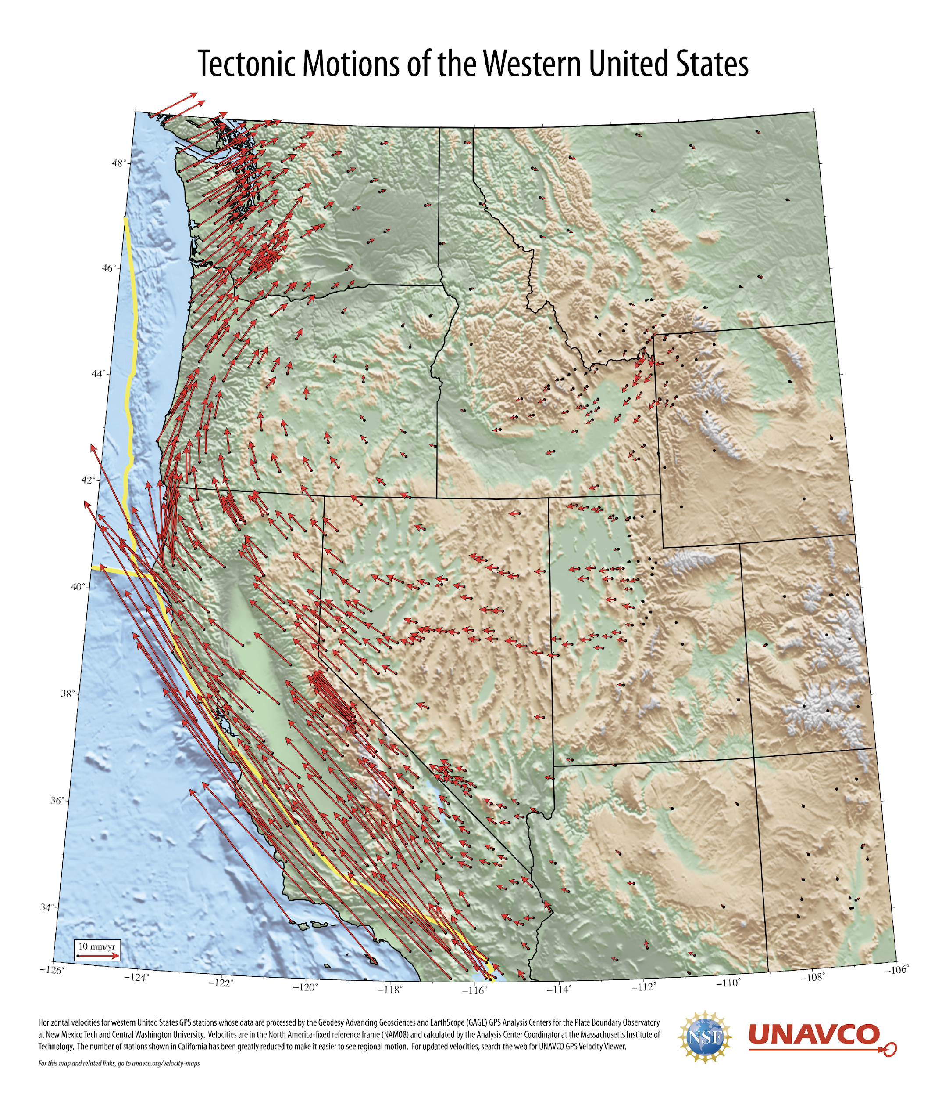
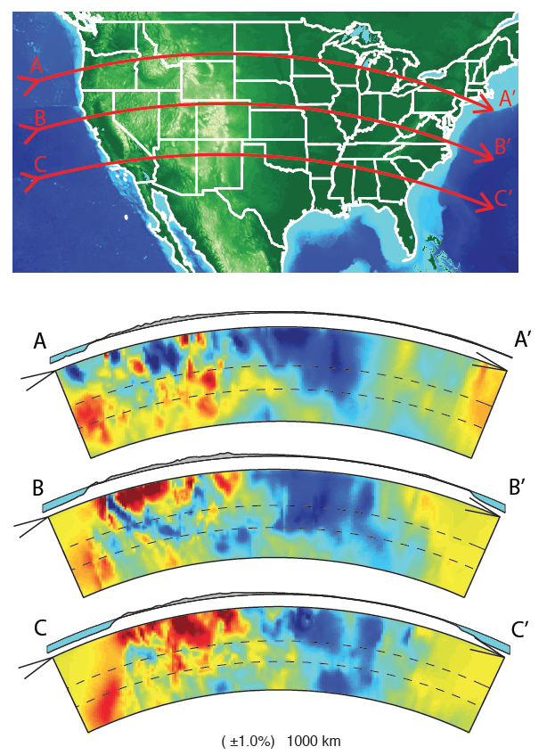
EarthScope v1.1

Slide 3
EarthScope v2
Jan. 1st, 2023

Slide 4
EarthScope Yesterday
TODAY
Sensors
Tens of millions of files (Pb scale)
Monolithic apps, some web services, no clear DevOps, no clear upgrade paths

Slide 5
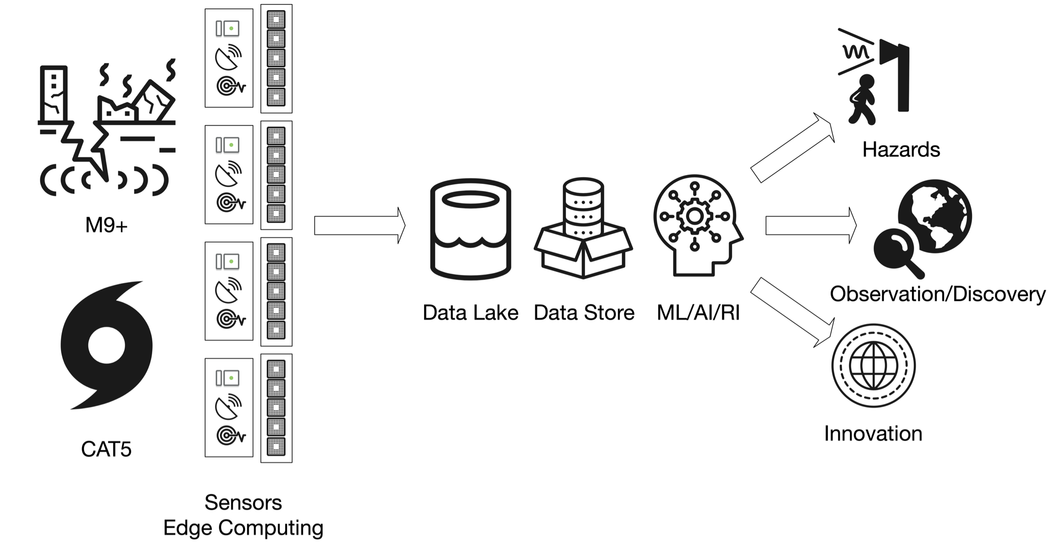
EarthScope Today

Slide 6
Old System
(Various iterations since 2016)
Based on BKG Caster service legacy formats:
RTCM 3.1
BINEX
PPP Solutions
Requires simple registration, no license, and no cost recovery.
Not scalable, unreliable, expensive and difficult to maintain.
Has been successful in limited pilot commercial cases.

Slide 7
Old System
(Various iterations since 2016)
3000+ registered users
2000+ commercial users registered
750+ academic users registered
Others are government, administrative, etc.
@10000 active connections at any given moment.

Slide 8
Past GNSS Data Architecture
Network Operator
Network Operator
raw
NTRIP
Earthworm
RabbitMQ Connecter
geojson2ew
raw
positions
Processing Center
GNSS RabbitMQ
Earthworm GPS_RING
GNSS Processing Center
Existing Data Center
Positions (tracbuf)
SHAKEALERT DATA CENTER
Earthworm GPS_RING
Many single points of failure and bottlenecks.
ShakeAlert Analysis
Center

Slide 9
New Ntrip Caster
Full horizontal scalability (Kafka and AWS ECS driven)
Can handle 100,000’s of connections.
Full user authentication management and license management.
Significantly faster, lower latency (< 50 ms vs 500 ms) and more reliable.
Handles all data types, including multiple per site.
Users may select reference frame and epoch, ephemeris messages buffered for quick deliver on new connections (not implemented)
Allows deep observability of users and usage in real-time.

Slide 10
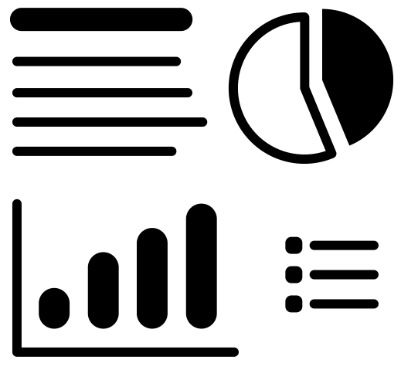
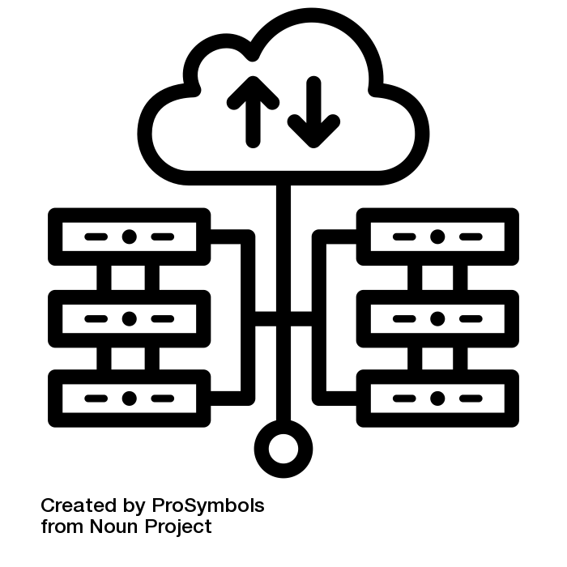
EarthScope GNSS Architecture
Dashboards
Position time series
Station maps
Latency reports
QC status
Perform queries
Long-term data storage
(raw, positions, QC)
Web service
Retrieve
Raw data
Position data
Latency & QC
mseed/tank/geoJSON
Network Operator
Network Operator
NTRIP
raw
Kafka Connecter
DATA HUB
raw
Kafka Connecter
GNSS Processing Center
QC analysis
Processing Center
Kafka Connecter
positions
GNSS processing center can be within the EarthScope cloud or external
Kafka Connecter
SHAKEALERT DATA CENTER
ShakeAlert Analysis
Center

Slide 11
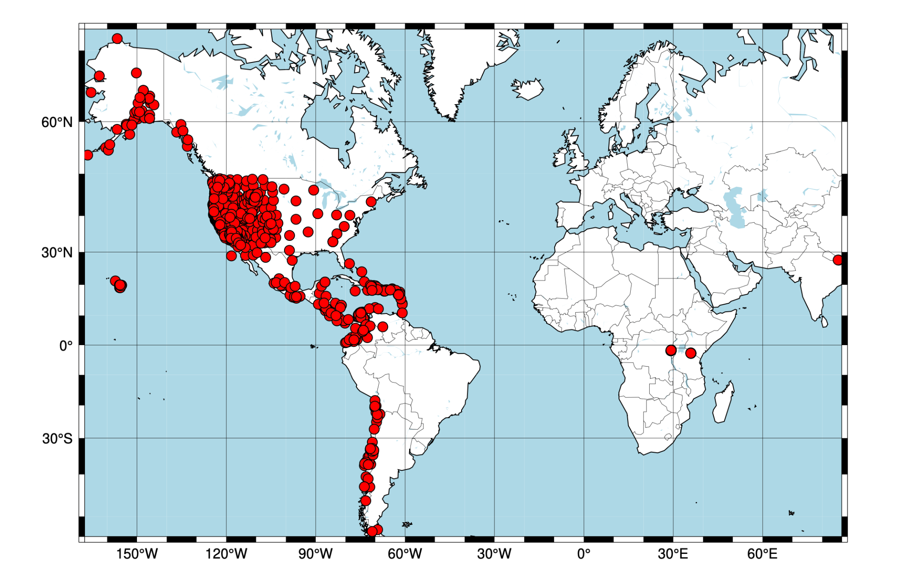
Today

Slide 12
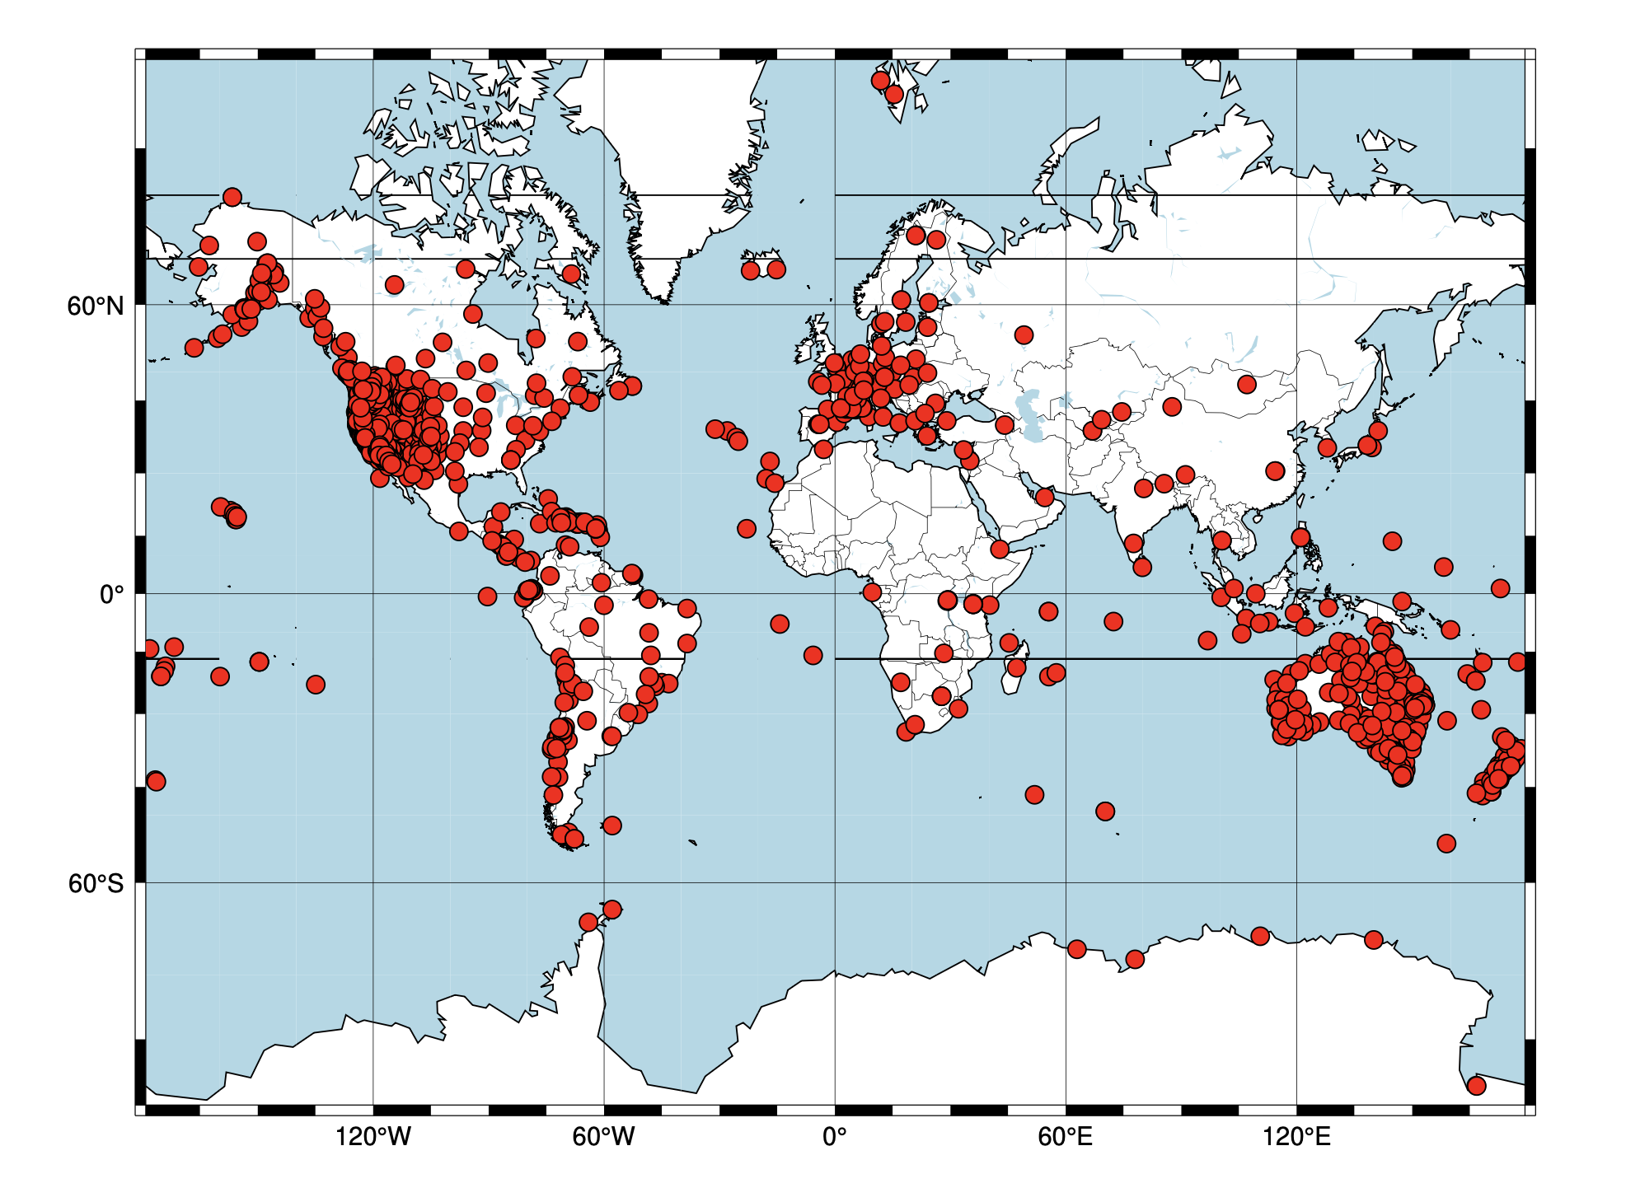
Tomorrow (recently signed MOUs with EPOS, AuScope and GNS Science)

Slide 13
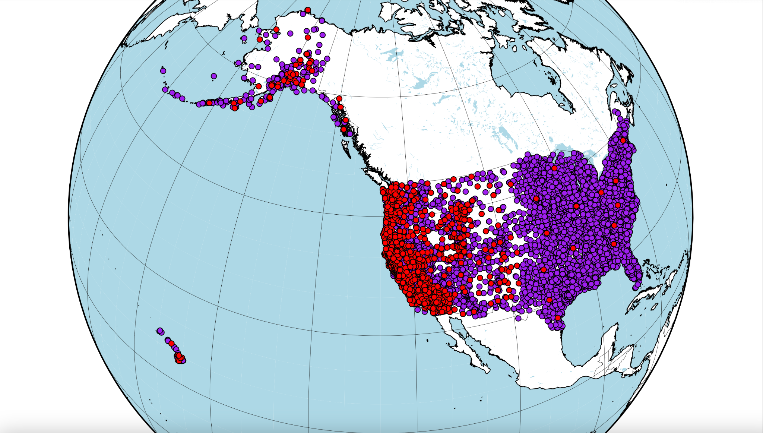
Next Year
NGF - Proposes over 10K stations

Slide 14
Observability: PGD
Maps to view data spatially
Heat maps - easy to see the most common latencies, ~250ms & ~1 sec

Slide 15
Observability: TDCP

Slide 16
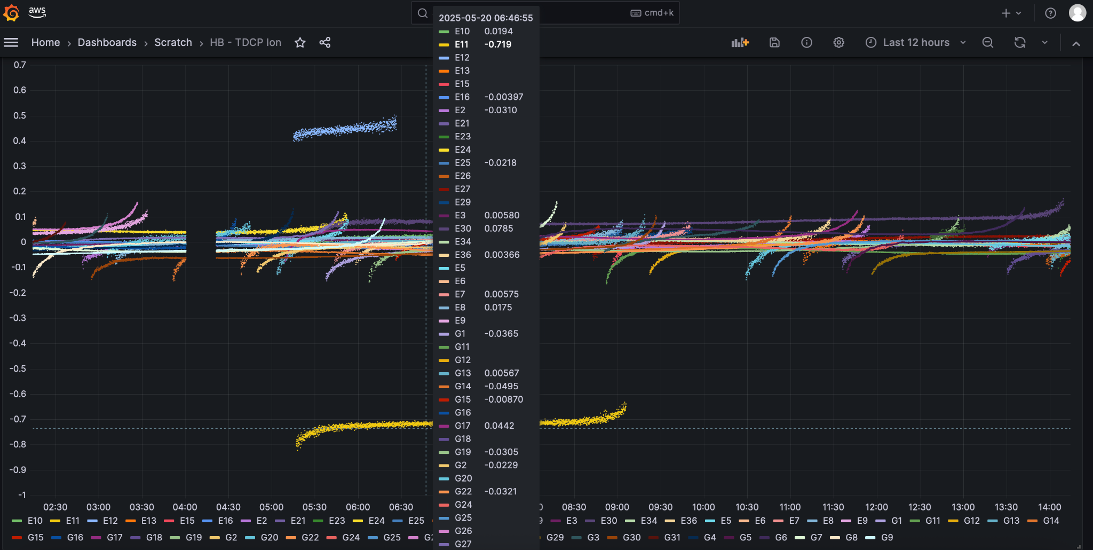
Observability: Geometry Free Slants (dTECU)

Slide 17
Observability: ShakeAlert
Notes:
- infinity == 0

Slide 18
JPL GUARDIAN

Slide 19
Use Case: High Rate GNSS Seismology
Dittmann, T., Liu, Y., Morton, Y., & Mencin, D. (2022). Supervised machine learning of high rate GNSS velocities for Earthquake strong motion signals. Journal of Geophysical Research: Solid Earth, 127, e2022JB024854. https://doi. org/10.1029/2022JB024854

Slide 20
Use Case: High Rate GNSS Seismology
Dittmann, T., Liu, Y., Morton, Y., & Mencin, D. (2022). Supervised machine learning of high rate GNSS velocities for Earthquake strong motion signals. Journal of Geophysical Research: Solid Earth, 127, e2022JB024854. https://doi. org/10.1029/2022JB024854
Notes:
Overlappting 30 second windows.

